Slide 1
Chapter 19: Scuba Related Illness and Treatment
Notes:
Describe how scuba works.
Describe the risks associated with scuba diving.
Explain decompression illness.
Explain how to report diving accidents.

Slide 2

How Scuba Works

Slide 3
Divers breathe compressed air (not pure O2)
Other gases used can include nitrox, heliox, or trimix
Regulator and hose is attached to tanks
The regulator reduces air pressure to breathable level
The deeper the dive the greater the pressure, the regulator adapts to that pressure
One atmosphere is 14.7 psi
For every 33 feet add an atmosphere of pressure
As pressure increases air volume decreases
Air breathed at an appropriate pressure below the surface can be lethal if the diver surfaces too quickly.
Notes:
Most scuba divers breathe air, which is compressed in two different ways – mechanically and by water pressure.
Air (not pure oxygen) is compressed into a scuba tank by a mechanical compressor.
A regulator with a hose and mouthpiece attached is used to breathe air from the tank.
The regulator reduces the delivery pressure of the compressed air in the tank to ambient pressure, so that it can be inhaled normally without damaging the lungs.
Divers may also use mixed or altered breathing gases. These include nitrogen-oxygen (nitrox), helium-oxygen (heliox), or helium-nitrogen-oxygen (trimix).
The use of mixed gases requires special training.
Air is made available through the regulator during the dive, at a pressure consistent with the depth of the dive. As a diver descends, the ambient pressure becomes greater due to the increasing pressure of the water above.
Pressure is expressed in atmospheres.
Surface atmospheric pressure is 14.7 pounds per square inch (psi). This is known as one atmosphere of pressure.
For every 33 feet a diver descends, add one additional atmosphere of pressure.
As the pressure increases, the volume of a given quantity of air decreases.
While a regulator reduces the pressure of air from the scuba tank to a comfortable, breathable level, air breathed below the surface remains compressed compared to what its volume would be on the surface.

Slide 4
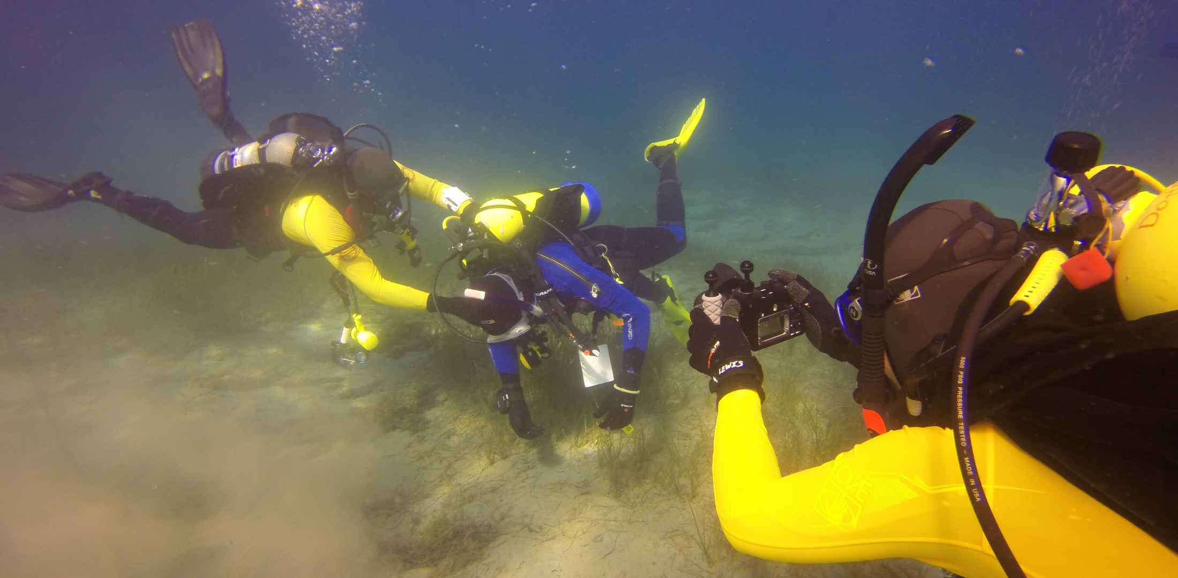
Risks Associated with Scuba Diving

Slide 5
There are an estimated 1 million scuba divers in USA
Yearly there are over 1,000 scuba related incidents reported
Death causes: drowning - 50%+; cardiovascular 20%+; arterial gas embolism 10%
80% male victims
Notes:
It is difficult to judge the rate of injury associated with diving because the number of participants is unknown.
Estimates of number of active scuba divers in the United States exceed one million.
Divers Alert Network (DAN), a nonprofit membership association dedicated to the safety of recreational scuba diving, provides annual statistics based on the number of reported injuries and deaths associated with scuba diving
Each year, there are over 1,000 emergency department admissions for scuba related injuries in the U.S.
Drowning is the reported cause of over 50% of diving deaths, with cardiovascular disease responsible for over 20% of diving deaths, and arterial gas embolism responsible for about 10%. However, cardiovascular disease is the leading disabling factor that led to death.
Divers in the 50 – 59 year age range are most likely to be involved in fatal accidents, followed by divers in the 60 – 69 year age range and the 40 – 49 year age range. Men are over 80% of the victims. However these numbers could simply be reflective of the dive population at large.

Slide 6
Decompression Illness (DCI) Types
Decompression Sickness (DCS)
  The bends
  Diver ascends to quickly
  Usually affects divers who dove past 80’
  Repetitive dives
  Prolonged dive(s)
Arterial Gas Embolism (AGE)
  Diver runs low on air or out of air
  Panicked diver hold their breath which closes the airway and over-inflates lung tissue
  Rupture alveoli which creates air bubbles in bloodstream
  More likely in 1st atmosphere
Notes:
Decompression illness (DCI) is the result of a bubble phenomenon which occurs in the body’s tissues as the diver ascends to the surface or at some point after the dive.
There are two types of decompression illness (DCI):
Decompression Sickness (DCS)
Arterial Gas Embolism (AGE)
Decompression Sickness (aka the bends)
DCS occurs when the diver ascends too rapidly and nitrogen trapped in the body cells form air bubbles.
DCS most often occurs in dives below 80 feet and is strongly associated with repetitive, deep, and/or prolonged dives.
Dive tables were created many years ago to help scuba divers avoid decompression sickness. They allow divers to determine maximum depth and time profiles, the number of dives they can safety make in a day, and the number of stops they must make while returning to the surface.
Many divers now use small, computerized dive gauges attached to their scuba gear or on their wrists. Arterial Gas Embolism (AGE) - (aka air embolism)
Occurs when compressed air is trapped in the alveoli
(small sacs in the lungs where exchange of carbon dioxide and oxygen
take place).
AGE most often results from a rapid ascent when the diver runs low air or out of air.
On a panicked ascent divers sometimes hold their breath, which closes the airway and allows expanding gas to over-inflate lung tissue.
The expanding gas causes rupture of the alveoli, forcing air bubbles into the lung tissues and the arterial bloodstream.
AGE can happen at any depth, but more likely in waters less than 33 feet.
Divers need to ascend slowly and make safety stops.

Slide 7
Symptoms of Decompression Illness
Pain in joints and numbness or tingling
Dizziness
Headache
Extreme fatigue
Weakness
Nausea
Visual disturbance
Difficulty in walking
Notes:
Onset of symptoms of DCS is usually somewhat gradual, although they may be present immediately upon surfacing. Symptoms may include:
Pain in the joints and numbness or tingling.
Dizziness
Headache
Extreme fatigue
Weakness
Nausea
Visual disturbance
Difficulty in walking
Divers tend to deny symptoms of DCS, which delays treatment.
Onset of symptoms of AGE is typically more rapid than DCS, can be immediate and extreme.
If there is a loss of consciousness upon surfacing, AGE should be suspected.
Symptoms similar to an acute stroke can be a result of AGE.

Slide 8
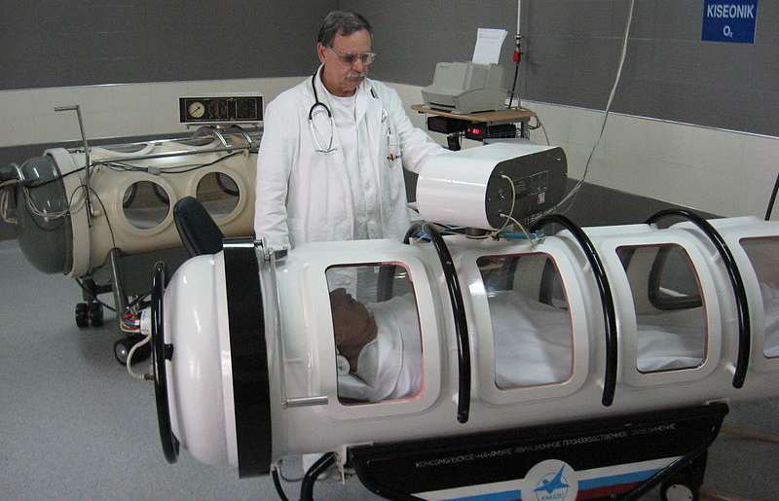
Treatment of Decompression Illness

Slide 9
Monitor ABC’s
O2 should be at 15 liters per minute
EMS should transport victim to emergency room
Treatment in decompression chamber
Provide EMS with depth gauge or dive computer
Notes:
Lifeguards need not spend extensive amounts of time deciding whether a diving case involves DCS or AGE.
If either DCS or AGE is suspected, the victim should first be treated for the ABC’s: (A) open airway, (B) breathing and (C) circulation
Secondly, oxygen should be given at 15 liters per minute.
Victim should be transported to an emergency room under the care of trained medical personnel.
Full resolution of a decompression illness generally requires treatment in a recompression chamber.
Be sure to check the dive buddy, who may have followed the same dive profile and may have similar problems.

Slide 10
Gather information
How deep was the dive?
How long was the dive?
How many dives were taken in the last 24 hours?
Was there a rapid ascent?
Notes:
The following information should be obtained and turned over to the emergency medical personnel when addressing decompression illness. If the diver is unable to provide this information, the diver’s depth gauge or dive computer may provide it. The dive buddy is another excellent source.
How deep was the dive?
How long was the dive?
How many dives were taken in the last 24 hours?
Was there a rapid ascent?
Consult the medical staff of DAN and advise the attending physician of their availability: 919 684-8111

Slide 11
Reporting Diving Accidents
DAN maintains a 24-hour diving medical emergency hotline (919) 684-9111
Provides divers and health care providers with expert consultation and referrals
Fill out all incident reports required by your agency
Report all scuba diving accidents to DAN at diversalertnetwork.org
Lifeguards and lifeguard agencies are encouraged to join DAN and help support the organization

Slide 12
Notes:
Divide class into small groups. Assign a “Discussion Point” to each group. Ask each group to share the most important parts of their lesson point with the rest of the class. Expand on each group’s comments so that all lesson material is covered.

