Slide 1
Advanced GEMS Course
Lesson 8A
Implantable Cardioverter Defibrillators

Slide 2
Objectives
Identify the ECG findings in patients with ventricular dysrhythmias, paced rhythms, and implantable cardioverter defibrillators (ICDs).
Discuss and describe the special concerns of an ICD in an older patient.
Describe the signs and symptoms of a patient with a malfunctioning ICD.
Discuss how patients with ICDs are managed.
Notes:
INSTRUCTOR NOTES AND TIPS By the end of Lesson 8A, participants should be able to:
Identify the ECG findings in patients with ventricular dysrhythmias, paced rhythms, and implantable cardioverter defibrillators (ICDs).
Discuss and describe the special concerns of an ICD in an older patient.
Describe the signs and symptoms of a patient with a malfunctioning ICD.
Discuss how patients with ICDs are managed.

Slide 3
Dispatch
The triage officer has assigned your transport unit to Mr. Hart, a 77-year-old patient. While Mr. Hart was walking out of Eastern Hills Nursing Home during the evacuation, he developed palpitations. He tells the triage officer that his ICD fired 2 times in the past 30 minutes during the evacuation.
Notes:
INSTRUCTOR NOTES AND TIPS
Triage assignment: The triage officer has assigned your transport unit to Mr. Hart, a 77-year-old male patient in Room 101, Bed 1. He was being evacuated to the ambulatory stable patients’ bus when he began to complain of palpitations. He then stated that his ICD fired 2 times. The patient was placed back in his room for EMS transport. Your crew will now transport him to University Hospital for evaluation.

Slide 4
Note to Instructors
At this time, break participants out into individual case scenarios OR continue with slide presentation for group discussion.

Slide 5
Initial Observation
The patient is being evacuated due to the flood.
The patient was stable and being moved with other ambulatory patients to the evacuation bus when he began to complain of palpitations and was mildly apprehensive; he then complained that the ICD was discharging.
He was returned to his room for EMS transport.
The patient is an English-speaking Hispanic.
Notes:
INSTRUCTOR NOTES AND TIPS
Scene safe: Secure
Situation: Evacuation relocation
Cultural: Hispanic, English-speaking
Communication: Awake, alert, and oriented x4; anxious but clearly communicating
Medical devices: ICD
Chief complaint: Palpitations; ICD discharging 2 times

Slide 6
Primary Survey
LOC: Awake and alert; A&O x4
Airway: Intact and open
Breathing: Clear lungs, RR: 22
Circulation: Irregular rhythm, 90 bpm
Sick or not sick?
Notes:
INSTRUCTOR NOTES AND TIPS
Level of consciousness: Awake and alert
Airway: Open, intact
Breathing: Normal rise and fall, clear lung sounds, RR: 22
Circulation: Irregular rhythm at rate of 90 at radial artery bilaterally; heart rate occasionally jumps up to 165 bpm and then goes back to the 90s; skin color appears normal, but the patient is fully clothed. First impression: Irregular heart rhythm, tachycardia, and self-report of ICD firing
Differential diagnosis: ICD incorrectly discharging (runaway ICD)

Slide 7
GEMS Assessment
G: 77-year-old male
E: Skilled nursing facility
M: Diabetes, AMI (2 in past 5 years), atrial flutter and atrial fibrillation, heart failure; chart includes Hx of nonischemic cardiomyopathy and left ventricular ejection fraction (LVEF) of 38%
S: Limited family support; moderate limitations of ADL due to cardiac disease
Notes:
INSTRUCTOR NOTES AND TIPS
Geriatric: 77-year-old male residing in a skilled nursing facility; patient is ambulatory
Environmental: Skilled nursing facility
Medical: Diabetes, AMI (2 in past 5 years), atrial flutter and atrial fibrillation, heart failure; chart includes history of nonischemic cardiomyopathy and low ejection fractions.
LVEF is the measurement of how much blood is being pumped out of the left ventricle of the heart with each contraction. Normal LVEF is 55–70%. For this patient, an LVEF of 38% means that 38% of the total amount of blood in the left ventricle is pumped out with each beat. Typically, an LVEF of less than 40% indicates heart failure.
Social: Limited family support; moderate limitations of activities of daily living (ADL) due to cardiac disease

Slide 8
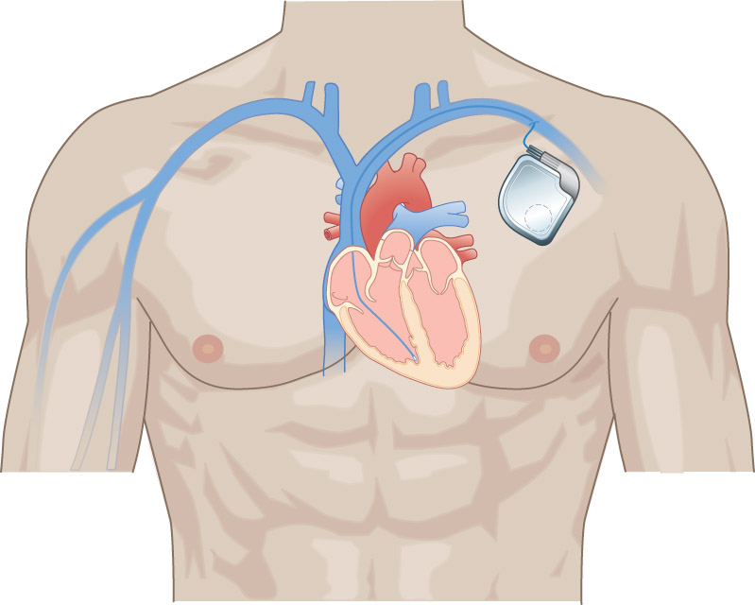
Discussion
What does an ICD do?
What are the indications for an ICD?
© Jones & Bartlett Learning.
Notes:
INSTRUCTOR NOTES AND TIPS
What does an ICD do? The primary purpose of an ICD is to treat potentially fatal ventricular arrhythmias (ventricular tachycardia [VT] and ventricular fibrillation [VF]) through cardioversion, defibrillation, or anti-tachycardia pacing. Most ICDs also work as a pacemaker to increase the heart rate when it falls below a set number and can deliver anti-tachycardia pacing if VT is detected. Some ICDs can also deliver cardiac resynchronization therapy (CRT) to treat heart failure.
What are the indications for an ICD? The main indications for use of an ICD relate to secondary prevention in patients with prior sustained VT, VF, or resuscitated sudden cardiac death (SCD) thought to be due to VT or VF. An ICD is also indicated for the prevention of sudden cardiac arrest in patients at risk of developing VF or VT.

Slide 9
Discussion (cont’d)
What are some long-term risks with an ICD?
Under normal situations, what should a person do after a shock is delivered?
Notes:
INSTRUCTOR NOTES AND TIPS
What are some long-term risks with an ICD?
Infection or erosion of the device. In most cases, the entire system must be removed.
Lead failure. The leads are the weakest part of the ICD system, and the mechanical stresses on the leads can lead to breakage of the wires within the leads or in the insulation surrounding the leads.
Inappropriate detection and subsequent delivery of a shock.
Premature battery depletion or device failure. Like any other piece of electronic equipment, these devices can occasionally fail without warning.
Under normal situations, what should a person do after a shock is delivered?
If a person experiences a shock from an ICD, he or she should immediately notify his or her doctor. Because most arrhythmias require only one shock to return the heart rhythm to normal, anyone who has frequent or clusters of shocks must be evaluated to investigate the cause. In some cases, programming and/or medications may need to be adjusted; less commonly, a malfunctioning lead may be detected.
The patient in this scenario had 2 shocks, which should raise your suspicions about a continued cardiac rhythm or a malfunctioning ICD.

Slide 10
Pre-transport Check
Records: The patient has his medical records.
ECG: Based on the patient’s history and ICD discharge, you determine that cardiac monitoring, along with oxygen, is needed right away.
What specific cardiac concerns do you have at this point?
Notes:
INSTRUCTOR NOTES AND TIPS
Records: The patient has his medical records.
ECG: Based on the patient’s history and ICD discharge, you determine that cardiac monitoring is needed right away. After discharge, it is important to immediately place a patient with an ICD on a cardiac monitor.
Getting the patient’s history prior to discharge is very important.
What specific cardiac concerns do you have at this point?
The patient has a history of AMI, atrial arrhythmias, low ejection fraction, and cardiomyopathy.
He states his ICD has already discharged.
He has an irregular heart rate.

Slide 11
ECG
The ECG tracing shows atrial fibrillation with wide-complex QRS showing a ventricular rate of 120–140.
Reproduced from Arrhythmia Recognition: The Art of Interpretation,
courtesy of Tomas B. Garcia, MD.
Notes:
INSTRUCTOR NOTES AND TIPS
ECG: Review the tracing.
P wave: Fibrillatory
PRI: No consistent PRI
QRS: >120 ms
Pulse corresponds with ventricular rate.
An ICD can electronically store the information of the event. Later, the ICD can be "interrogated" and the information electronically retrieved, with a printout of the rhythm strip. The interrogation involves placing a magnetic device over the ICD, which is connected to a portable computer that uses specialized software to deliver the information in a usable format. Not only can information about the most recent shock be obtained, but information about previous shocks can also be retrieved.

Slide 12
En Route
Patient status: The patient remains A&O x4. His agitation and apprehension increase during the ride to the hospital. He is worried that his ICD will discharge again and that he may go into cardiac arrest.
Vital signs: BP: 108/66, RR: 22, HR: 120–140, SpO2: 96%
Notes:
INSTRUCTOR NOTES AND TIPS
It is important to communicate with the patient to try and keep him calm.

Slide 13
En Route (cont’d)
The patient comments that he is not only worried about additional ICD shocks, but he also wants to know if the ICD should be “turned off” because he has become too sick and does not want to have heroic measures performed to save his life, only to go on to “live like a vegetable,” if he makes it that far.
How would you address his concerns?
Notes:
INSTRUCTOR NOTES AND TIPS
Psychological and emotional support for the patient with an implanted device is an important aspect of care that is often not adequately addressed with the patient and family.
Some patients, including the elderly, experience a worsening of their life status after a pacemaker/ICD has been implanted. The major psychosocial concerns, no matter what the age of the patient, include device dependency, fear of shock, poor body image, device malfunction, significant lifestyle changes, unpredictability of therapy, and isolation. An ICD can be deactivated; doing so does not constitute euthanasia or physician-assisted suicide, nor does it necessarily speed up the dying process.
In this case, it is important to tell the patient that you are not able to turn off the device.
The patient should be encouraged to speak to his primary caregiver and discuss how the ICD should be included in the discussion of advanced directives and DNRs.

Slide 14
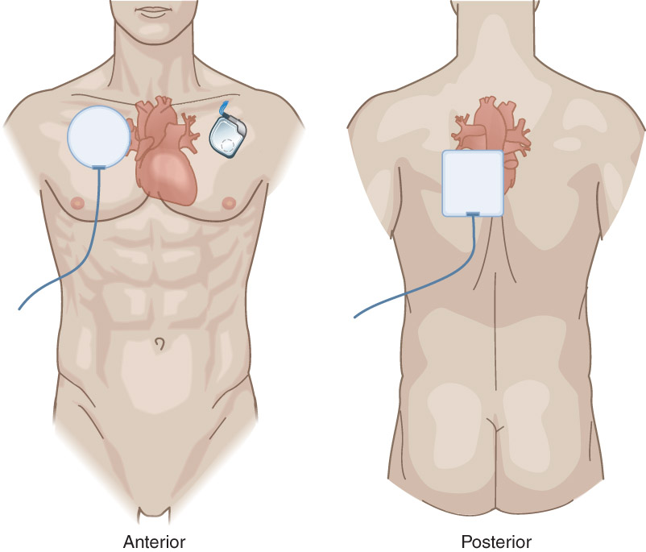
En Route (cont’d)
Knowing that the patient is at risk for sudden cardiac arrest, what concerns do you have defibrillating a patient with an ICD?
© Jones & Bartlett Learning.
Notes:
INSTRUCTOR NOTES AND TIPS
If you witness a cardiac arrest, allow the patient’s ICD to sense and discharge. If this does not occur due to possible ICD malfunction, perform normal resuscitation procedures but modify paddle/pad placement. Put the defibrillator paddles or pads in the anterior-posterior position to avoid damaging the pacemaker. If you have to put both pads on the chest, try to stay at least 10 cm away from the device.

Slide 15
Detailed Assessment
S: Chest pain, SOB, anxiety
A: NKDA
M: Metoprolol, quinidine, atorvastatin, apixaban, metformin
P: Diabetes, AMI with successful resuscitation from SCA, cardiomyopathy, heart failure
L: Lunch
E: Relocation due to evacuation
Risk factors: ?
Notes:
INSTRUCTOR NOTES AND TIPS
Signs/Symptoms: N/A
Allergies: PCN
Medications: Metoprolol (beta blocker), quinidine (sodium channel blocker), atorvastatin (cholesterol lowering), apixaban (blood thinner), metformin (antidiabetic)
Past medical history: Diabetes, AMI, cardiomyopathy, heart failure
Last oral intake: Lunch
Events: Relocation due to evacuation
Risk factors: Serious cardiac disease and risk of sudden cardiac arrest

Slide 16
Detailed Assessment (cont’d)
HEENT: PERRL
Chest: Unremarkable w/ ICD implanted
Abdomen: Unremarkable
Extremities: Unremarkable
Notes:
INSTRUCTOR NOTES AND TIPS
Head, eyes, ears, nose, and throat: PERRL
Chest: Unremarkable; implanted ICD
Abdomen: Unremarkable
Extremities: Unremarkable

Slide 17
Arrival at Receiving Facility
Report the following:
Age
Gender
S/S
Vitals
Interventions
Significant changes
Notes:
INSTRUCTOR NOTES AND TIPS
Have participants deliver the report to the receiving facility. Make sure they address all of the needed information, interventions, and any significant changes that may have occurred.

Slide 18
Case Summary
Always perform a good patient assessment. Patients may not discuss or reveal that they have an ICD.
You must know how to recognize a patient with an ICD; look for pacer spikes in an ECG and/or a device implanted under the skin on the left side of the chest.
Notes:
INSTRUCTOR NOTES AND TIPS
Did the patient in this scenario receive an inappropriate shock from his ICD? Inappropriate shocks occur in up to 40 percent of patients with an ICD. The main cause is supraventricular tachyarrhythmia (SVT), including sinus tachycardia, atrial fibrillation, and other rapid supraventricular arrhythmias as well as nonsustained VT. Other causes include electrical noise, inappropriate sensing, and ICD malfunction (e.g., lead fracture). The rate of inappropriate shocks is continually reducing due to modern ICD equipment and sensing capabilities.
Many current ICDs are dual chamber devices that have an atrial lead for sensing and atrial anti-tachycardia pacing. This can detect specific atrial and ventricular arrhythmias and can accurately discriminate between atrial tachycardia/atrial flutter and atrial fibrillation.
Some patients have reported "phantom shocks.” The exact cause of this phenomenon is unknown, but patients who report phantom shocks are more likely to have received an actual ICD shock and may continually worry about receiving another shock. Some of these patients also suffer from unrelated anxiety or depression.
Electromagnetic interference
Because reliable functioning of the ICD depends upon proper sensing of the electrical activity of the heart, a potential concern is electromagnetic interference from external sources, including cellular telephones, welding equipment, motor-generator systems, and surveillance systems (e.g., metal detectors). It is generally accepted that ICDs and pacemakers are adequately shielded from microwave ovens. Cellular telephones are unlikely to cause clinically significant interference with cardiac devices. Patients should be advised to be aware of the location of security systems and to move through them at a normal pace. Patients may be taught the phrase "don't linger, don't lean.”

Slide 19
Case Summary (cont’d)
Always perform a 12-lead ECG for ICD patients; do not rely on the ECG to be accurate at recognizing certain rhythms, such as a myocardial infarction.
Treat an ICD patient like any other cardiac patient, but know the device’s purpose and basic function, as well as any unusual issues a patient may experience, such as misfirings.

