Slide 1
Advanced GEMS Course
Lesson 4
Left Ventricular Assist Devices

Slide 2
Objectives
Identify the patient with a left ventricular assist device (LVAD).
Know what role the LVAD plays in the patient with heart failure (HF).
Know the LVAD’s basic operational function, settings, and equipment.
Discuss and describe the special concerns of an LVAD in the older patient.
Notes:
INSTRUCTOR NOTES AND TIPS By the end of Lesson 4, participants should be able to:
Identify the patient with a left ventricular assist device (LVAD).
Know what role the LVAD plays in the patient with heart failure (HF).
Know the LVAD’s basic operational function, settings, and equipment.
Discuss and describe the special concerns of an LVAD in the older patient.
Describe the signs and symptoms of a patient with a malfunctioning LVAD.
Discuss how patients with LVADs are managed.

Slide 3
Objectives (cont’d)
Describe the signs and symptoms of a patient with a malfunctioning LVAD.
Discuss how patients with LVADs are managed.
Notes:
INSTRUCTOR NOTES AND TIPS By the end of Lesson 4, participants should be able to:
Identify the patient with a left ventricular assist device (LVAD).
Know what role the LVAD plays in the patient with heart failure (HF).
Know the LVAD’s basic operational function, settings, and equipment.
Discuss and describe the special concerns of an LVAD in the older patient.
Describe the signs and symptoms of a patient with a malfunctioning LVAD.
Discuss how patients with LVADs are managed.

Slide 4
Dispatch
The triage officer has assigned your transport unit to Mr. Samuel Martinez. Mr. Martinez is a patient with an LVAD. He is to be evacuated to the Kenwood Manor Assisted Living and Rehab.
Notes:
INSTRUCTOR NOTES AND TIPS
Triage assignment: The triage officer has assigned your transport unit to Samuel Martinez, a 58 y/o male patient in Room 147, Bed 1. He is stable and needs to be transported to Kenwood Manor, another assisted living/nursing/rehab home in the county. When you enter the room, you find Mr. Martinez alone, awake, and alert. He has no complaints of physical discomfort; he only states trepidation about moving out of the facility with no medical support while on the LVAD.

Slide 5
Initial Observation
The patient is being evacuated due to the flood.
He is stable, but due to his LVAD, he needs medical observation during transport.
He has no complaints, only trepidation about leaving the facility and the facility’s staff.
He is English speaking, awake, alert, and fully oriented.
No one else is in the room with him.
Notes:
INSTRUCTOR NOTES AND TIPS
Scene safe: Secure
Situation: Evacuation relocation
Cultural: English speaking
Communication: Awake, alert, and oriented x4
Medical devices: LVAD
Chief complaint: He has no complaints of physical discomfort; he only states trepidation about moving out of the facility with no medical support while on the LVAD.

Slide 6
Primary Survey
LOC: Awake and alert; A&O × 4
Airway: Intact and open
Breathing: Clear lungs, RR: 16 (a continuous machine-like noise during auscultation)
Circulation: Unable to assess pulse (absent in peripheral, diminished in central)
Sick or not sick?
Notes:
INSTRUCTOR NOTES AND TIPS
Level of consciousness: Awake and alert
Airway: Open, intact
Breathing: Normal rise and fall, clear lung sounds, RR: 16
Circulation: Unable to assess pulse (absent in peripheral, diminished in central)
First impression: Stable patient with an LVAD
Differential diagnosis: None at this time

Slide 7
GEMS Assessment
G: 58-year-old male
E: Skilled nursing facility
M: End-stage heart failure, multi-vessel coronary artery disease, CABG, HTN, type II diabetes, rheumatoid arthritis
S: Strong family support; visitors almost daily; limited physical activity since LVAD placement (mostly psychologically based fear of causing an issue with the LVAD)
Notes:
INSTRUCTOR NOTES AND TIPS
Geriatric: 58-year-old residing in a skilled nursing facility
Environmental: Skilled nursing facility with no other patients in the room
Medical: End-stage heart failure, multi-vessel coronary artery disease, CABG, HTN, type II diabetes, rheumatoid arthritis
Social: Strong family support; visitors almost daily; limited physical activity since LVAD placement (mostly psychologically based fear of causing an issue with the LVAD)

Slide 8
Discussion
What does an LVAD do?
What are the indications for an LVAD?
© Jones & Bartlett Learning.
Notes:
INSTRUCTOR NOTES AND TIPS
LVADs are typically used for patients with end-stage heart failure. The population of patients with LVADs is increasingly growing. EMS practitioners must understand how these devices work, the common complications related to these devices, and the approach that should be taken to evaluate patients with these devices.
What are the indications for LVAD insertion?
As a bridge to cardiac transplantation
As a bridge to recovery (i.e., reversible myocardial pathology)
As long-term treatment for patients who are not candidates for transplant
What are the components of an LVAD?
An inflow cannula that pulls blood from the left ventricle into the pump
A pump that generates blood flow
An outflow conduit that pushes blood into the aorta
A driveline that connects to the external controller
Controller, monitors, power source, and battery; these external components monitor the device’s performance.
What are the different types of VADs?
Left ventricular assist device (LVAD)
Right ventricular assist device (RVAD)
Biventricular assist device (BiVAD)
Pulsatile flow devices
Continuous flow devices
What is the physiology of continuous flow devices?
Increased diastolic pressure and flow allowing for continuous flow of the entire cardiac cycle, meaning aortic flow is present during diastole when normally absent. This results in a diminished pulse pressure. Also, LVADs are preload dependent (i.e., they only pump blood or volume that gets to it), so maintenance of preload is of utmost importance.
The LVAD is placed in the upper abdomen and connected to an external power supply. Blood travels through a tube in the left ventricle into the LVAD, which pumps blood through another tube into the aorta and throughout the body.

Slide 9
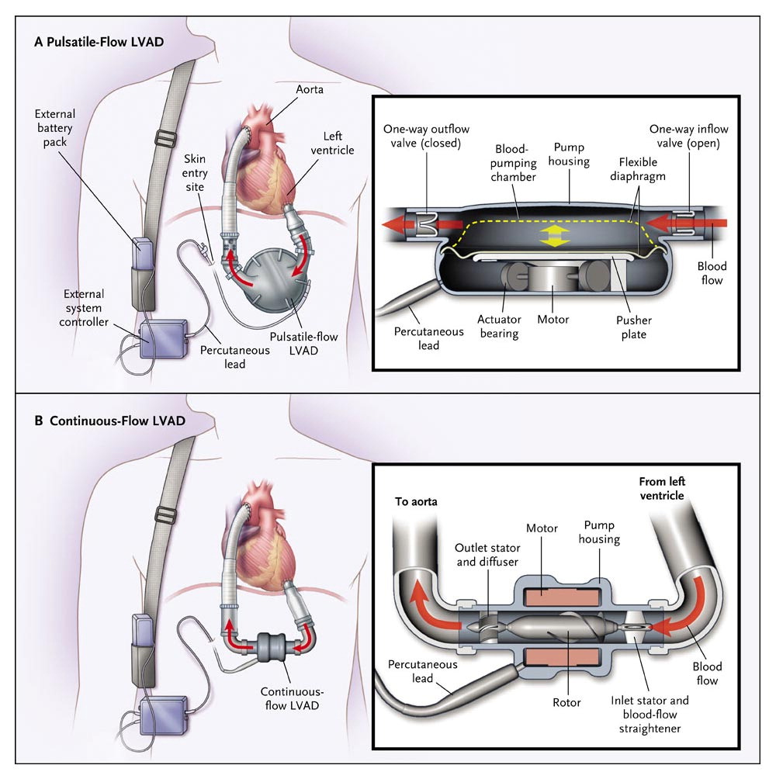
Discussion (cont’d)
What does the pump of a pulsatile VAD vs. a continuous-flow VAD look like?
From New England Journal of Medicine, Slaughter, et al., Advanced Heart Failure
Treated with Continuous-Flow Left Ventricular Assist Device, 2009, 361:2241-2251.
Copyright © Massachusetts Medical Society. Reprinted with permission from
Massachusetts Medical Society.
Notes:
INSTRUCTOR NOTES AND TIPS
An LVAD is a treatment option for a patient with end-stage heart failure. Continuous and nonpulsatile devices are available, each with different effects on a patient's physiology. In general, these effects are not clinically significant; however, continuous-flow devices are smaller and are associated with less overall morbidity than pulsatile devices.

Slide 10
Pre-transport Check
Records: The patient has his medical records.
ECG: HR: 80, NSR with artifact
LVAD is assessed for appropriate functioning:
Auscultate; listen for continuous machine-like noise.
View the controller for information such as pump speed, flow, power, and remaining battery life.
Ensure appropriate settings and adequate battery power.
Make sure backup batteries are available and charged.
Make sure you have the needed power cords.
Notes:
INSTRUCTOR NOTES AND TIPS
Records: The patient has his medical records.
Prior to departure: The patient gives you the contact card for the closest VAD coordinator. He states that after 2 years on the transplant waiting list his condition worsened and he was placed on an LVAD. It has been 1 month since the implantation, and the patient says he is still not comfortable with having it. He says that he is afraid of leaving the facility and not having appropriate medical support. The patient is assessed medically (ABCs, BP, 12-lead ECG) and reassured that the transport will not harm him or the device. After appropriate assessment and transport packaging, the patient is moved to the ambulance for transport to the evacuation relocation site. The LVAD is assessed for appropriate functioning:
Auscultate precordium and/or epigastrium and listen for a continuous machinery-like noise.
View, document, and confirm external controller for information such as pump speed, flow, power, and remaining battery life.
Ensure appropriate settings and battery power:
Pump speed is based on VAD type.
Power, flow, and pulsatility index remain relatively standard with most VAD types.
Make sure backup batteries are available and fully charged.
Make sure you have any power cords that go with the LVAD. The emergency department does not have any batteries or power connections needed for the LVAD. Ensure the patient has supplied all needed backup equipment for the transport.

Slide 11
En Route
Patient status: LVAD is reassessed.
LVAD settings are as follows:
Pump speed: 2400
Power: 5 watts
Flow: 5 L/min
Pulsatility index: 5
Pump type: HeartWare VAD (settings match manufacturer’s recommendations)
Notes:
INSTRUCTOR NOTES AND TIPS
How do you assess VAD function?
You can tell if the pump is running simply by placing your stethoscope over the precordium or epigastrium and listening for a continuous machinery-like noise.
The external controller will tell you some important information as well: pump speed (rpm), flow (L/min), power (watts), and remaining battery life.
Normal values:
Pump speed: 2200–2800 rpm (HeartWare VAD); 8000–10,000 rpm (HeartMate II VAD)
Power: 4–6 watts
Flow: 4–6 L/min
Pulsatility index (PI): 1–10

Slide 12
En Route (cont’d)
Patient status: Patient is reassessed.
Airway: Patent
Breathing: 16 bpm
Circulation: Unreadable radial, diminished central; automated BP cannot acquire an accurate BP; auscultation BP does not offer a reliable reading either
Notes:
INSTRUCTOR NOTES AND TIPS
Manage ABCs (airway, access, monitoring).
If prehospital attempts fail to acquire a blood pressure, the only option may be waiting until the patient arrives at the hospital and the blood pressure can either be achieved by Doppler ultrasound or by placing an arterial line.
Contact the LVAD team coordinator. The patient is a University Hospital patient. The hospital may have contact information or the information may be available in his chart (will be specific to your local hospital, or the patient may have the phone number of the coordinator).
Auscultate for hum of LVAD and alarms. An alarm may indicate a battery problem. Check the driveline and pump parameters.

Slide 13
En Route (cont’d)
Many patients with VADs present with hypotension. What are some of the causes of this?
VAD Related | Non-VAD Related
Pump failure | Hypovolemia
Pump/cannula obstruction | Dehydration
-Thrombus | Hemorrhage
-Conduit compression/kink | Ventricular arrhythmias
Pump speed set too high | Right ventricular failure
 | Cardiac tamponade
 | Aortic valve regurgitation
Notes:
INSTRUCTOR NOTES AND TIPS
How often do life-threatening VAD malfunctions occur?
1st generation VADs: 6% at 6 months and 64% at 2 years (no longer in use)
2nd generation VADs: 54% at 2 years for continuous-flow LVAD (Continuous-flow LVADs are currently the most commonly found 2nd generation devices. These devices are smaller than 1st generation devices and have continuous nonpulsatile flow [decreases risk of hemolysis due to shear stress on RBCs but also means no palpable pulse and difficulty determining BP from automated cuff].)
3rd generation VADs: May help minimize thrombus formation and hemolysis
The number of people with LVADs continues to grow. Hypertension is now an established risk factor for adverse outcomes in patients with LVADs. Increasingly, evidence suggests that more stringent BP goals may be protective against complications of stroke, pump thrombosis, and aortic insufficiency. In the long-term management of LVAD patients, MAP should be maintained between 70 and 80 mmHg, striking a balance between tight BP control and the avoidance of the side effects of low BP. Fortunately, the same pharmacotherapy regimen that can be utilized to lower BP in LVAD patients may have additional benefits in terms of managing heart failure and establishing a favorable environment for potential myocardial recovery. Doppler measurement of BP is currently the standard of care; however, this method is not without its limitations. While it is now generally accepted that Doppler pressure is the most reliable and consistent method to obtain a BP in the setting of continuous flow, there is less consensus on whether the obtained Doppler pressure represents MAP or SBP. In patients with significant pulsatility, the Doppler pressure may more closely measure the SBP. Efforts are under way to develop easier, more accessible noninvasive methods to measure BP in the setting of continuous flow.

Slide 14
Detailed Assessment
S: N/A
A: NKDA
M: Propranolol, lisinopril, rivaroxaban, Digitek, eplerenone, potassium, abatacept, rosiglitazone
P: End-stage heart failure, multi-vessel coronary artery disease, CABG, HTN, type II diabetes, rheumatoid arthritis
L: Lunch
E: Relocation due to evacuation
Notes:
INSTRUCTOR NOTES AND TIPS
Signs/Symptoms: N/A
Allergies: NKDA
Medications: Propranolol (beta blocker), lisinopril (ACE inhibitor), rivaroxaban (blood thinner), Digitek (digoxin), eplerenone (aldosterone receptor antagonist; diuretic for HF), potassium, abatacept (RA treatment), rosiglitazone (thiazolidinedione for type II diabetes)
Past medical history: End-stage heart failure, multi-vessel coronary artery disease, CABG, HTN, type II diabetes, rheumatoid arthritis
Last oral intake: Lunch
Events: Relocation due to evacuation

Slide 15
Detailed Assessment (cont’d)
Risk factors: ?
HEENT: PERRL
Chest: Unremarkable w/ LVAD placement
Abdomen: Unremarkable w/ LVAD placement
Extremities: Unremarkable
Notes:
INSTRUCTOR NOTES AND TIPS
Risk factors: Causes of LV failure (pump thrombosis, cannula obstruction, motor failure, aortic insufficiency, anemia due to GI bleed)
Bleeding. LVADs can cause acquired von Willebrand Disease, thought to be due to the action of the rotary or axial flow pump of the LVAD, which causes high shear stress that may increase lysis. Patients are at a higher risk of GI bleeds and intracranial bleeds.
The insertion area of the percutaneous lead to the LVAD is without issue (no infection, raised skin, or irritation). This lead is located in the upper abdomen on the right side of the patient.
Pulses are absent in the extremities.

Slide 16
Arrival at Receiving Facility
Report
Notes:
INSTRUCTOR NOTES AND TIPS
Have the participants give a report on what information they have obtained from the patient and their interventions (if any) with the patient.

Slide 17
Case Summary
The population of patients with LVADs is growing every year, as is EMS exposure to these patients. You should understand how these devices work, the common complications with these devices, and the approach to take to evaluate these patients.
Notes:
INSTRUCTOR NOTES AND TIPS
Discuss with the class, again, the importance of backup equipment. Also, discuss the value of sharing information with the local hospitals when an LVAD patient is in the service area and making sure the LVAD manufacturer has contact information for these patients.

Slide 18
Case Summary (cont’d)
Points to remember:
Contact the closest VAD coordinator or cardiac transplant center as soon as possible.
Hypotension can be a nonspecific finding with VADs; always look for other etiologies.
VADs are preload dependent.
Check an ECG for all patients with VADs.

