Slide 1
Chapter 3: The Role of the Professional Lifeguard
Notes:
Describe the purpose of the USLA Code of Ethics for professional lifeguards.
Describe the responsibilities, challenges, and expectations of professional lifeguards in the United States.
Explain how professional lifeguards serve as managers of public safety in the aquatic environment.
Explain the rewards that professional lifeguards experience through serving the public.

Slide 2
The USLA Code of Ethics

Slide 3
Lifeguards will:
Maintain an unwavering dedication to the safety of those they are assigned to protect.
Recognize and accept that heightened personal dangers are an unavoidable aspect of the job.
Maintain high standards of fitness, recognizing that their strength, stamina, and physical skill may mean the difference between life and death.
Make every reasonable effort to prevent accidents before they occur.
Avoid any undue distraction which may deter them from their primary responsibility.

Slide 4
Proudly carry out the duties they are assigned, providing the highest possible levels of courtesy, respect and assistance to those whom they watch over.
Take proactive steps to educate the public about the hazards of the aquatic environment and ways to safely enjoy aquatic recreation.
Promote their profession through personal actions which serve to demonstrate that lifeguards everywhere are deserving of the trust placed in them by the public they serve.
Diligently follow established policies and procedures set forth by their employing agency to promote the best possible public service.
Notes:
Outlines the fundamental responsibilities of a professional open water lifeguard.
Highlights the trust and confidence placed in the professional lifeguard.
Focuses on the unwavering devotion to duty required of the professional lifeguard.
Points out that a lifeguard’s dignity is commensurate with the position and the ethical principles of public safety service.
USLA Code of Ethics components [show the actual code on screen] - Dedication, acceptance of heightened dangers, maintenance of a high standard of fitness, accident prevention, avoidance of distractions from primary responsibility, proudly carry out duties, implementation of proactive steps to educate the public, promotion of professionalism through personal actions, diligent adherence to policies and procedures

Slide 5
Responsibilities and Expectations

Slide 6
The prevention of injury and death in the aquatic environment
Notes:
All lifeguards are dedicated to a key goal – preventing injury and death in the aquatic environment.

Slide 7
Anticipate
Prevent
Respond
Notes:
Lifeguards are specially trained professionals who are prepared to anticipate, prevent, and respond to emergencies in and around the aquatic environment.

Slide 8
Trained to prevent
The benefits are far reaching
Most drownings are preventable
Lifeguards are emergency service professionals
The public expects lifeguards on their beaches
Notes:
Professional lifeguards are trained and prepared to prevent the loss of life on a daily basis.
Accomplishment of the core task of prevention and rescue has direct impact not only on the individual life that is saved, but also on the families of those rescued and the national economy.
It is estimated that for every 10,000 beach visitors there is a national monetary savings of between $705,000 and $16,000,0000 as a direct result of professional lifeguards doing their job.
The Centers for Disease Control and Prevention's National Center for Injury Prevention issued a report in 2001entitled Lifeguard Effectiveness: A Report of the Working Group.
This report states that, "Most drownings are preventable through a wide variety of strategies, one of which is to provide lifeguards in public areas where people are known to swim and to encourage people to swim in those protected areas."
In the United States, open water lifeguards have worked hard to be recognized as equals with other emergency services professionals such as police, firefighters, and emergency medical personnel. Americans today expect lifeguards on their beaches to protect them.

Slide 9
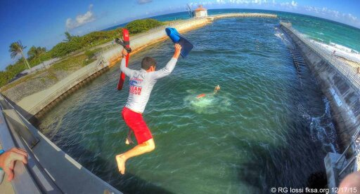
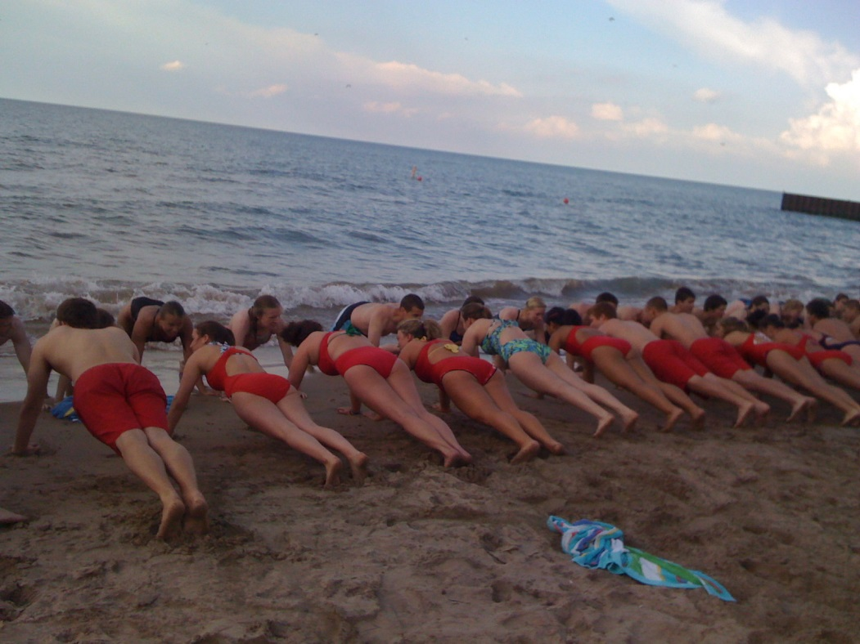
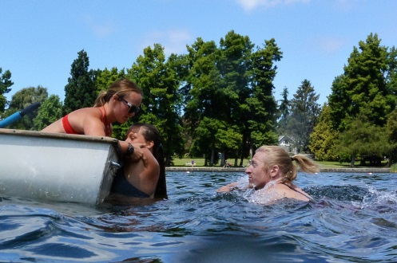
The Physical Demands of Lifeguarding
Notes:
Lifeguarding is viewed by many professionals as the most physically demanding job among the emergency services. Strength, physical endurance, running ability, swimming skills, and rescue skills are among the requirements of professional open water lifeguards.

Slide 10
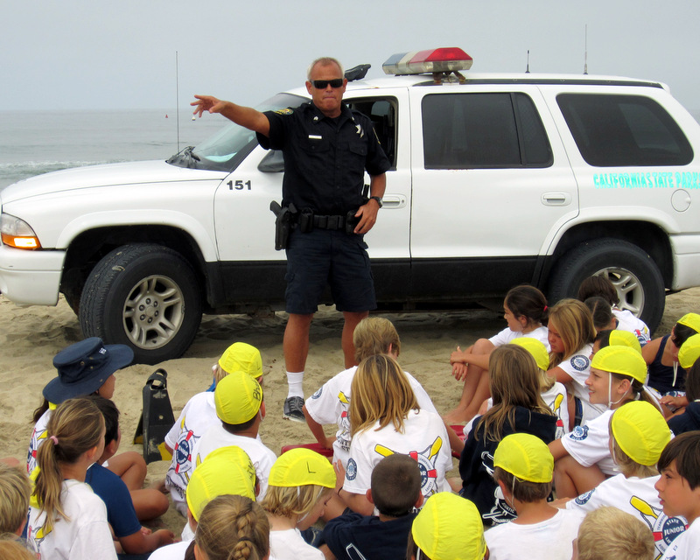
Public Safety is Job One
Notes:
The primary job of a professional open water lifeguard in the United States is public safety. The core role is drowning prevention, but the breadth of job responsibilities can vary from one locale to the next.

Slide 11
Emergency medical services
Scuba search and recovery
Cliff rescue
Boat rescue
Marine firefighting
Swiftwater rescue
Flood rescue
Law enforcement
Notes:
Lifeguard responsibilities can include emergency medical services, scuba search and recovery, cliff rescue, boat rescue, marine firefighting, swiftwater rescue, and flood rescue. In addition lifeguards may be given law enforcement powers.
Lifeguards should never be assigned or assume duties beyond those directly related to their public safety role.

Slide 12
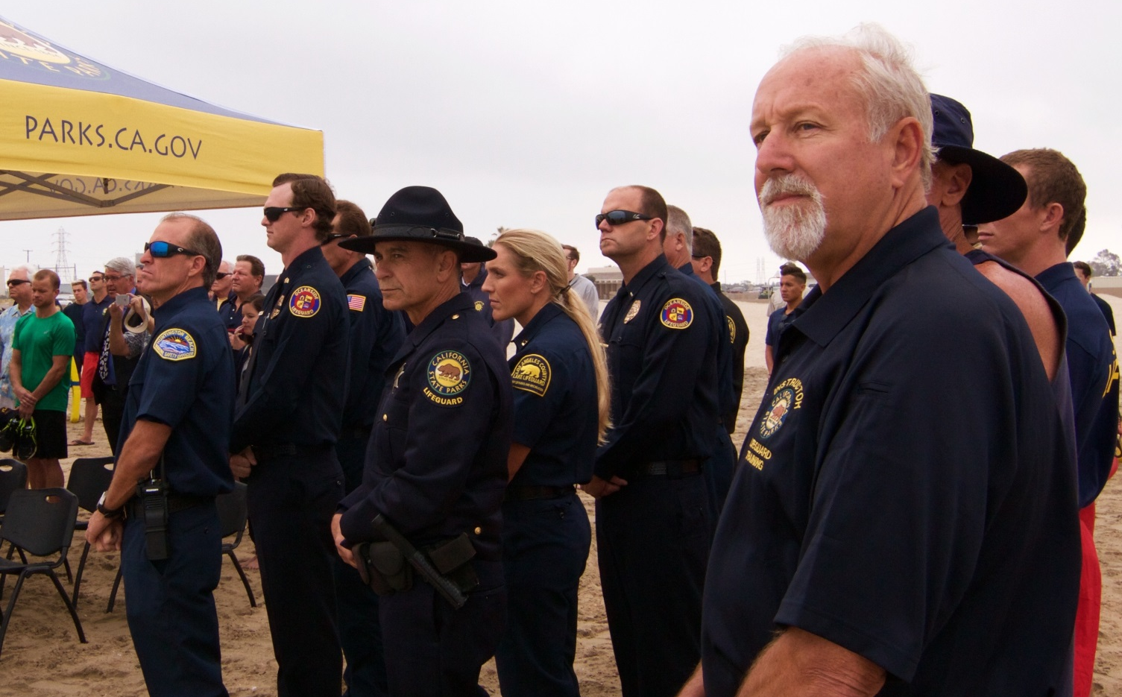
The Lifeguard as Manager
Notes:
Lifeguards serve as managers of safety and managers of the interaction of people, both with the environment and with each other.
Lifeguards must manage the public and maintain constant vigilance to protect them.

Slide 13
Managing Safety
Compensating for the incorrect assumptions and unknown capabilities of the public
Providing adequate means to avoid loss of coverage
Notes:
Many emergencies occur because people visiting the area presume that the conditions will be similar to those near their home or the same as the last time they visited a beach.
Lifeguards should never assume that beach visitors are familiar with a beach's particular hazards or conditions.
Good managers will be sure adequate backup is available to maintain watch over the water and that lifeguards are trained to conclude any contact which diverts attention from the water as soon as possible.

Slide 14
Managing Conflict
Providing viable boundaries and limitations for activities
Safest way to get compliance
Notes:
Effective beach management includes preventing conflicts by separating incompatible activities whenever possible.
A lifeguard must evaluate the safest approach prior to intervening in a conflict.

Slide 15
Lifeguard Rewards

Slide 16
Preventing injury or death of others is a critical and rewarding role.
Lifeguarding stays with you forever
“Lifeguards for Life®”
Notes:
Helping people and the public can be a reward in and of itself.
Lifeguards can perform the most important act of all – saving the life of another person.
Lifetime of friendship with fellow lifeguards around the United States and the world.
Common bond with other professional lifeguards - "Lifeguards for Life".

Slide 17
Notes:
Divide class into small groups. Assign a “Discussion Point” to each group. Ask each group to share the most important parts of their lesson point with the rest of the class. Expand on each group’s comments so that all lesson material is covered. Ask each group if they have ever been involved in an emergency situation and been involved in a lifesaving effort.

