Slide 1
Notes:
Chapter 7: Social Determinants of Health

Slide 2
Chapter 7 Social Determinants of Health
Notes:
Chapter 7: Social Determinants of Health

Slide 3
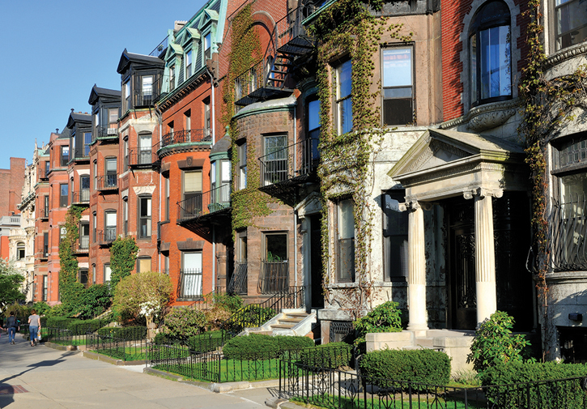
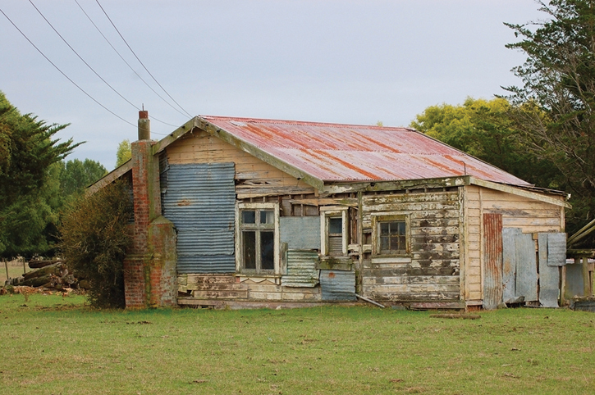
Introduction (1 of 5)
Social determinants
Conditions in which people are born, grow, live, work, and age
Shaped by:
Wealth distribution
Resource availability
Individuals
© Jorge Salcedo/Shutterstock.
© Kenneth William Caleno/Shutterstock.
Notes:
Lecture Outline
Introduction
A. Social determinants
1. The World Health Organization defines social determinants as the conditions in which people are born, grow, live, work, and age.
2. These determinants are shaped by:
a. Wealth distribution
Resource availability
Individuals in the community

Slide 4
Introduction (2 of 5)
Community and patient needs assessments
Identify social issues that may play a role in:
The health of the patient
The overall health of the community
Notes:
Lecture Outline
3. One of the most important aspects of community needs assessment or individual patient needs assessment is identifying those social issues that may play a role in the:
a. Health of the patient
b. Overall health of the community

Slide 5
Introduction (3 of 5)
Social issues related to health
Culturally guided behavior practices that impact diet and exercise
Socioeconomic constraints such as poverty
Notes:
Lecture Outline
4. Social issues related to health can range from culturally guided behavior practices that impact diet and exercise to socioeconomic constraints such as poverty.

Slide 6
Introduction (4 of 5)
Community paramedic
Identifies social aspects of a patient’s and the community’s health
Prepared to assist in developing initiatives to address or overcome those issues
Addressing one determinant has a domino effect
eg, employment provides access to health care
Notes:
Lecture Outline
5. By researching and identifying the social aspects of an individual patient’s and the community’s health, the community paramedic can be better prepared to assist in developing initiatives to address or overcome those social issues.
6. Addressing one social determinant can have a domino effect.
a. Example: When people find employment, it increases their income, and may give them access to health care, thereby improving their ability to take control of their own and their family’s health.

Slide 7
Introduction (5 of 5)
Social determinants should be addressed early and at the foundational level
Example: Identifying and educating patients who frequently contact EMS for chronic health issues
Notes:
Lecture Outline
7. Social determinants should be addressed early and at the foundational level.
a. Example: Identifying patients who frequently contact EMS for chronic health issues, evaluating their home environment and educating them on their health condition can help them to take control of their health situation.

Slide 8
Social Determinants of Health (1 of 23)
Social determinants that affect the community’s overall health include:
Religion
Culture
Socioeconomic status
Age
Relationship status
Notes:
Lecture Outline
II. Social Determinants of Health
A. Broadening our perspective
1. Social determinants that can affect the community’s overall health include:
a. Religion
b. Culture
Socioeconomic status
Age
Relationship status

Slide 9
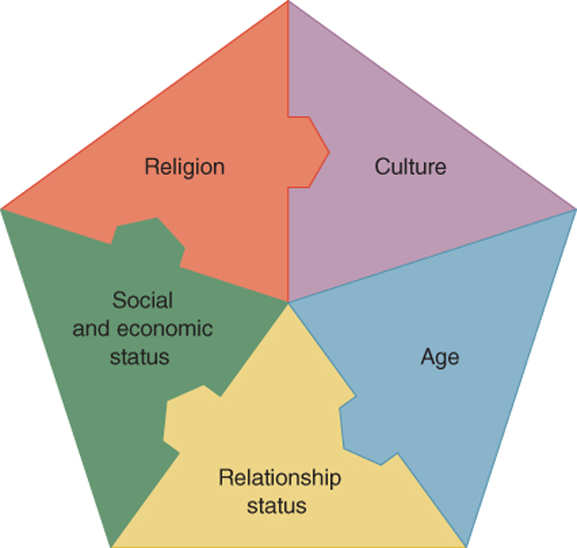
Social Determinants of Health (2 of 23)
© Jones & Bartlett Learning.
Notes:
Figure 7-2 show social determinants that can have an impact on the health of a community.

Slide 10
Social Determinants of Health (3 of 23)
Need to broaden our perspective: encompass all social interactions
Of all determinants affecting health, the social ones are the most fluid.
Notes:
Lecture Outline
3. When we think of social determinants, we need to broaden our perspective to encompass any and all social interactions people have with their environment.
4. Of all the determinants affecting a person’s health, those of a social nature are by far the most fluid.

Slide 11
Social Determinants of Health (4 of 23)
Religion
Plays an important role in overall health of a community and an individual
Can impact health positively or negatively
Some practices/rituals have helped maintain the public’s health
Example: circumcision
Notes:
Lecture Outline
B. Religion
1. Religion can play an important role in the overall health of a community and in an individual.
2. A patient’s religious beliefs or practices may impact his or her health positively or negatively.
3. Since the advent of organized religion, some practices and rituals have had positive effects by promoting and maintaining the public’s health.
a. Example: Hebraic practices of circumcision reduce the potential for infection by human immunodeficiency virus and other sexually transmitted diseases according to the Centers for Disease Control and Prevention.
b. Example: Practices of quarantining people with diseases such as leprosy were intended to prevent the spread of those diseases to the community.

Slide 12
Social Determinants of Health (5 of 23)
Religion (cont’d)
Beliefs may determine types of medical intervention people seek
Some belief systems see prayer as the most effective means to healing.
Affects end-of-life decisions
Community paramedic should be aware of patient’s beliefs
Notes:
Lecture Outline
4. Religious beliefs may play a role in determining when and what types of medical intervention people seek out. Some belief systems have guidelines regarding:
a. Blood transfusions
b. Vaccines
c. Contraception
5. Some belief systems see prayer as the most effective means to healing and encourage their adherents to seek it before, or along with, any medical interventions.
6. In our society, it is every person’s right to abide by his or her religious convictions, and we must remember that spiritual care is just as important to some patients as physical care.
7. Religion also affects a person’s end-of-life decisions
a. Medical interventions
b. Palliative care
8. The community paramedic should be aware of a patient’s beliefs and seek to identify what their effects might be both on the individual’s health and on the community’s overall health.

Slide 13
Social Determinants of Health (6 of 23)
Culture
Beliefs and customs
Cultural environment can influence outlook on life
Cultural practices include dietary choices.
© Craevschii Family/Shutterstock.
Notes:
Lecture Outline
C. Culture
1. Cultural practices are also important when examining the social determinants that affect a person’s and a community’s health.
2. Culture is defined as the beliefs, customs, and art of a particular society, group, place, or time. Our focus will be culture as identified in customs.
3. The cultural environment in which a person lives can influence his or her outlook on life.
a. Today, when food is ever present and easy to access, obesity has become a public health problem.
b. To complicate this unhealthy trend, a person growing up in a culture that places great emphasis on an unrealistic body size (eg, an unattainably thin waist) may be influenced to make choices that are not healthy in an effort to fulfill cultural expectations.
i. Anorexia and bulimia
4. Cultural practices include dietary choices.
a. Some cultures cook and prepare foods that are high in sodium, sugar, or saturated fats.
i. Excessive amounts of these elements in food have been linked to increased health problems ranging from high blood pressure to cardiovascular disease to diabetes.
b. Some cultures have a history of healthy food preparation and choices.
i. Mediterranean diets often have at their center foods that include olive oil, nuts, and other foods that reduce inflammation and benefit the body.

Slide 14
Social Determinants of Health (7 of 23)
Culture (cont’d)
May influence a person’s willingness to seek medical attention
Influences the way we make decisions
Community paramedics should identify cultural influences of patients for greater success.
Notes:
Lecture Outline
5. Culture may also influence a person’s willingness to seek medical attention.
a. If someone comes from a family that has historically seen health care as something that only “really sick” people need, he or she may wait until symptoms become unbearable before seeking medical attention.
b. Other people may have grown up in families that highly value health maintenance and checkups.
6. Culture influences the way we make decisions.
a. Our cultural environment often dictates to us which choices are good and which are bad, in the eyes of our society.
7. A community paramedic who listens to the patient and seeks to identify the cultural influences affecting him or her will have greater success in communicating and working with patients.
a. As health care professionals, it is the job of the community paramedic to give patients the best information possible to help them make the most well-informed decisions.
i. Example: A community paramedic may have to explain to a diabetic that although his father lived to 80 without going to a doctor, heredity only plays a part. Each person’s health is unique.

Slide 15
Social Determinants of Health (8 of 23)
Social and economic status
Financial capacity, educational level, work status
Factors affecting a person’s health:
Social exclusion
Housing and water
Education
Employment
Transportation
Notes:
Lecture Outline
D. Social and economic status
1. Social and economic status is the most commonly discussed social factor affecting a person’s health.
a. Socioeconomic status refers to a person’s financial capacity, educational level, and/or work status.
2. Socioeconomic factors that can have an effect on a person’s health include:
a. Social exclusion
b. Housing and water
c. Education
d. Employment
e. Transportation

Slide 16
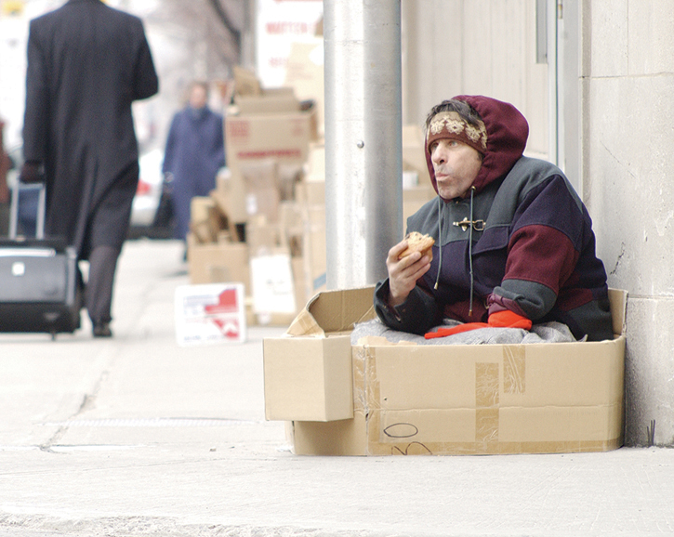
Social Determinants of Health (9 of 23)
Social exclusion
Unequal access to health care
Homeless
Mentally ill
History within prison system
Result of poverty
© AbleStock/Getty.
Notes:
Lecture Outline
3. Social exclusion
a. Measured more by subjective means than by hard data
b. Phenomenon by which a person, or group, is excluded from social interaction with those in the community
c. When social exclusion results from racial, ethnic, or cultural discrimination, people may not be able to access health care.
d. Social margin: people who are on the fringes of the social system and often have an unequal access to health care.
e. People who are more likely to be marginalized:
i. Homeless
ii. Mentally ill
iii. History within the penal system
f. Poverty: social exclusion can also be the result of absolute or relative poverty.
i. Absolute poverty: the lack of basic material necessities for life, including health care
ii. Relative poverty: living on less than 60% of the national median income
g. People who are impoverished may be unable to access even free community health services due to lack of transportation, odd working hours due to multiple jobs, or an inability to find or coordinate child care.
h. Social exclusion, if unchecked or unchanged, ultimately leads to an unequal distribution of, or at least unequal access to, health care and other resources. It can cost lives.
i. People at the lower end of the social gradient are often unable to access basic health care services due to financial issues.
i. Those lower on the social gradient are often at higher risk for life-threatening diseases, injury, or other health-related issues.
ii. The decline in health of a person who remains on the lower end of the gradient is often exponential (eg, if a person with high blood pressure is unable to access resources to control it, it can easily compound to the point of a stroke or even death).
j. By assisting people at the lower end of the gradient in accessing proper health care services, the community paramedic could potentially have a large effect not only on the patient’s short-term health, but also on his or her long-term health.

Slide 17
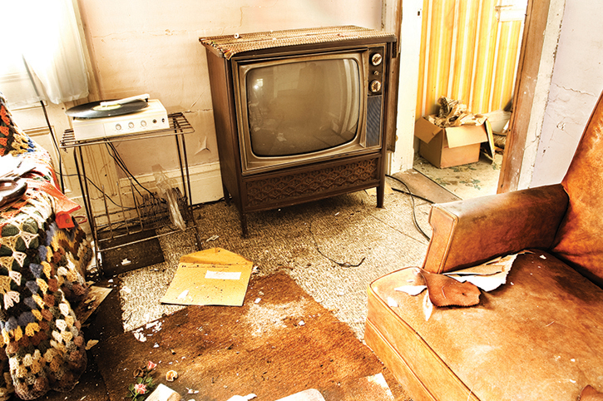
Social Determinants of Health (10 of 23)
Housing
Protects against the elements
Inadequate housing can affect a person’s health
© shaunl/iStock/Getty.
Notes:
Lecture Outline
4. Housing and water
a. Housing is a shelter and form of protection against environmental elements.
b. Adequate housing impacts more than just basic comfort; it can also have ramifications on a person’s health.

Slide 18
Social Determinants of Health (11 of 23)
Housing (cont’d)
Provides access to basic services needed for proper health:
Clean water
Sanitation
Waste disposal
Shelter
Notes:
Lecture Outline
c. Housing provides access to many of the basic services needed to ensure proper health:
i. Clean water
ii. Sanitation
iii. Waste disposal
iv. Shelter

Slide 19
Social Determinants of Health (12 of 23)
Water
Clean water is essential to proper health/hygiene
Proper food preparation
Sanitization
Improper hygiene can lead to increased rates of infection.
eg. flu, Staphylococcus infections, common cold
Notes:
Lecture Outline
d. Clean water is essential to proper health and hygiene
i. Proper food preparation
ii. Sanitization
e. Improper hygiene can lead to increased rates of infection and other health-related issues such as:
i. Flu
ii. Staphylococcus infections
iii. Common cold

Slide 20
Social Determinants of Health (13 of 23)
Water (cont’d)
Approximately 630,000 households, or 1.6 million Americans, live in housing with inadequate or no access to:
Indoor plumbing
Running water
Notes:
Lecture Outline
f. Improper waste disposal can create:
i. A breeding ground for rodent vectors
ii. An accumulation of toxic or hazardous substances
g. Contaminants can easily enter into water systems and create a higher risk for the general population to contract:
i. Diarrhea-causing illnesses
ii. Parasites
iii. Cancer
h. Recent surveys by the US Census Bureau show that approximately 630,000 households, or 1.6 million Americans, live in housing with inadequate or no access to indoor plumbing or running water.

Slide 21
Social Determinants of Health (14 of 23)
The home visit assessment
Focus on common causes of injury
Trip hazards
Kitchen safety
Adequate lighting inside and outside
Grab bars/lift handles in bathroom if needed
Notes:
Lecture Outline
i. The home visit assessment is not a mechanical inspection of the home. It is designed to focus on common causes of injury, such as:
i. Trip hazards
ii. Kitchen safety
iii. Adequate lighting inside and outside of the house
iv. Grab bars and lift handles in bathroom if needed
j. During the first home visit, the community paramedic can evaluate the home setting to identify items that can be immediately corrected without the need for any additional resources.

Slide 22
Social Determinants of Health (15 of 23)
Homes with dust, mold, lead paint, cockroaches, rodents
Exacerbate health issues in people with chronic respiratory diseases
© kay roxby/Shutterstock.
Notes:
Lecture Outline
k. Homes with large amounts of dust, mold, lead paint, cockroaches, and rodents can create environments that exacerbate health issues in people with chronic respiratory diseases.

Slide 23
Social Determinants of Health (16 of 23)
Education
The more education you have, the higher your chance of employment.
Higher probability of access to health insurance
Access to education
Longer life expectancy, improved health and quality of life, health-promoting behaviors
Notes:
Lecture Outline
5. Education
a. Can be an important contributor to a person’s health and well-being
b. Equips people to be involved in various productive activities in society
i. Those with a high school diploma have a much greater chance of being employed than those who do not complete high school.
ii. Those who continue on to obtain an undergraduate and postgraduate education tend to obtain higher-paying jobs, which can lead to obtaining employee health insurance or the ability to purchase private health insurance.
c. Education also empowers people with critical thinking skills, enabling them to make better choices, specifically in regard to health.
i. Increased access to education has been associated with longer life expectancy, improved health and quality of life, and health-promoting behaviors.

Slide 24
Social Determinants of Health (17 of 23)
Health education
Can be just as important as education
Even people at lower end of education social gradient can take control of their health
Example: Diabetic-related emergencies that require EMS could be avoided by educating patient (eg, proper diet, insulin use)
Notes:
Lecture Outline
d. Good health education can be just as important as good general education.
i. Even people at the lower end of the education social gradient can be empowered to take control of their health.
ii. Example: many diabetic-related emergencies that require EMS assistance could be avoided by educating patients on proper diet, eating schedules, insulin use, and blood glucose measurement.
e. Educating the patient on his or her health condition and ensuring that the patient has received and understood the message can go a long way in improving patient health.

Slide 25
Social Determinants of Health (18 of 23)
Employment
Positive impact on person’s health
Higher on social ladder, which positively impacts overall health condition
Improves the likelihood of access to health care services and resources
Notes:
Lecture Outline
6. Employment
a. Employment is closely linked to and often associated with the educational social determinant.
b. Being employed can have a positive impact on a person’s overall health.
i. People who are employed often find themselves further up on the social ladder, which tends to positively impact their overall health condition.
ii. Employment also improves people’s likelihood of having access to health care services and resources (eg, employer-based health care programs).

Slide 26
Social Determinants of Health (19 of 23)
Employment (cont’d)
Negative impact on person’s health
Increased stress
Length of commute
Length of shift
Wages
Shift schedule
Physical environment
© Lawrence Wee/Shutterstock.
Notes:
Lecture Outline
c. However, overall work environment can play a large role in person’s health.
i. Increased stress levels at work
ii. Length of the commute
iii. Length of the shift
iv. Wages
Shift schedule
Physical work environment
d. While employment can have both positive and negative effects on a person’s health, the effects of unemployment are often purely negative.
e. Unemployed people and their families are at a greatly increased risk of:
i. Premature death
ii. Significant health issues
iii. Negative feelings about themselves (eg, not able to provide for their families)

Slide 27
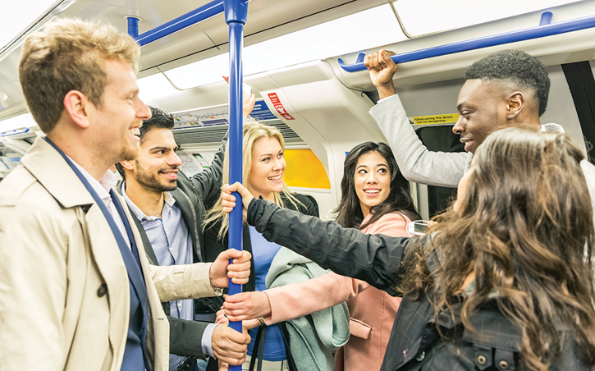
Social Determinants of Health (20 of 23)
Transportation
People walk less
Walking to public transportation increases physical activity
© William Perugini/Shutterstock.
Notes:
Lecture Outline
7. Transportation
a. When we think of transportation as a social determinant of health, we are focusing on the role that transportation plays in affecting our environment.
i. Increase in motorized transportation led to decrease in manual transportation (ie, people walk less)
ii. Walking to the grocery store or to the nearest bus stop to use public transportation increases the level of physical activity in a country where obesity is on the rise.

Slide 28
Social Determinants of Health (21 of 23)
Transportation (cont’d)
Any increase in cost of goods and services can:
Prevent people with fixed or limited income from maintaining healthy diets
Cause families with low- and midlevel incomes to fall into poverty end of social gradient
Send people into arena of health risks caused by poverty
Notes:
Lecture Outline
b. Transportation systems also have an effect on the cost of goods and services.
i. For people on a fixed or very limited income, any increase in the cost of goods and services can have a negative effect on their ability to maintain a diet that supports proper health.
ii. Increases in food prices have even caused some families with low- and midlevel incomes to fall into the poverty end of the social gradient.
iii. When people fall into this end of the social gradient, not only is their health affected due to poor diet but they also enter into the arena of health risks caused by poverty.
iv. This is a prime example of the extreme fluidity of the social determinants of health.

Slide 29
Social Determinants of Health (22 of 23)
Age
Important role in person’s health
Some dependent on others to access health care
Often associated with risk of disease
Think of how age affects patient’s ability to:
Handle illness and injury
Access health care
Notes:
Lecture Outline
E. Age
1. Age can play an important role in a person’s health. At the extreme ends of the age spectrum, people are often dependent upon others to help them access health care.
a. Young children
b. Older population
2. Age is often associated with increased risk of disease.
a. Infants, young children, and older adults are at higher risk for infectious diseases.
b. This is why each year these groups are encouraged to receive vaccinations for certain diseases.
3. As a community paramedic, keep in mind how age affects your patient’s ability to handle illness or injury and access necessary health care.

Slide 30
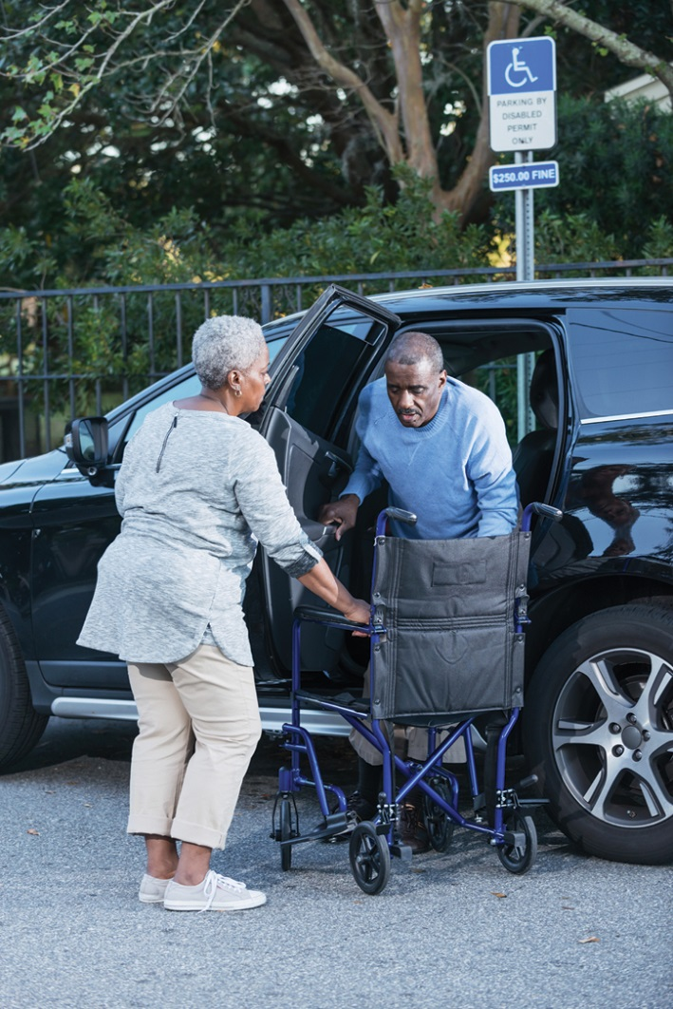
Social Determinants of Health (23 of 23)
Relationship status
Access to physician/pharmacy
Assist with medications
Combined incomes allow for basic services
© Susan Chiang/iStock/Getty.
Notes:
Lecture Outline
F. Relationship status
1. Ideally, every person has someone on whom he or she can rely in times of need.
2. Such relationships are very important to a person’s health. A person may need someone to:
a. Drive them to the physician or the pharmacy
b. Assist them with taking their medications
c. Care for them while they recover from a procedure
3. In the case of marriage, or similar shared-living situations, two people means two incomes, which can determine where a person or family falls on the social gradient.
a. Combined incomes may allow for at least basic services
b. Employer may offer health insurance to cover family members
4. It is important to note that relationship status extends beyond significant others.
5. A community paramedic must examine the patient’s entire social safety net.
a. Friends
b. Other family members (nieces, cousins)
c. Community of faith

Slide 31
Identifying Social Determinants (1 of 7)
Social ecology
Field that emerged in mid 1960s/early 1970s
Identifies correlation between social aspects of person’s environment and health status
Data collected from patient and community needs assessments
Notes:
Lecture Outline
III. Identifying Social Determinants
A. Social ecology
1. Field of study that emerged in the mid-1960s and early 1970s that focuses on the social contexts of humans’ interactions with their environment
2. Seeks to identify the correlation between the social aspects of the person’s environment and the person’s overall health status
3. Data required for this research are collected by the community health team during both the patient and the community needs assessments.
4. The information from both the patient and the community needs assessments is evaluated and used by the community health team to develop communitywide health programs to address the issues identified during the research and subsequent evaluations.
5. There are other factors that contribute to the community’s and the patient’s overall health, including geographic dimensions and environmental dimensions, but the social dimension is often the most fluid and difficult to address.

Slide 32
Identifying Social Determinants (2 of 7)
Socio-ecological model: four overall dimensions of interaction
The person as an individual
The person’s close relationship with others
The person as a member of a community
Societal influences on the person
Notes:
Lecture Outline
6. The social-ecological model focuses on four overall dimensions of interaction:
a. The person as an individual
b. The person’s close relationship with others
c. The person as a member of a community
d. Societal influences on the person

Slide 33
Identifying Social Determinants (3 of 7)
The person as an individual
Focuses on person’s environment and history
Community paramedic:
Seeks information related to patient’s personal situation
May inquire about religious/cultural beliefs
At this level, interventions include educating patients on the condition(s) impacting health.
Notes:
Lecture Outline
B. The person as an individual
This dimension focuses on the person’s environment and history.
This information is collected during the patient needs assessment.
The community paramedic seeks information related to the patient’s personal situation.
Where does the patient fall on the social gradient?
What biologic factors are present that could affect the person’s health?
Is there a history of chronic health diseases?
Do any immediate family members have the same ailments?
What about the patient’s diet? What type of foods is the patient eating? Is it a balanced diet?
f. While exploring this dimension, the community paramedic may also inquire about the patient’s religious and cultural beliefs.
4. At this level, interventions include educating patients on the condition(s) impacting:
a. Health
b. Healthy diet
Additional preventive measures
Example: a patient needs assessment may identify that a patient with diabetes does not understand how blood glucose levels impact overall health.
e. The community paramedic may determine that educating the patient on ways to maintain blood glucose levels through proper diet and exercise is the best course of action.

Slide 34
Identifying Social Determinants (4 of 7)
The person’s relationships with others
Focuses on interactions with friends and family
At this level, interventions include:
Counseling
Educating the family
Empowering the patient
Notes:
Lecture Outline
C. The person’s relationships with others
1. This dimension focuses on the person’s close interactions with friends and family.
2. This information is collected during the patient needs assessment.
a. Are there relationships that are having an effect on his or her overall health?
b. Are there unhealthy relationships that are causing undue stress?
c. Are there domineering relationships that are keeping the patient from taking control of his or her own health condition?
3. At this level, interventions are more within the realm of:
a. Counseling
b. Educating the family
c. Empowering the patient to take control of his or her environment
d. Example: if the patient needs assessment identifies that a family member makes all the health-related decisions for a nonverbal adult patient, the community paramedic may determine that the best course of action is to educate the family member regarding the patient’s condition.

Slide 35
Identifying Social Determinants (5 of 7)
The person as a community member
Focuses on interactions with larger community
At this level, deeper exploration of:
School
Workplace
Neighborhood
Other relevant settings
Notes:
Lecture Outline
D. The person as a community member
1. This dimension focuses on the person’s interaction with the larger community
2. This information is also collected during the patient needs assessment and contrasts with information about the community.
3. At this level, a deeper exploration can be made into the general environments of:
a. School
b. Workplace
c. Neighborhood
d. Other relevant settings, with special consideration to how the person relates within these settings.
i. Is the problem isolated to just the patient or is there a larger, communal aspect to the issue?
ii. Does the patient have social interactions or is there evidence of social exclusion?
iii. Are there cultural issues within the local community that are having an effect on the patient?

Slide 36
Identifying Social Determinants (6 of 7)
The person as a community member (cont’d)
At this level, intervention could include changes in interaction with community
Example: Council on Aging; Meals on Wheels
Notes:
Lecture Outline
4. At this level, intervention could include suggesting changes to enhance or alter the patient’s interaction with the community or finding a new community for the patient to interact with.
a. Example: Community paramedic may help an older patient get involved with the local Council on Aging or a Meals on Wheels program to increase social interaction.

Slide 37
Identifying Social Determinants (7 of 7)
Societal influences on a person
Focuses on overall societal pressures on the person
Culture and stereotypes are primary subjects
Interventions are sweeping policy changes at the government level.
Notes:
Lecture Outline
E. Societal influences on a person
1. This dimension examines the overall societal pressures placed on the person.
2. This information can be evaluated during both the patient and the community needs assessment.
3. Culture and stereotypes are the primary subjects addressed at this level.
4. Questions to consider include the following:
a. What message is society sending this person that could be affecting his or her health, or at least his or her behavior?
b. Are there any societal barriers keeping the person from accessing education or health care?
5. In the societal dimension, the only interventions are often sweeping, broad-spectrum policy changes at the government level.
F. A brief example
1. Utilizing social ecology, the community health team can gain an understanding of the unique role that social determinants play in community health.
2. A community health team can get a broad picture of both the individual and community by:
a. Evaluating the four domains
b. Comparing data from both patient needs assessment and community needs assessment
3. Example: The community health team may identify through social-ecological research that a portion of their community that suffers from chronic high blood pressure also engages in cultural dietary practices that involve consuming foods high in sodium.
a. Through the team’s research, they have identified a social determinant of the overall health of a portion of their community.
4. In our example:
a. The community paramedic may serve as a liaison with the patient, referring information about the dietary habits of the patient’s family back to the community health center.
b. The community health center may be able to take this information and access resources, such as a nutritionist, to assist the community paramedic in treating the patient.
c. Hospitals may be able to assist by providing low-cost services or community-based programs (eg, cooking classes that demonstrate how to modify family recipes to meet health needs).

Slide 38
Environmental Determinants (1 of 4)
The physical conditions that affect
How people live
How people interact with their community
Notes:
Lecture Outline
IV. Environmental Determinants
A. Another determinant on health is the environment in which a person lives.
1. It is suggested that 24% of the world’s disease issues and 23% of all deaths can be attributed to the environment.
2. Environmental determinants are the physical conditions that affect how people live and interact with their community.

Slide 39
Environmental Determinants (2 of 4)
Include:
Air quality
Water quality
Urban degradation
Climate change
Immense impact on people at lower end of social gradient
Notes:
Lecture Outline
3. Include:
a. Air quality
b. Water quality
c. Urban degradation
d. Climate change
4. Environmental determinants can have an immense impact on the health of a person, especially those on the lower end of the social gradient.

Slide 40
Environmental Determinants (3 of 4)
Effects of environment
Large public transit systems/industrial areas
Children at increased risk for asthma
© imageBROKER/Alamy.
Notes:
Lecture Outline
5. One example cited is the rise of childhood asthma.
a. Prevalence of the disease has greatly increased over the past decade in children 0 to 5 years of age.
b. Children living in environments with large public transit systems or near industrial areas with higher concentrations of smoke are at an increased risk for developing asthma.
c. A family that is already struggling to meet its health care needs may be overwhelmed by this added strain, and the child’s needs may go unmet.
6. Urban degradation, or urban blight, has also been shown to have an adverse effect on the health of people and communities.
a. Degrading buildings often pose risks to those around them
i. Lead paint or asbestos insulation
b. These degrading buildings are often a source of low-cost housing; thus they attract families and other people who are lower on the social gradient, exposing them to environmental hazards.

Slide 41
Environmental Determinants (4 of 4)
Identifying environmental determinants
Community paramedics should pay close attention to:
Evidence of environmental degradation
Nearby industries
Areas with history of pollution
Immediate environment in which the patient lives
Notes:
Lecture Outline
B. Identifying environmental determinants
1. Environmental determinants can be identified during both the patient and the community needs assessments.
2. Community paramedics should pay close attention to the physical community in which a patient lives and ask the following questions:
a. Is there evidence of environmental degradation?
b. What industries are close by?
c. Does the area have a history of high pollution? If so, research the area and identify what health patterns are associated with it.
3. During the patient needs assessment, evaluate the immediate environment in which the patient lives. Survey the home, and consider the following:
a. What is the condition of the home?
b. Where is the home located?
c. How close is the home to a health care facility?
d. Does the home have a clean water source? Does the potential exist for contamination of the water source?
e. Does the home appear to be structurally sound?
f. Is the house well insulated or does it feel drafty?
g. Could the house contain asbestos or lead paints? The presence of lead paint is a greater possibility in houses built before 1978.

Slide 42
Documentation
Provides the foundation for the development of treatment plans
Serves as a means to evaluate/improve on those plans
Provides platform to request grants/public funding to continue or increase efforts
Notes:
Lecture Outline
V. Documentation
A. Documentation provides the foundation for the development of treatment plans, and it serves as a means to evaluate and improve upon those plans.
1. The documentation process may start with the initial referral to the community paramedic.
2. The community paramedic will then visit the patient and conduct a patient needs assessment.
3. The patient needs assessment includes an evaluation of the patient’s:
a. Physical environment
b. Social interaction
c. Income level
d. Employment
e. Disabilities
f. Relationships
4. In conjunction with the patient needs assessment, the community paramedic may need to reference a community needs assessment.
5. This information, which can often be accessed through community-based health systems, includes:
a. Any common health issues among the community
b. Rates of mortality and morbidity in the community
c. Overall ability to access health care communitywide
6. Together these two assessments will assist the community paramedic and the overall community health team in determining what exactly is affecting the patient’s health and how best to develop a plan of care to assist the patient.
7. Documentation of each patient visit and notation of improvements or setbacks play an important role in monitoring the overall effectiveness of the treatment program.
a. If you have data showing that your interventions are working to improve the overall health of patients and their communities, you have a good platform from which to request grants or public funding to continue or increase your efforts.

Slide 43
The Social Aspect of Public Health Policy (1 of 2)
Public health initiatives
Local level examples
Education on safe sex and abstinence
Blood pressure and diabetes screening clinics
Policy level examples
Continuance of physical education in schools
School nutrition programs
Drug education programs
Notes:
Lecture Outline
VI. The Social Aspect of Public Health Policy
A. Several public health initiatives have been enacted in an effort to address health disparities.
1. Initiatives at the local level:
a. Public health education regarding safe sex and abstinence to address sexually transmitted diseases
b. Free blood pressure and diabetes screening clinics
c. Classes on proper diet and exercise
2. Policy initiatives to address the social dimensions of health at an early age have included:
a. School nutrition programs
b. Drug education programs
c. Sexual health education in high schools
d. Continuance of physical education in schools
e. Increased focus on literacy levels

Slide 44
The Social Aspect of Public Health Policy (2 of 2)
Public health initiatives (cont’d)
Societal level examples
Unemployment benefits
Health care clinics
Patient Protection and Affordable Care Act of 2010 (PPACA)
Notes:
Lecture Outline
3. At a broader societal level, initiatives such as unemployment benefits and low-cost health care clinics have been established to address the social dimension of health and help people gain access to health care services that they might not otherwise have been able to access.
4. One of the most recent and well-known initiatives is the Patient Protection and Affordable Care Act of 2010 (PPACA).
a. This attempt at a major overhaul of the health care system focuses on making health insurance and access to health care available to virtually all members of society.
b. While some aspects of the laws have resulted in increased access to care for some patients, other patients have been negatively impacted.
c. Be aware that some patients who had access to care prior to PPACA have lost access to important aspects of their health care that were previously affordable for them.

