Slide 1
Notes:
Chapter 15: Chronic Disease Management

Slide 2
Chapter 15 Chronic Disease Management
Notes:
Chapter 15: Chronic Disease Management

Slide 3
Introduction (1 of 2)
Chronic disease
Medical or psychological condition that is recurrent for more than 3 to 6 months
May not be “curable”
Managed over time
Examples: osteoarthritis, depression, diabetes
Notes:
Lecture Outline
I. Introduction
A. Chronic disease
1. A chronic disease is a medical or psychological condition that occurs or is recurrent for more than 3 to 6 months.
2. Acute conditions come on abruptly and end quickly, with the end result being either recovery or death; chronic conditions continue indefinitely.
a. Chronic conditions
i. May not be “curable” (ie, treated to the point that they completely disappear)
ii. Are managed over time
b. Examples: osteoarthritis, depression, diabetes, chronic obstructive pulmonary disease, asthma, and heart failure
3. A diagnosis of chronic disease may affect the physical, psychological, spiritual, and economic aspects of a person’s life.
a. Change in quality of life
b. May cause stress and anxiety

Slide 4
Introduction (2 of 2)
Community paramedics must be ready to:
Assess, monitor, and manage the patient to determine progress or a decline in health
Navigate the patient to outreach services
Provide support to the patient, family, caregivers
Notes:
Lecture Outline
4. Community paramedics must be ready to:
a. Assess, monitor, and manage the patient to determine if progress is being made or if the chronic disease is causing a decline in the patient’s health
b. Navigate the patient to outreach services and provide support to the patient, caregivers, or family based on the patient’s condition
5. The goal of the community paramedic in caring for patients with chronic disease is to promote self-management.
6. Self-management of a chronic disease:
a. Combines the elements and behaviors of patient self-care with the management of the disease
b. Encourages the patient and family to be active agents in managing the patient’s illnesses
7. The community paramedic needs to understand and promote the idea that the patient will become an expert in managing the disease process and the life changes it requires.

Slide 5
Self-Management (1 of 10)
Person’s ability to understand, define, and act upon the symptoms of a disease
Goal of community paramedic in caring for patients with chronic disease
Self-management
Requires that the patient/family be willing and able to provide care needed for chronic disease
Physically, intellectually, financially, emotionally
Notes:
Lecture Outline
II. Self-Management
A. Elements of self-management
1. Self-management:
a. Emphasizes the patient’s involvement in his or her own health management and the problems associated with it
b. Can be defined as a person’s ability to understand, define, and appropriately act upon the symptoms that a disease may present
2. It requires that the patient or family be willing and able to provide the care needed for the chronic disease:
a. Physically
b. Intellectually
c. Financially
d. Emotionally
4. Due to the pressures on hospitals to focus on acute care, the length of hospital stays continues to decrease, with the responsibility for chronic health care being shifted to the patient and his or her social network at home.
5. The ultimate goal of chronic disease self-management is an improved condition for the patient.

Slide 6
Self-Management (2 of 10)
Patient incentives for self-management
Autonomy
Self-determination
© sdominick/Getty.
Notes:
Lecture Outline
3. Patient incentives for self-management include:
a. Autonomy (remaining at home with loved ones)
b. Self-determination (remaining informed and active in health care choices and decisions)

Slide 7
Self-Management (3 of 10)
Key measures of effective self-management:
Outcomes of improved health
Prevention of complications of chronic illness
Prevention of worsening conditions
Notes:
Lecture Outline
6. Key measures of effective self-management:
a. Outcomes of improved health
b. Prevention of complications of chronic illness
c. Prevention of worsening conditions

Slide 8
Self-Management (4 of 10)
Self-management is achieved by:
Self-monitoring
Organization of medications
Better communication with health care providers
An understanding of patient’s disease
Notes:
Lecture Outline
7. Self-management is achieved when the patient can effectively:
a. Self-monitor
b. Organize medications
c. Communicate with health care providers
d. Understand his or her disease

Slide 9
Self-Management (5 of 10)
The community paramedic can assist the patient’s self-management by:
Providing education
Acting as a navigator to outreach resources
Developing a better communication process between the patient’s providers
Notes:
Lecture Outline
8. The community paramedic can assist in this process by:
a. Providing education
b. Acting as a navigator to outreach resources
c. Developing a better communication process between the patient’s providers

Slide 10
Self-Management (6 of 10)
The community paramedic can assist the patient’s self-management by (cont’d):
Monitoring patient’s progress
Communicating when the patient’s condition no longer meets the plan of care
Notes:
Lecture Outline
d. Monitoring patient progress
e. Communicating when the patient’s condition no longer meets the plan of care

Slide 11
Self-Management (7 of 10)
Self-monitoring
For self-management to be successful, the community paramedic must:
Provide patients with educational resources
Promote their understanding of self-regulation and self-efficacy
Notes:
Lecture Outline
B. Self-monitoring
1. For self-management to be successful, the community paramedic must:
a. Support patients by providing them with educational resources
b. Promoting their understanding of self-regulation and self-efficacy
2. Self-regulation is the patient’s understanding of and respect for his or her own limitations.
3. Self-efficacy is the patient’s belief in his or her own ability to accomplish or succeed in a specific task.
4. The patient who succeeds at self-management will require:
a. Social support
b. Motivation
c. Ability to self-monitor

Slide 12
Self-Management (8 of 10)
Medication inventory
Key aspect of self-management is patient’s ability to:
Inventory
Confirm use of correct medications
Notes:
Lecture Outline
C. Medication inventory
1. Another key aspect of self-management is the patient’s ability to inventory and confirm use of the correct medications.
2. Community paramedic’s medication-related responsibilities may include assisting the patient with:
a. Record keeping
b. Compliance
c. Associated self-monitoring (eg, blood glucose readings, vital signs, weight, pain scores, dietary intakes, and sleep logs)

Slide 13
Self-Management (9 of 10)
Self-management of medications
Multiple prescriptions
Herbal remedies
Over-the-counter medications
© Jones & Bartlett Learning.
Notes:
Lecture Outline
3. Self-management of medications can be complex, given that a patient with a chronic disease is likely to be taking:
a. Multiple prescriptions
b. Herbal remedies
c. Over-the-counter (OTC) medications
4. The community paramedic’s role in supporting a patient’s self-management of medications will occur in collaboration with the patient’s health care team, including the patient’s primary care physician.

Slide 14
Self-Management (10 of 10)
Motivating patients
Patient education
Motivational coaching techniques
Emotional support
Outside resources
Appropriate nutritional education
Notes:
Lecture Outline
D. Motivating patients
1. In addition to the medical interventions involved in the treatment and care of patients with a chronic disease, it is important to consider intervening using:
a. Patient education
b. Motivational coaching techniques
c. Emotional support
d. Outside resources
e. Appropriate nutritional education
2. Tailoring the interactions to the patient will play a critical role in the patient’s long-term success in managing the chronic ailment.
a. A patient-centered outcome needs to be the center of all interventions and treatments provided.

Slide 15
Management of Specific Chronic Diseases (1 of 2)
To care for a patient with a chronic disease, the community paramedic has to:
Monitor the patient’s condition
Educate the patient
Manage the patient’s needs
Notes:
Lecture Outline
III. Management of Specific Chronic Diseases
A. Specific chronic diseases
1. Understanding each disease is crucial to success if a community paramedic is to:
a. Effectively treat the patient’s condition (monitor)
b. Educate the patient
c. Manage the patient’s individual needs

Slide 16
Management of Specific Chronic Diseases (2 of 2)
Monitoring and management practices will reflect:
Scope of practice of each community paramedicine program
Local protocols developed by the program’s medical director
Notes:
Lecture Outline
2. Monitoring and management practices will reflect:
a. The scope of practice of each community paramedicine program
b. The local protocols developed by the program’s medical director
i. Always follow local protocols.

Slide 17
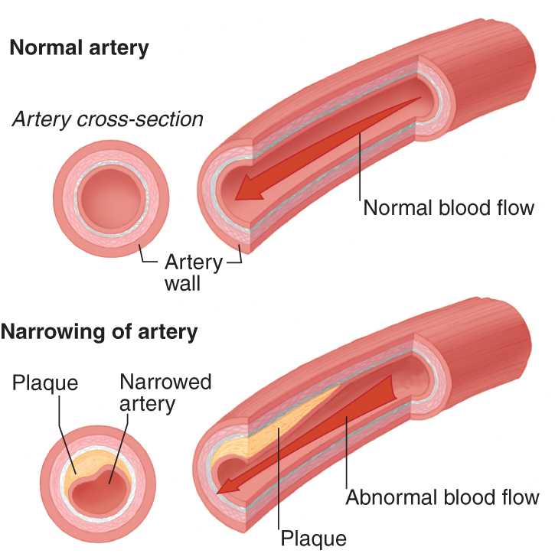
Common Cardiovascular Conditions (1 of 13)
Coronary artery disease (CAD)
Inflammatory or metabolic disease
Atherosclerotic plaque narrows coronary blood vessels
© Jones & Bartlett Learning.
Notes:
Lecture Outline
IV. Common Cardiovascular Conditions
A. Coronary artery disease
1. Coronary artery disease (CAD) is an inflammatory or metabolic disease of the cardiac vasculature in which atherosclerotic plaque builds up in, and ultimately narrows, the coronary blood vessels.
a. Narrowing of the vasculature
b. Pain such as angina
c. Acute myocardial event possible

Slide 18
Common Cardiovascular Conditions (2 of 13)
CAD (cont’d)
Monitor symptoms
Dyspnea on exertion
Chest pain or shortness of breath at rest
Jaw pain
Intermittent nausea
Notes:
Lecture Outline
2. Monitoring
a. When a cardiovascular condition is present or suspected:
i. Perform a thorough history and physical assessment
ii. Use guidelines such as OPQRST (onset, provocation/palliation, quality, region/radiation, severity, timing)
b. Common symptoms of CAD include:
i. Dyspnea on exertion
ii. Chest pain or shortness of breath at rest
iii. Jaw pain
iv. Intermittent nausea

Slide 19
Common Cardiovascular Conditions (3 of 13)
CAD (cont’d)
During physical assessment, evaluate the patient for:
Bruits, murmurs, third heart sounds, basilar rales, peripheral edema, jugular vein distension
Notes:
Lecture Outline
c. During the physical assessment, evaluate the patient for:
i. Bruits
ii. Murmurs
iii. Third heart sounds
iv. Basilar rales
v. Peripheral edema
vi. Jugular vein distention
d. Obtain a 12-lead electrocardiogram (ECG) as part of the baseline assessment and anytime the patient experiences symptoms or events that could be considered cardiac related.
e. Document the patient’s most recent serum lipid profile, or at least the last date it was performed.
i. Remind physician to order updated serum lipid profile or evaluate the efficacy of medications

Slide 20
Common Cardiovascular Conditions (4 of 13)
CAD (cont’d)
Management
Smoking cessation
Lifestyle changes
Dietary habit changes
Medication management
Potential surgical/intervention procedures
Notes:
Lecture Outline
3. Management
a. The primary goals when managing CAD are to:
i. Identify the risk of unstable angina or an acute myocardial infarction
ii. Improve the quality of overall functional capacity limiting the patient’s capabilities
b. The treatment modalities for CAD include:
i. Smoking cessation
ii. Lifestyle changes
iii. Dietary habit changes
iv. Medication management
v. Potential surgical/intervention procedures (ie, placement of stents and removal of the plaque)
c. The community paramedic should determine the patient’s specific dietary needs from the plan of care.
d. Medications used to manage CAD include:
i. Antiplatelet agents
ii. β-blockers (beta-blockers)
iii. Lipid-lowering agents
iv. Angiotensin-converting enzyme (ACE) inhibitors
e. Long-term monitoring of these patients should focus on:
i. Documenting compliance with the treatment regimen
ii. Vital signs
iii. Changes in overall symptoms and ability to carry out activities of daily living (ADLs)
f. Obtain a baseline ECG during the enrollment visit for all patients who have a known diagnosis of cardiovascular disease and a secondary one for those exhibiting symptoms.
g. Follow local protocols.

Slide 21
Common Cardiovascular Conditions (5 of 13)
CAD (cont’d)
Education should focus on the generalized definition and causes of the disease, such as:
Poor dietary habits
Sedentary lifestyle
Undesirable cholesterol levels
Notes:
Lecture Outline
4. Education
a. Education related to CAD should focus on the generalized definition and causes of this disease, such as:
i. Poor dietary habits
ii. Sedentary lifestyle
iii. Undesirable cholesterol levels
b. If the patient’s health literacy level is high, discuss how the body processes fatty deposits, plaque buildup, and laboratory tests such as a full serum lipid profile.

Slide 22
Common Cardiovascular Conditions (6 of 13)
Congestive heart failure (CHF)
Cardiac condition in which ventricles are unable to pump enough to maintain adequate circulation
Secondary to systolic, diastolic, or right-sided heart dysfunction
Notes:
Lecture Outline
B. Congestive heart failure
1. Congestive heart failure (CHF) is a cardiac condition in which the ventricles are unable to pump effectively enough to maintain adequate circulation to the rest of the body.
a. According to the American Heart Association (AHA), more than 650,000 cases of CHF are diagnosed in the United States each year.
b. CHF can occur secondary to either systolic, diastolic, or right-sided heart dysfunction.
c. CHF is very complex and affects multiple organ systems.

Slide 23
Common Cardiovascular Conditions (7 of 13)
CHF (cont’d)
Risk factors for this condition include:
Diabetes
Hypertension
Metabolic syndromes
Atherosclerotic disease
Obesity
Myocardial infarction
Viral infections
Notes:
Lecture Outline
d. Risk factors for this condition include diabetes, hypertension, metabolic syndromes, atherosclerotic disease, obesity, myocardial infarction, and viral infections.
e. To establish a diagnosis of CHF, the patient’s primary care physician assesses the patient’s risk and symptoms, and performs diagnostic tests.
i. Two-dimensional echocardiogram
ii. Measurement of B-type natriuretic peptide
iii. Comprehensive metabolic panel
2. The American College of Cardiology Foundation has established four stages of CHF:
a. Stage A. At high risk for heart failure but without structural heart disease or symptoms of heart failure
b. Stage B. Structural heart disease but without signs or symptoms of heart failure
c. Stage C. Structural heart disease with prior or current symptoms of heart failure
d. Stage D. Refractory heart failure requiring specialized interventions
3. Once the patient’s primary care physician has established the patient’s stage, the patient’s condition is then classified according to the New York Heart Association’s functional capacity guidelines (Classes I, II, III, and IV).
4. The community paramedic should document the classification during:
a. The enrollment and end-of-care visits to evaluate the efficacy of the treatments provided
b. At each visit to determine whether there are differences in symptoms or exacerbation with physical activity

Slide 24
Common Cardiovascular Conditions (8 of 13)
CHF (cont’d)
Monitoring and management
Confirm primary manager with medical director
Evaluate treatment goals designated per the plan of care
Notes:
Lecture Outline
5. Monitoring and management
a. To help manage patients, the primary manager of the patient’s condition is established before the patient is enrolled in the community paramedicine program.
6. In the early stages of CHF, the primary care physician may treat the patient; in the later stages, a cardiologist and a nephrologist may control all aspects of treatment.
7. Once you have confirmed the primary manager with the medical director, evaluate the treatment goals designated by that physician per the plan of care.
8. Considerations include:
a. What is the goal “dry” or optimal weight for this patient?
b. Is there a diuresis protocol that the community paramedic should follow?
c. Are there any dietary and fluid restrictions that the patient must adhere to?
d. Has the physician established a “threshold of exacerbation” weight?
9. The threshold of exacerbation is the weight level at which a patient begins to have symptoms of exacerbation.
a. Some patients with CHF have their symptoms worsen when they gain 2 to 3 pounds; others can gain 20 pounds before they experience exacerbation.
b. Once you confirm the dry or optimal weight per the plan of care, you will be able to evaluate the threshold of exacerbation.
10. Medications that are commonly prescribed for systolic heart failure include:
a. ACE inhibitors
b. Angiotensin receptor blockers (ARBs) for those patients who cannot tolerate ACE inhibitors
c. β-blockers
d. Diuretics
e. Digitalis glycosides for patients with atrial fibrillation

Slide 25
Common Cardiovascular Conditions (9 of 13)
CHF (cont’d)
Education
Many resources are available online from the American Heart Association (AHA) and hospitals.
Stoplight action plan: classify symptoms as red, yellow, or green
Notes:
Lecture Outline
11. Education
a. Patient education related to CHF is essential for a patient to manage his or her symptoms.
b. Many resources to increase understanding of this disease are found online from the AHA and at local hospitals.
c. Stoplight action plan uses traffic lights as a metaphor to classify symptoms as red, yellow, or green.
i. Patients evaluate if it is time to call their primary care physicians if the patient is in the yellow zone to prevent symptoms from progressing to red zone (worsened dyspnea, edema, or weight gain).

Slide 26
Common Cardiovascular Conditions (10 of 13)
Hypertension
Systolic blood pressure greater than 140 mm Hg
Diastolic pressure greater than 90 mm Hg
Can stem from:
Cardiovascular, renal, hepatic, neurologic diseases
Notes:
Lecture Outline
C. Hypertension
1. Hypertension is defined as a chronic:
a. Systolic blood pressure greater than 140 mm Hg
b. Diastolic pressure greater than 90 mm Hg
2. Hypertension may stem from:
a. Cardiovascular disease
b. Renal disease
c. Hepatic disease
d. Neurologic disease
e. Secondary to a genetic or structural abnormality
3. According to the AHA, almost 80 million people (1 out of every 3) in the United States had hypertension in 2015.
4. Appropriate blood pressure monitoring is done:
a. When the patient has been at rest for 5 minutes in a seated position
b. Using an appropriately sized cuff; either a manual or an automatic cuff
i. Automatic blood pressure devices found at local stores may not be accurate.
5. Hypertension affects all the organs and systems throughout the body.
a. Elevated blood pressure can cause damage to organs and blood vessels.

Slide 27
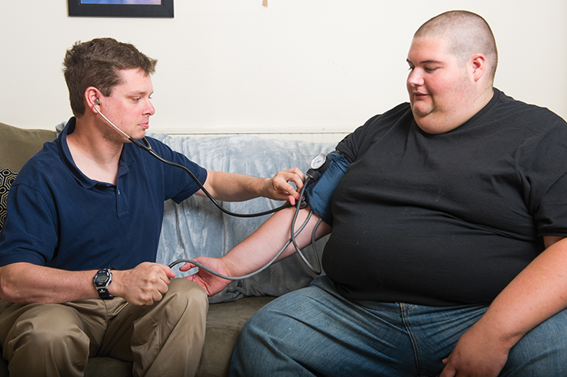
Common Cardiovascular Conditions (11 of 13)
Hypertension (cont’d)
Monitoring
Obtain full set of vital signs
Measure blood pressure on both arms
© Jones & Bartlett Learning.
Notes:
Lecture Outline
6. Monitoring
a. During each visit with the patient, it is important to obtain a full set of vital signs.
b. Blood pressure monitoring must be performed, with measurements taken on both arms during each visit.
c. Document findings in medical record or patient binder; look for trends.
d. If you notice a change, contact the medical director to determine the patient’s next steps.
e. The patient’s primary care physician will be treating this condition, but sometimes the cardiologist may manage all of the patient’s cardiac care.

Slide 28
Common Cardiovascular Conditions (12 of 13)
Hypertension (cont’d)
Management
Follow plan of care and ensure compliance with:
Medications
Diet
Exercise plans
Notes:
Lecture Outline
7. Management
a. To help manage patients with hypertension, you should follow the patient’s plan of care and ensure compliance with:
i. Medications
ii. Diet
iii. Exercise plans
b. Standard management of hypertension includes lifestyle modifications and antihypertensive medications.
8. A wide variety of antihypertensive medications are available, and patients may be on either single or combination therapies.
9. Common medication classes used to treat hypertension include:
a. ACE inhibitors
b. Calcium-channel blockers
c. Thiazide diuretics
d. ARBs
e. β-blockers
f. Loop diuretics
g. Aldosterone antagonists
h. α₁-blockers
i. Centrally acting agents
j. Direct vasodilators
k. Postganglionic neural inhibitors
l. Direct renin inhibitors

Slide 29
Common Cardiovascular Conditions (13 of 13)
Hypertension (cont’d)
Education
Dietary changes, exercise, reduction in alcohol consumption
Teach patient to take blood pressure readings
Goal blood pressure with medication
Notes:
Lecture Outline
10. Education
a. Education should focus first on dietary changes, exercise, and reduction in alcohol consumption.
b. Help the patient learn how to take blood pressure readings.
c. Patients also need to understand what their goal blood pressure is, as determined by their primary care physicians.

Slide 30
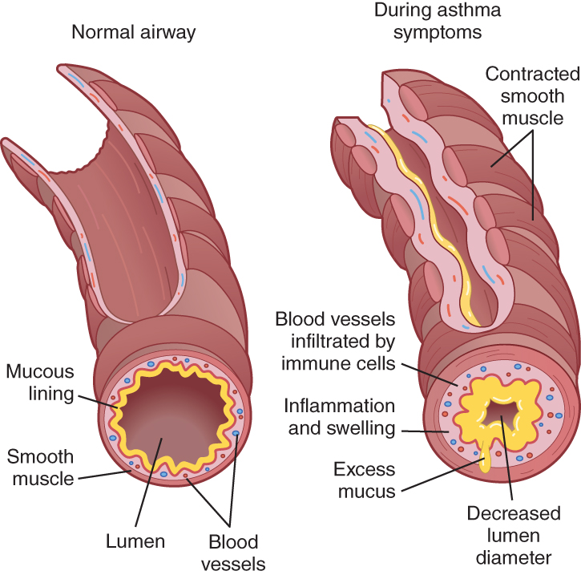
Common Respiratory Conditions (1 of 10)
Asthma
Chronic inflammatory process
Reduces size of airway
Limits airflow to bronchioles
© Jones & Bartlett Learning.
Notes:
Lecture Outline
V. Common Respiratory Conditions
A. Asthma
1. Asthma is defined as a chronic inflammatory process involving the lower airways and associated with excessive mucus production and swelling of the bronchioles.
2. It is causally associated with to an increase in reactivity (hyper-reactivity), which variably:
a. Reduces the size of the airway
b. Limits airflow to the bronchioles
3. To limit their complications, which could sometimes have fatal outcomes, patients must adhere to the guidelines established by their plan of care, such as:
a. Eliminating allergens
b. Maintaining medication compliance
c. Reducing exacerbating factors
4. According to the Centers for Disease Control and Prevention (CDC), more than 18.7 million US adults had diagnosed asthma in 2010, 7 million of whom were children.
a. From 2001 to 2010, there was a steady increase in:
i. The number of patients diagnosed
ii. The number of primary care visits
iii. The number of emergency department visits and hospitalizations secondary to an asthma diagnosis or exacerbation
b. The number of asthma-related deaths declined 3.3% every year in the United States over the same 10-year period thanks to:
i. Increased knowledge about asthma
ii. Better medications
iii. Overall management in the primary care setting
c. The CDC has also identified predictors of death, such as:
i. Overuse of β-agonists
ii. Multiple hospitalizations
iii. Intubation secondary to asthma
iv. Lack of (or lack of adherence to) a plan of care
v. Presence of comorbidities such as cardiovascular disease

Slide 31
Common Respiratory Conditions (2 of 10)
Asthma (cont’d)
Patients may present with:
Expiratory wheezing
Coughing
Generalized shortness of breath
Notes:
Lecture Outline
5. Asthma is diagnosed through a combination of history and physical findings.
6. Patients may present with:
a. Expiratory wheezing
b. Coughing
Generalized shortness of breath
7. When evaluating the patient’s history, investigate precipitating factors such as:
a. Allergens
b. Irritants
c. Humidity
d. Exercise

Slide 32
Common Respiratory Conditions (3 of 10)
Asthma (cont’d)
Monitoring
Do a thorough examination of the patient’s respiratory system and the environment.
Effective monitoring and thorough assessments will decrease need for aggressive treatment.
Notes:
Lecture Outline
8. Monitoring
a. During each home visit with a patient who has asthma, it is important to do a thorough examination of the patient’s respiratory system and the environment.
9. If the patient presents with exacerbating factors that are not relieved by the standard EMS treatment or by the parameters that the primary care physician has set, then it is essential to initiate aggressive airway management such as:
a. Short-acting bronchodilators via nebulized treatment
b. Intravenous (IV) corticosteroids
c. Continuous positive airway pressure (CPAP)
d. Intubation
10. Effective monitoring and thorough assessments will most likely decrease the need for aggressive treatment.

Slide 33
Common Respiratory Conditions (4 of 10)
Asthma (cont’d)
Management
Control factors that contribute to severity (allergens, irritants)
Monitor respiratory status with objective measures of lung function
Use pharmacologic therapy
Provide education for a partnership
Notes:
Lecture Outline
11. The National Institutes of Health has published guidelines and an example of a plan of care for asthma. The guidelines are:
a. Control factors that contribute to asthma severity (such as allergens and irritants) to improve baseline respiratory status and decrease the frequency of exacerbations.
b. Monitor respiratory status with objective measures of lung function for diagnosis, for classification of severity, and to assess response to treatment.
c. Use pharmacologic therapy to address the inflammatory nature of asthma.
d. Provide education for a partnership in asthma care, so that the patient and family understand the disease well enough to be motivated to make changes, use medications wisely, and work collaboratively with the physician.
12. By following these guidelines, the community paramedic can help the patient understand and manage the disease effectively.
13. A wide variety of medications are used to manage asthma. They include:
a. Inhaled corticosteroids
b. Leukotriene antagonists
c. Long-acting β₂-agonists
d. Mast cell stabilizers
e. Methylxanthines
f. Anti-immunoglobulin E (anti-IgE)
g. Short-acting β₂-agonists
h. Anticholinergics
14. The community paramedic needs to ensure that he or she understands the indications and properties of each class of medications, as it is common to encounter patients on multiple medications for chronic asthma.

Slide 34
Common Respiratory Conditions (5 of 10)
Asthma (cont’d)
Education
Establish goals based on plan of care
Educate patient on implementing a self-monitoring system or stoplight action plan
Notes:
Lecture Outline
15. Education
a. Patient education and understanding are essential to effective home management of the patient with asthma.
b. You should:
i. Try to understand the nature of the disease
ii. Understand the exacerbating factors
iii. Work with the patient to establish goals based on the plan of care
c. Based on local protocols, educate the patient on implementing a self-monitoring system or stoplight action plan.
i. Green zone: Patient is not experiencing symptoms
ii. Yellow zone: Patient begins to have mild exacerbation
iii. Red zone: Patients encounter emergency paramedics during acute care calls

Slide 35
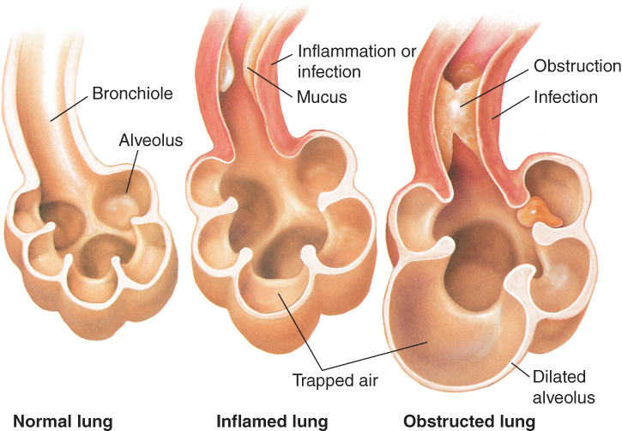
Common Respiratory Conditions (6 of 10)
Chronic obstructive pulmonary disease (COPD)
Chronic inflammation
Obstruction of the pulmonary tract
© Jones & Bartlett Learning.
Notes:
Lecture Outline
B. Chronic obstructive pulmonary disease
Chronic obstructive pulmonary disease (COPD) is characterized by chronic inflammation and obstruction of the pulmonary tract.
a. The intrathoracic or inferior airway becomes blocked at the lobar bronchi, segmental bronchi, and ultimately the terminal bronchioles, including the alveolar ducts and alveolar sacs.
2. COPD is a progressive illness; it is irreversible and incurable.

Slide 36
Common Respiratory Conditions (7 of 10)
COPD (cont’d)
Disease progresses slowly
Patients may not recognize worsening condition until breathing difficulty.
Third leading cause of death in the United States
15 million Americans diagnosed
Notes:
Lecture Outline
3. The primary cause of COPD is smoking, although chronic bronchitis, air pollution, and asthma may also lead to its development.
4. COPD progresses very slowly, so that many patients do not recognize the effects of their worsening conditions until they experience difficulty breathing.
5. According to the CDC, chronic lower respiratory disease is the third leading cause of death in the United States, with as many as 15 million Americans having been diagnosed with such disease.
6. Many comorbidities exist with COPD, such as:
a. CAD
b. Asthma
c. CHF
d. Pulmonary vascular diseases
7. Comorbidities present a challenge to the community paramedic in:
a. Differentiating the cause of the exacerbation
b. Making the determination of treatment plans

Slide 37
Common Respiratory Conditions (8 of 10)
COPD (cont’d)
Monitoring
Perform full physical examination; pay close attention to respiratory system
Evaluate the patient’s “workload” (work of breathing) and lung sounds
Evaluate causes of change in status
Notes:
Lecture Outline
8. Monitoring
a. Patients with COPD sometimes have exacerbations quickly over a few hours; others have a significant event that evolves over the course until serious enough to warrant treatment.
b. Perform a full physical examination; pay close attention to the respiratory system.
c. Evaluate the patient’s “workload” (ie, work of breathing).
i. Evaluate the patient’s normal work of breathing and status prior to first visit with patient.
d. When evaluating the work of breathing and lung sounds, you will want to evaluate the causes of the change in status.
i. Patient’s underlying condition informs the interpretation of current problems
e. The key to success when managing a patient with COPD is:
i. Understanding what the patient’s normal is
ii. Following the plan of care
iii. Working with the health care team to identify and prioritize treatment goals

Slide 38
Common Respiratory Conditions (9 of 10)
COPD (cont’d)
Management
Follow patient’s plan of care
Identify exacerbations early
Intervene at an early stage; prevent progression
Help the patient understand the need for smoking cessation
Notes:
Lecture Outline
9. Management
a. To help manage patients with COPD, you should follow the patient’s plan of care.
b. The difference with the community paramedic role (as opposed to traditional paramedic) is that you will need to:
i. Identify exacerbations early
ii. Intervene at an early stage and prevent significant exacerbations
c. Management of COPD is very similar to asthma, including the goal of stopping the progression of the disease if possible.
d. Given that smoking is the primary cause of COPD, a key role for the community paramedic is to help the patient understand the need for smoking cessation.
e. Some patients with COPD require extensive workups beyond spirometry, which may include:
i. Referral to a pulmonologist by the primary care physician
ii. Incentive spirometry
iii. Home oxygen supply
iv. Other breathing devices as required

Slide 39
Common Respiratory Conditions (10 of 10)
COPD (cont’d)
Education
Tailor to the patient’s health literacy level
Discuss symptoms and experiences patient has had in the past; ways to manage yellow zone symptoms
Notes:
Lecture Outline
10. Education
a. Education for COPD should be tailored to the patient’s health literacy level.
b. Discuss the symptoms and experiences the patient has encountered in the past; suggest ways to lessen or manage yellow zone symptoms.

Slide 40
Common Gastrointestinal Conditions (1 of 9)
Constipation
Inability to produce stool 3 or more times in a 7-day time frame
Factors that influence constipation:
Stress
Travel
Pregnancy
Aging
Notes:
Lecture Outline
VI. Common Gastrointestinal Conditions
A. Constipation
1. Constipation is the inability to produce stool three or more times in a 7-day time frame, with the hardening of the stool requiring significant effort (straining) or painful discharge to eliminate.
a. Chronic constipation is the inability to produce three or more stools or poor stool output in a 7-day time frame over 3 to 6 months’ duration or longer.
b. Frequent constipation can also be considered chronic, referring to patients who experience periods of constipation once a month or more often.
2. Complications from constipation may include:
a. Hemorrhoids
b. Anal fissures
c. Rectal prolapse
d. Fecal impaction
e. Diverticulitis
f. Diverticulosis
3. Constipation is very common, affecting as many as 42 million people in the United States each year.
4. Many factors can influence the incidence of constipation, such as:
a. Stress
b. Travel
c. Pregnancy
d. Aging
5. It is important for everyone to recognize and assess his or her weekly stool production.
6. The community paramedic is responsible for:
a. Helping patients recognize their symptoms early
b. Identifying any red flags immediately to prevent further complications
7. Early detection and prevention of further symptoms are key to a patient-centered outcome.

Slide 41
Common Gastrointestinal Conditions (2 of 9)
Constipation (cont’d)
Monitoring
Speak with your patients about their normal passage of stool and ask questions.
“How often do you have a stool?”
“Can you describe the stool for me?”
Notes:
Lecture Outline
8. Monitoring
a. Speak with your patients about their normal passage of stool by asking questions such as the following:
i. How often do you have a stool?
ii. Can you describe the stool for me?
iii. Do you have any concerns about the amount of stool you pass in a weekly period?
b. When the patient answers, it may be helpful to describe the various stool types by using a tool such as the Bristol Stool Scale.

Slide 42
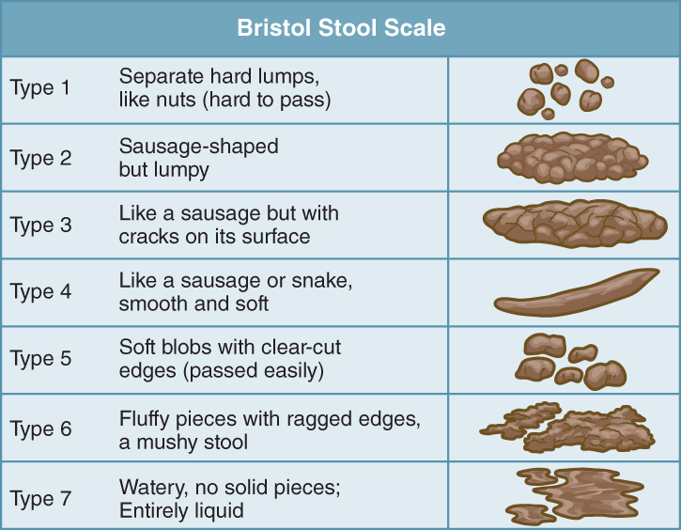
Common Gastrointestinal Conditions (3 of 9)
Constipation (cont’d)
Talk of frequency, consistency, straining
Use Bristol Stool Scale
Data from Lewis SJ, Heaton KW. Stool form scale as a useful guide to intestinal
transit time.Scand J Gastroenterol. 1997;32(9):920-924.
Notes:
Lecture Outline
9. When a patient complains of abdominal discomfort or change in stool habits, you should discuss the specifics associated with the stool:
a. Frequency
b. Consistency
c. Discomfort
d. Straining
e. Bleeding
10. Red flags to watch for include:
a. Severe pain with discharge of stool
b. Bleeding (hematochezia)
c. Significant change in odor that is persistent
d. Bloating
e. Rapid and persistent diarrhea
11. Risk factors include:
a. Sudden weight loss of more than 10 pounds (4.5 kg)
b. Anemia
c. Family history of gastrointestinal cancers or bowel disorders
d. Need to manually remove the stool
e. Age greater than 50 years

Slide 43
Common Gastrointestinal Conditions (4 of 9)
Constipation (cont’d)
Management
Focuses on primary cause of this condition, such as dehydration, and use of:
Opioids, antacids, anticholinergics, calcium-channel blockers, iron supplements
More fruits, vegetables, fiber
Notes:
Lecture Outline
12. Management
a. The management of constipation generally focuses on primary causes of this condition, such as dehydration and use of:
i. Opioids
ii. Antacids
iii. Anticholinergics
iv. Anticonvulsants
v. Antispasmodics
vi. Calcium-channel blockers
vii. Diuretics
viii. Iron supplements
ix. Narcotics
b. Patients who take these medications will need to:
i. Ensure appropriate hydration by eating more fruits and vegetables
ii. Add more fiber to their diet
c. Physicians attempt to treat this condition with the least invasive method possible, such as by addressing factors related to diet, fluid intake, and exercise.
i. “Mobility equals motility”
d. When the patient’s constipation is not remedied with these measures, the primary care physician may discuss types of OTC to reduce constipation, such as:
i. Bulk-forming agents, such as fiber
ii. Osmotic agents
iii. Stool softeners
iv. Lubricants
v. Stimulants (eg, caffeine)
vi. Prescription medications (eg, chloride-channel activators; guanylate cyclase-C)

Slide 44
Common Gastrointestinal Conditions (5 of 9)
Constipation (cont’d)
Education
Geared toward cause of the condition
Encourage patient to talk about any abnormality he or she encounters
Help patient understand the importance of prevention
Notes:
Lecture Outline
13. Education
a. Education of a patient with constipation needs to be geared toward the cause of that condition.
b. After a patient assessment, identify some of the potential causes.
c. Most of the time constipation is an acute event not requiring further medical intervention.
d. Talk to your patient and encourage him or her to talk about any abnormality he or she encounters.
e. Help the patient understand the importance of prevention to avoid complications in the future.

Slide 45
Common Gastrointestinal Conditions (6 of 9)
Diarrhea
Significant change or alteration in bowel habits, characterized by:
Increased frequency
Decreased consistency
Increased volume of stool
Can be acute or chronic
Notes:
Lecture Outline
B. Diarrhea
1. Diarrhea is defined as a significant change or alteration in bowel habits, characterized by:
a. Increased frequency
b. Decreased consistency
c. Increased volume of stool (sometimes)
2. Diarrhea is further defined as acute or chronic.
a. Acute: Sudden change in bowel habits lasting less than 14 days; generally has an infectious cause
b. Chronic or intermittent: Considered as an alteration (commonly increased frequency rather than quantity) in bowel habits that lasts for more than a month
3. Chronic diarrhea is further classified as:
a. Secretory
b. Osmotic
c. Fatty
d. Inflammatory
4. Chronic diarrhea is known to significantly impact ADLs for affected people and can ultimately cause a significant decline in status.
a. Labeled a global burden by the CDC and World Health Organization
b. Causes 1 out of every 9 deaths among children; second leading cause of death among children
c. Chronic diarrhea affects 3% to 5% of the US population, putting a significant strain on both individuals and the overall workforce.

Slide 46
Common Gastrointestinal Conditions (7 of 9)
Diarrhea (cont’d)
Monitoring
Most cases are acute and viral or bacterial in origin
People at risk for dehydration can develop complications even at early stages.
Notes:
Lecture Outline
5. Monitoring
a. Most cases of diarrhea are acute and either viral or bacterial in origin; people at risk for dehydration can develop complications even in early stages of acute or chronic diarrhea.
b. As a community paramedic, it is important to establish what is normal for the patient.
6. Red flags for patients with acute or chronic diarrhea include sudden changes such as:
a. Watery discharge
b. Bleeding
c. Extremely foul change in smell and composition

Slide 47
Common Gastrointestinal Conditions (8 of 9)
Diarrhea (cont’d)
Management
Focuses on removing the cause
Patients usually require only supportive treatment, such as supplementation of electrolytes and hydration.
Notes:
Lecture Outline
7. Management
a. Treatment primarily focuses on removing the cause; the preferred approach is to:
i. Ensure adequate adsorption of nutrients
ii. Restore appropriate intestinal structure and function
b. In most cases, patients require only supportive treatment, such as:
i. Electrolyte supplementation
ii. Hydration supplementation
c. Patients with chronic diarrhea may require long-term supportive treatment with electrolyte management, along with OTC medications such as:
i. Loperamide (an antimotility drug)
ii. Bismuth subsalicylate
d. Prescription medications such as antispasmodics and 5-HT₃ agonists are commonly administered to control noninfectious diarrhea.
e. When the diarrhea has an infectious cause, many different forms of antibiotics may be prescribed, such as ciprofloxacin, azithromycin, erythromycin, doxycycline, and metronidazole.
f. Regardless of the treatment and management regimen selected, this condition can easily spin out of control—especially in:
i. Older patients
ii. People with significant medical comorbidities
iii. Children
g. The community paramedic should perform simple assessment techniques such as:
i. Evaluating skin turgor
ii. Performing an ECG
iii. Electrolyte monitoring (if local protocols permit)

Slide 48
Common Gastrointestinal Conditions (9 of 9)
Diarrhea (cont’d)
Education
Discuss aspects of each stool; help patients understand normal
Explain how to identify abnormalities
Encourage patients to start a stool log
Notes:
Lecture Outline
8. Education
a. Due to the significant differences in types of diarrhea, it is important to:
i. Discuss the aspects of each stool; help patients understand normal
ii. Explain how to identify abnormalities
iii. Emphasize that they should not be concerned with occasional mild abnormalities
iv. Encourage patients to start a stool log
b. Some patients with chronic diarrhea may encounter significant life complications such as the inability to work and perform ADLs.
i. Apply a depression screening scale
ii. Recommend appropriate psychological treatment

Slide 49
Common Genitourinary Conditions (1 of 11)
Dysuria
Change in urine production or volume that is associated with the bladder or urethra
Most common cause: a urinary tract infection (UTI)
Can also occur secondary to a structural change
Notes:
Lecture Outline
VII. Common Genitourinary Conditions
A. Dysuria
1. Dysuria is a change in urine production or volume that is associated with the urinary bladder or urethra.
a. Normal urine production is roughly 1 to 2 quarts (1 to 2 L) a day for most healthy adults.
2. The most common cause of dysuria is urinary tract infection (UTI); however, it can also occur secondary to a structural change, such as:
a. Vaginal atrophy in postmenopausal women
b. Sexually transmitted infections
c. Prostatitis or urethritis in men

Slide 50
Common Genitourinary Conditions (2 of 11)
Dysuria (cont’d)
UTI: inflammation of the urinary tract that causes:
Pain
Discomfort
Complete urinary tract blockage (sometimes)
Notes:
Lecture Outline
3. Urinary tract infection is an inflammation of the urinary tract that causes:
a. Pain
b. Discomfort
c. Complete urinary tract blockage (sometimes)
4. According to the CDC, UTIs are the most common health care-associated infection, and catheter-associated UTIs are the most common nosocomial (hospital- or health care-acquired) infection.
a. An estimated 75% of these infections are associated with urinary catheters, and as many as 25% of hospitalized patients receive urinary catheters.
b. Infection is the most common cause of acute or subacute altered mentation in older adults, and such infection is often associated with or begins in the urinary tract.

Slide 51
Common Genitourinary Conditions (3 of 11)
Dysuria (cont’d)
Monitoring
Evaluate patient to determine if this is:
A change in production (associated with kidney disease)
A urinary tract change
Perform in-depth assessment
Notes:
Lecture Outline
5. Monitoring
a. When assessing a patient with change in urine production, the community paramedic will need to evaluate if this is:
i. A change in production (eg, associated with kidney disease)
ii. A urinary tract change
b. This distinction can be made by performing an in-depth assessment of the patient’s symptoms. Ask questions such as the following:
i. How many times do you urinate each day?
ii. Have you had any discomfort, discharge, or change in urination recently?
6. Identifying the cause at an early stage is critical: the earlier an infection is caught, the more likely it can be treated with a noninvasive antibiotic or treatment modality.
7. As with all infections, it is important to fully assess each aspect of the symptoms and document them in detail.
a. After reviewing the results of a follow-up visit physical examination, the medical director may refer the patient to the primary care physician to see the patient for further evaluation or to perform lab tests.

Slide 52
Common Genitourinary Conditions (4 of 11)
Dysuria (cont’d)
Management
UTIs generally do not cause complications beyond a week.
Focuses on hydration, frequent urination
Notes:
Lecture Outline
8. Management
a. Management of a patient with UTI requires:
i. Performing a patient assessment
ii. Ensuring the patient receives education on how to prevent infections
b. Depending on local protocols, the medical director or the primary care physician will monitor the patient’s symptoms and provide appropriate medications and supplements.
c. As UTIs generally do not create complications beyond a week, management of women with acute uncomplicated lower tract infections may focus on:
i. Hydration
ii. Frequent urination
d. With acute pyelonephritis (kidney infection) in women, management is geared toward appropriate hydration with water.
i. Complications rarely last beyond a week
ii. Some require antibiotics
iii. Follow local protocols
e. Should these types of infections become a chronic issue:
i. Discuss the potential causes
ii. Patient will work with the primary care physician to decrease the likelihood that the infection will spread.
f. Men with UTIs require a more extensive evaluation and sometimes have more complicated symptoms secondary to the anatomic differences in the male urinary tract.
g. With all patients, but specifically with older adults, it is very important to look for key indications that the infection has spread, such as:
i. Tachycardia
ii. Altered mentation
iii. Tachypnea
iv. Fever
v. Dizziness
h. Patients whose symptoms have not improved or have worsened may require more aggressive treatment, such as IV antibiotics.

Slide 53
Common Genitourinary Conditions (5 of 11)
Dysuria (cont’d)
Education
Focuses on preventative measures, such as hydration, appropriate hygiene
Some patients may feel uncomfortable speaking with community paramedics of different genders.
Notes:
Lecture Outline
9. Education
a. Education surrounding all infections of the urinary tract should focus on preventive management measures, such as:
i. Hydration
ii. Appropriate hygiene
b. Be aware that some patients feel uncomfortable speaking with community paramedics of different genders about urination-related issues, so be sensitive to the patient’s needs.
i. Try to have a community paramedic of the same gender present during the evaluation or available to provide the education.

Slide 54
Common Genitourinary Conditions (6 of 11)
Kidney disease/failure
Decrease in function or failure of the kidneys to filter waste and excess fluid
Acute kidney failure can occur secondary to:
Ischemic issues
Over-diuresis
Pyelonephritis
Infectious causes
Can also be chronic
Notes:
Lecture Outline
B. Kidney disease/failure
1. Kidney disease is defined as a decrease in function or failure of the kidneys to filter waste and excess fluid that is secreted in urine.
a. Disease evolves over time
b. Considered a chronic condition
2. Kidney failure is total inability to produce or filter urine.
3. Acute kidney failure can occur secondary to:
a. Ischemic issues
b. Over-diuresis
c. Pyelonephritis
d. Infectious causes
4. Chronic kidney disease affects many people—more than 10% of the global population and more than half of all older adults.
a. In the United States, more than 26 million adults are believed to have chronic kidney disease.
b. The most prevalent causes of chronic kidney disease include hypertension, hyperlipidemia, diabetes, and cardiovascular disease.
5. The kidneys regulate both volume and electrolyte status in the body.
a. Chronic kidney disease can cause significant complications such as inability to maintain adequate euvolemia (fluid balance) or hyperkalemia.
b. As with all medical conditions, it is important to:
i. Evaluate
ii. Treat
iii. Prevent further damage
c. Often chronic kidney disease is not diagnosed until an advanced stage and sometimes not until full failure exists.

Slide 55
Common Genitourinary Conditions (7 of 11)
Kidney disease/failure (cont’d)
Renal disease is classified into 5 stages; glomerular filtration rate (GFR) is most common way to determine stage.
Blood urea nitrogen (BUN)
Another test of renal function
Notes:
Lecture Outline
6. Stages of kidney disease
a. Renal disease is classified into 5 stages, and the glomerular filtration rate (GFR) is the most common way to determine the stage of kidney disease.
i. The GFR measures the amount of blood that passes through each glomerulus during 1 minute.
ii. The glomeruli are filters of the kidneys; that is, they are responsible for eliminating/filtering out waste from the blood.
7. Creatinine: primary chemical waste molecule produced by muscle metabolism
a. Good indicator of kidney function, although its level differs in men versus women
b. Normal readings are usually in the range of 0.7 to 1.3 mg/dL for men and 0.6 to 1.1 mg/dL for women.
c. Establish the normal lab value for each patient prior to the enrollment visit if possible.
8. Blood urea nitrogen (BUN) is another test whose result is an indicator of renal function.
a. The amount of urea nitrogen in the blood can vary, but usually falls within the range of 6 to 20 mg/dL.

Slide 56
Common Genitourinary Conditions (8 of 11)
Kidney disease/failure (cont’d)
Monitoring
Establish the patient’s normal BUN, serum creatinine, GFR
Diuretics
End-stage renal disease: dialysis, renal transplant
Notes:
Lecture Outline
9. Monitoring
a. When treating patients who have kidney disease, who require diuretics, or who have significant risk for kidney disease, the community paramedic should (per the plan of care) establish the patient’s:
i. Normal BUN
ii. Serum creatinine
iii. GFR
10. Diuretics will have a significant impact on GFR.
a. At low doses, they can have positive effects; however, they may occasionally have negative effects, such as causing acute renal failure or increasing the stage of renal failure.
11. End-stage renal failure is common and must be treated with:
a. Dialysis
b. Renal transplant

Slide 57
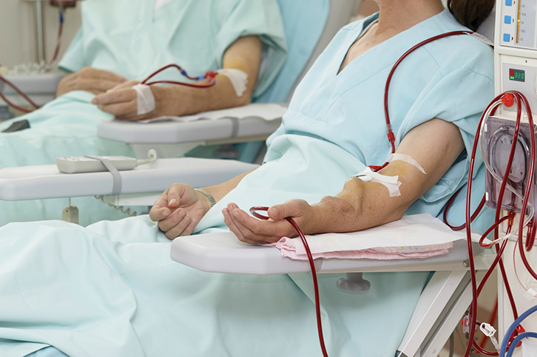
Common Genitourinary Conditions (9 of 11)
Kidney disease/failure (cont’d)
Dialysis
Two types:
Hemodialysis
Peritoneal dialysis
© Picsfive/Shutterstock.
Notes:
Lecture Outline
12. Dialysis is the artificial or mechanical filtration of blood via machine.
a. There are two types of dialysis: hemodialysis and peritoneal dialysis.
13. Hemodialysis is the mechanical filtering of blood to remove waste and maintain appropriate electrolyte values by IV implanted devices.
a. Procedure generally performed in a dialysis center with qualified medical personnel
b. Takes about 4 hours to complete
c. Patients require placement of an arteriovenous (AV) fistula, AV graft, or central venous catheter.
14. Peritoneal dialysis allows the body to filter the blood more naturally.
a. In this technique, the peritoneal cavity is filled with dialysate through a surgically implanted device.
b. The blood is then filtered by the arteries that line the abdominal cavity, and the dialysate draws the waste out of the blood, allowing it to be filtered out into the machine.

Slide 58
Common Genitourinary Conditions (10 of 11)
Kidney disease/failure (cont’d)
Management
Diligent monitoring of urine production
Management of comorbid disease(s)
Close monitoring of GFR
Determine the patient’s normal lab values and urine production per the plan of care
Notes:
Lecture Outline
15. Management of chronic kidney disease requires:
a. Diligent monitoring of urine production
b. Management of comorbid disease(s)
c. Close monitoring of GFR
16. Good practice is to determine the patient’s normal lab values and urine production per the plan of care.
a. This baseline will help you interpret any subsequent variations in these parameters.
b. Verify with the plan of care any specific restrictions that the patient may have.
17. Some common diet limitations in patients with chronic kidney disease are:
a. Limiting total fluid intake to 1,500 to 2,000 mL/day
b. Eating less protein in the latter stages of the disease
c. Restricting sodium to 2,000 mg/day
d. Ensuring that the patient has a sufficient caloric intake to prevent drastic weight loss
18. Loss of valuable electrolytes is common for a patient when he or she has renal disease—specifically sodium, potassium, and calcium.
a. The patient’s electrolyte levels will be monitored via lab tests.

Slide 59
Common Genitourinary Conditions (11 of 11)
Kidney disease/failure (cont’d)
Education
Focuses on the patient’s comorbidities and issues stemming from the disease
Help the patient understand symptoms
Consult with medical director on patient’s questions about special diets, medications, supplements
Notes:
Lecture Outline
19. Education
a. Education related to chronic kidney disease should focus on the patient’s comorbidities as well as the issues stemming from the kidney disease.
b. Help the patient understand the worrisome symptoms associated with kidney disease, such as:
i. Slow or sudden decrease in urine production
ii. Rapid weight gain
iii. General fatigue and dyspnea on exertion
iv. Muscle cramping
v. Frequent urination, especially at night
c. Consult with the medical director on patient questions about special diets and OTC medications, vitamins, herbs, and supplements.
d. Dialysis will not cure kidney disease; rather, it is simply a replacement for the normal kidney function.
i. Many times patients must be on dialysis for the rest of their lives.
ii. In cases of acute kidney injury/failure, some hospitals can perform acute dialysis that leads to return of the kidney function; unfortunately, some of these patients will require some form of chronic dialysis.
iii. Discuss this issue with such patients.

Slide 60
Common Musculoskeletal Conditions (1 of 13)
Arthritis
Rheumatic disorder that involves one or more joints and/or inflammation
More than 100 different types
Notes:
Lecture Outline
VIII. Common Musculoskeletal Conditions
A. Arthritis
1. Arthritis is a rheumatic disorder that involves one or more joints with pain and/or inflammation.
a. Rheumatic (musculoskeletal) disease is pain in the joints and muscles that commonly causes stiffness.
b. It encompasses a variety of conditions and syndromes.
c. Taken together, arthritis and rheumatic disease are the number one cause of disability in the United States, affecting more than 50 million people in this country—nearly 1 in every 5 people older than 18 years.
2. According to the Arthritis Foundation, there are more than 100 different types of arthritis.

Slide 61
Common Musculoskeletal Conditions (2 of 13)
Arthritis (cont’d)
General guidelines of care for patients with any type of arthritis are the same
Identify the specific disease
Provide education, symptom relief, restoration, correction
Monitor/guide patient’s emotional health and suppression of symptoms
Notes:
Lecture Outline
3. The general guidelines of care for patients with any type of arthritis are the same.
a. Identify the specific disease.
b. Provide education, symptom relief, restoration of motion and function, and correction of deformities (through surgery).
c. Monitor and guide the patient’s emotional health and suppression of symptoms.

Slide 62
Common Musculoskeletal Conditions (3 of 13)
Arthritis (cont’d)
Two forms of arthritis that the community paramedic is most likely to encounter:
Osteoarthritis
Rheumatoid arthritis (RA)
Notes:
Lecture Outline
4. The two forms of arthritis that the community paramedic is most likely to encounter are:
a. Osteoarthritis
b. Rheumatoid arthritis

Slide 63
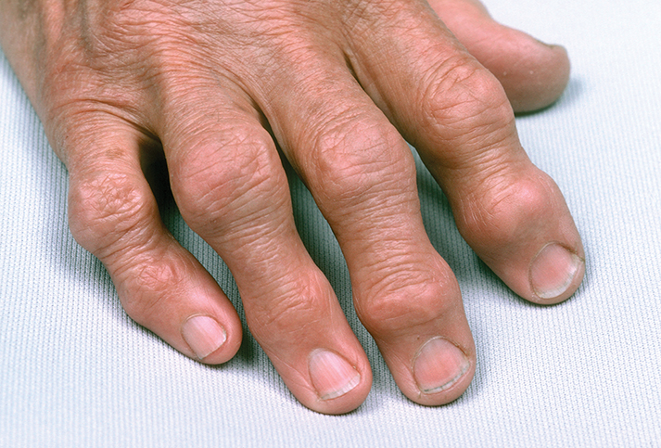
Common Musculoskeletal Conditions (4 of 13)
Osteoarthritis
Most common form of arthritis
Enlargement of interphalangeal joints
© Mediscan/Alamy.
Notes:
Lecture Outline
B. Osteoarthritis
1. Osteoarthritis is the single most common form of arthritis and is sometimes referred to as degenerative joint disease or wear and tear disease.
a. Osteoarthritis is the degeneration of articular cartilage and the joint, typically over the course of many years.
b. It is also believed to involve damage to the bone and synovium, which leads to further degeneration.
c. Patients may present with severe pain or inflammation to the joints.
d. In the hands, findings may include pain, limited motion, and enlargement of the interphalangeal joints.

Slide 64
Common Musculoskeletal Conditions (5 of 13)
Osteoarthritis (cont’d)
Common radiographic findings include:
Nonuniform joint space loss
Osteophyte formation
Cyst formation
Calcification of the cartilage
Subchondral sclerosis
Notes:
Lecture Outline
e. Common radiographic findings in patients with osteoarthritis include:
i. Non-uniform joint space loss
ii. Osteophyte formation
iii. Cyst formation
iv. Calcification of the cartilage
v. Subchondral sclerosis
2. Spinal degenerative changes are also very common in osteoarthritis, with patients often reporting:
a. Stiffness of the neck or back
b. Pain with movement
3. Another issue that could present is compression of the spinal nerve roots, causing neuropathy. Spinal stenosis can cause further complications.

Slide 65
Common Musculoskeletal Conditions (6 of 13)
Osteoarthritis (cont’d)
Monitoring: look for
Inflammation
Limitations in movement
Crepitus
Painful movement
Strength
Range of motion and passive range of motion
Notes:
Lecture Outline
4. Monitoring
a. Routine monitoring of patients with osteoarthritis includes assessment of functionality of the joints.
b. Ensure that you have exposed the joint or area you are evaluating, and look for:
i. Inflammation
ii. Limitations in movement
iii. Crepitus
iv. Painful movement
v. Strength
vi. Range of motion and passive range of motion
c. Do not attempt to move a joint beyond normal motor function and stop at any sign of discomfort and contact the medical director.
d. Document all assessment findings and duration of symptoms as well as exacerbating factors.
e. Follow local protocols on performing range of motion assessments.
5. There are some red flags that may present during the patient assessment. These findings include:
a. Weight loss, which could be secondary to metastatic disease
b. Fever and chills, which could be secondary to septic arthritis
c. Cutaneous nodules which could be indicative of gout or rheumatic arthritis
d. Conjunctivitis, which could occur secondary to rheumatoid arthritis
e. Diarrhea, which could also be indicative of rheumatoid arthritis
f. Dysuria or urethral discharge, which could be caused by reactive arthritis

Slide 66
Common Musculoskeletal Conditions (7 of 13)
Osteoarthritis (cont’d)
Management
Ensure the patient exercises at least twice a day
Avoids activity that causes pain for more than 2 hours
Braces, orthotics, joint support
Lose weight
Use of nonsteroidal anti-inflammatory drugs (NSAIDs)
Notes:
Lecture Outline
6. Management
a. The initial management is to ensure that the patient exercises at least twice a day and avoids activity that causes pain for more than 2 hours.
b. Some patients have found relief with:
i. Braces
ii. Orthotics
iii. Some form of support to the joint
c. Patients who are obese should be encouraged to lose weight and abstain from a sedentary lifestyle.
d. In addition to using nonsteroidal anti-inflammatory drugs (NSAIDs), many patients may seek complementary therapies, such as acupuncture, for their pain.
i. Current guidelines do not support the use of chondroitin sulfate or glucosamine for hip and knee osteoarthritis.
e. Discuss any changes in the patient’s condition with the medical director.
f. Consult the plan of care for specific exercise guidelines.
g. Help the patient understand the overall treatment/management process.
h. Ensure that the patient is able to perform all ADLs.

Slide 67
Common Musculoskeletal Conditions (8 of 13)
Osteoarthritis (cont’d)
Education
Focused on ensuring the patient understands severity of disease and management techniques
Assess patient’s understanding of his or her symptoms
Develop a log of symptoms
Notes:
Lecture Outline
7. Education
a. Education around osteoarthritis is focused on ensuring the patient understands the severity of the disease and appropriate management techniques.
b. Assess patient’s understanding of his or her symptoms by asking open-ended questions such as:
i. Do you feel any changes or limitations in movement?
ii. Do you have any changes in pain that you believe are associated with your arthritis?
c. Develop a diary or log of symptoms if appropriate; the patient can then take the document on visits to the primary care physician and use it as a basis for ongoing discussion.

Slide 68
Common Musculoskeletal Conditions (9 of 13)
Rheumatoid arthritis
Chronic autoimmune, polyarthritic inflammatory disease
Long progression; patients present with:
Only a few joints being affected
Morning stiffness
Fatigue without pain
Notes:
Lecture Outline
C. Rheumatoid arthritis
Rheumatoid arthritis (RA) is a chronic autoimmune, polyarthritic inflammatory disease.
a. The etiology of RA is unclear, but it is suspected to be a systemic inflammatory process that primarily affects the synovial membrane of the joints.
3. Patients generally experience a long progression of this disease, and it may be episodic in nature, with patients having:
a. Only a few joints being affected (mimicking osteoarthritis)
b. Morning stiffness
Fatigue without pain
4. Other patients have a rapid onset of the disease.
5. Rheumatoid disease is the most common inflammatory process in adults and decreases life expectancy in this population.
a. It affects more than 1.3 million people in the United States, and is especially prevalent in women.
b. Approximately 1% to 3% of all women may ultimately develop RA.

Slide 69
Common Musculoskeletal Conditions (10 of 13)
RA (cont’d)
Hammer fingers
Boutonniere
Flexion deformities of the toes
© Cristina Pedrazzini/Science Source.
Notes:
Lecture Outline
2. Most common symptoms appear in the hands and feet first, including deformities such as:
a. Hammer fingers
b. Boutonniere
c. Flexion deformities of the toes

Slide 70
Common Musculoskeletal Conditions (11 of 13)
RA (cont’d)
To confirm presence of disease, physicians use:
Multiple differential diagnoses
Laboratory tests
Radiographic examinations
Notes:
Lecture Outline
6. To confirm the presence of this disease, physicians rely on a comprehensive approach involving:
a. Multiple differential diagnoses
b. Laboratory tests
c. Radiographic examinations
7. Rheumatoid factor is one lab test used in the diagnostic process, but it may take weeks to months from the disease’s onset to become positive.
8. Monitoring
a. Patients may experience systemic changes rather than the specific changes associated with osteoarthritis.
b. Notify the medical director if the patient presents with:
i. Sudden-onset illness
ii. Fever
iii. Chills
iv. Significant impairment of function

Slide 71
Common Musculoskeletal Conditions (12 of 13)
RA (cont’d)
Management
Patients are prescribed:
Disease-modifying antirheumatic drugs (DMARDs)
Biologics
Corticosteroids
Notes:
Lecture Outline
9. Management
a. Patients with RA are prescribed:
i. Disease-modifying antirheumatic drugs (DMARDs)
ii. Biologics
iii. Corticosteroids
b. DMARDs often administered for this indication include methotrexate, hydroxychloroquine, and sulfasalazine.
c. Biologic treatments for RA include abatacept, adalimumab, anakinra, etanercept, and rituximab; these agents are often combined with a DMARD—especially methotrexate.
d. Many patients with arthritis have multiple comorbidities, so the primary care physician must take into account the treatment modalities used for the patient’s other conditions, such as CHF, hepatitis, or cancer.
e. Follow the patient’s plan of care. Discuss any changes in the patient’s condition with the medical director. Follow local protocols, and ensure that the patient is able to perform all ADLs.

Slide 72
Common Musculoskeletal Conditions (13 of 13)
RA (cont’d)
Education
Focuses on ensuring the patient understands the severity of disease and management techniques
Medications and therapies may take weeks to months to achieve response
Patient diary or log of symptoms
Notes:
Lecture Outline
10. Education
a. Education around osteoarthritis focuses on ensuring the patient understands the severity of the disease and appropriate management techniques.
i. RA is not curable, but rather is managed to lessen its effects on patients’ function over the remainder of their lives.
b. Patients with RA may have intermittent issues with this disease; that is, they may not suffer from chronic distress, as the disease may go into remission.
c. Achieving remission of RA is the goal of any therapy for this disease.
d. Many medications and therapies for RA may take weeks or months to achieve a peak response.
e. Discuss other treatment options such as therapy for depression or other psychological issues if appropriate.
f. Ask open-ended questions such as:
i. Do you feel any changes or limitations in movement?
ii. Do you have any changes in pain that you believe are associated with your arthritis?
g. Have the patient create a diary or log of symptoms, if appropriate, which the patient can then discuss with the provider.
i. Have patients write down specific instances, events, or locations where the symptoms may have started.

Slide 73
Common Integumentary Conditions (1 of 13)
Wounds
As a community paramedic, you need to:
Understand the stages of wounds and their therapy
Follow the patient’s plan of care and local protocols
Consult with the medical director
Notes:
Lecture Outline
IX. Common Integumentary Conditions
A. Wounds
1. As a community paramedic, you need to:
a. Understand the stages of wounds and the appropriate therapies
b. Follow the patient’s plan of care and local protocols
c. Consult with the medical director if you have any questions about the patient’s condition or care

Slide 74
Common Integumentary Conditions (2 of 13)
Wounds (cont’d)
Types of wounds
Contusions
Abrasions
Lacerations
Notes:
Lecture Outline
2. Types of wounds
a. Contusions
b. Abrasions
c. Lacerations

Slide 75
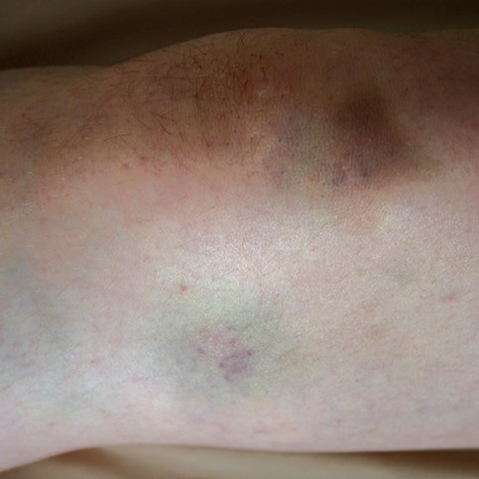
Common Integumentary Conditions (3 of 13)
Contusion
Injury that leaves the epidermis intact
© Jones & Bartlett Learning. Courtesy of MIEMSS.
Notes:
Lecture Outline
3. Contusion: an injury that leaves the epidermis intact
a. It occurs when there is damage to the cellular, vascular, and/or lymphatic system but the skin remains intact.
b. A contusion causes a buildup of blood under the skin—in other words, a bruise.

Slide 76
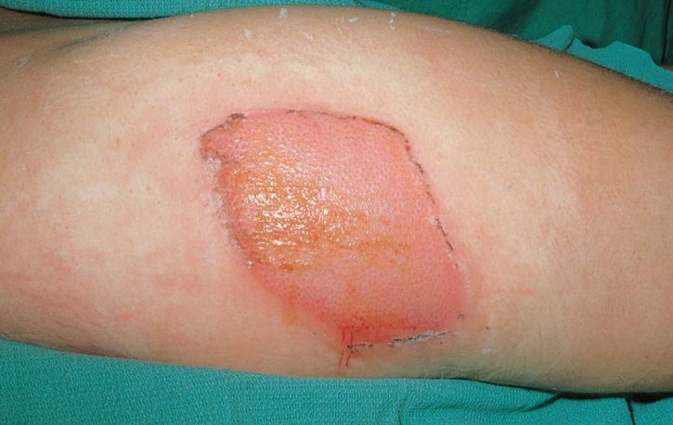
Common Integumentary Conditions (4 of 13)
Abrasion
Scraping-like injury to the epidermis and tissues below it
© American Academy of Orthopaedic Surgeons.
Notes:
Lecture Outline
4. Abrasion: a scraping-like injury to the epidermis and tissues below it, such as the cellular, vascular, and lymphatic tissues
a. The result is a multiple-system injury similar to the damage associated with a burn.

Slide 77
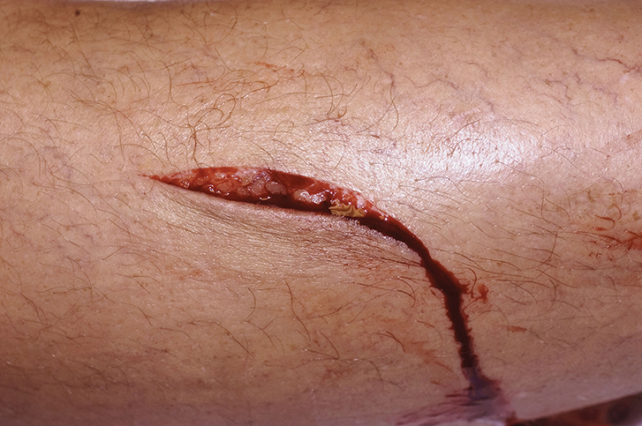
Common Integumentary Conditions (5 of 13)
Laceration
A sharp cut or tear of the epidermis or deeper tissue
© Scott Camazine/Alamy.
Notes:
Lecture Outline
5. Laceration: a sharp cut or tear of the epidermis or deeper tissue

Slide 78
Common Integumentary Conditions (6 of 13)
Ulcerations
Aging and other medical conditions may cause a breakdown of a person’s:
Vascular systems
Lymphatic systems
Nerves
Breakdowns create prime environment for skin ulcerations
Notes:
Lecture Outline
6. As a result of aging and other medical conditions, people may experience breakdown of their:
a. Vascular systems
b. Lymphatic systems
c. Nerves
7. Once deep-tissue injury occurs:
a. The healing process is much more complex
b. The injury may require significant treatment
c. Such significant breakdowns create a prime environment for a skin ulceration to occur.

Slide 79
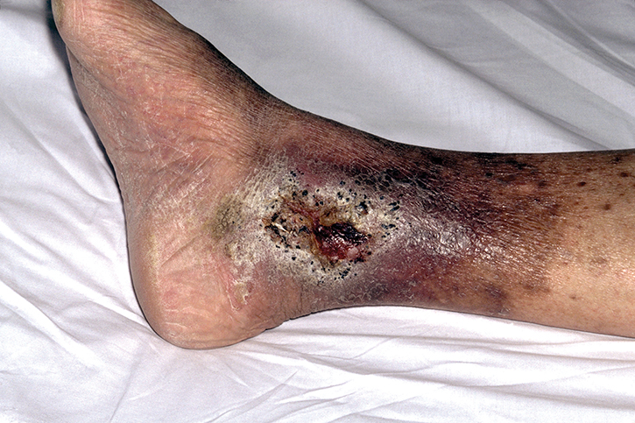
Common Integumentary Conditions (7 of 13)
Venous skin ulcerations
Common, associated with deep venous thrombosis
Pooling of blood
© Mediscan/Alamy.
Notes:
Lecture Outline
8. A skin ulceration is a wound that occurs on the skin and cannot obtain the appropriate circulation that would allow it to heal.
a. Venous skin ulcerations are common, such as those associated with deep venous thrombosis. They are caused by a breakdown in the venous valvular system that causes a “backup” or pooling of the blood.

Slide 80
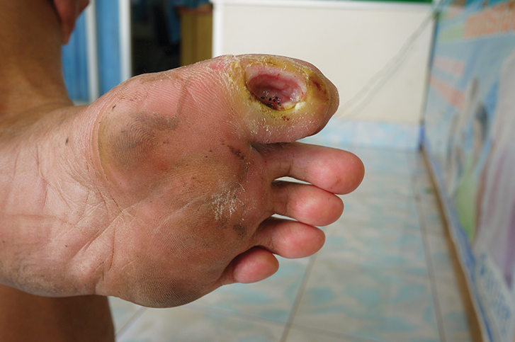
Common Integumentary Conditions (8 of 13)
Neuropathic skin ulcerations
Occur in conjunction with damage to nerve endings in skin
© Rattana/Shutterstock
Notes:
Lecture Outline
b. Neuropathic skin ulcerations occur in conjunction with damage to the nerve endings in the skin; a person may incur an injury but not feel it due to the existing damage in the skin.

Slide 81
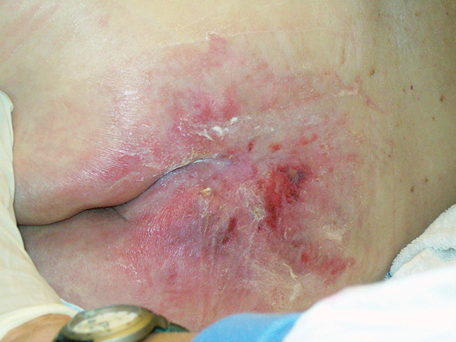
Common Integumentary Conditions (9 of 13)
Pressure ulcerations
Pressure between skin and bony tissue
Create necrotic and damaged tissue
© Boilershot Photo/Science Source.
Notes:
Lecture Outline
c. Pressure ulcerations/wounds are caused by pressure between the skin and the bony tissue, which leads to a lack of circulation and ultimately creates necrotic and damaged tissue.
i. This breakdown can occur over long periods, but may begin in as little as 30 minutes.
ii Pressure ulcerations have been found to be a significant factor in the care of older adults and people with disabilities.
iii. Any patient who has a sedentary lifestyle or who is unable to move frequently (three or more times per hour) may be at high risk for pressure ulcerations and should be encouraged to move so as to lessen the likelihood of a pressure ulceration developing.

Slide 82
Common Integumentary Conditions (10 of 13)
Wounds
Monitoring
Ask about the potential for skin breakdown or any possible injury.
Evaluate skin that has encountered lack of circulation, venous stasis, or potential for pressure lasting longer than 30 minutes.
Notes:
Lecture Outline
9. Other types of wounds are found in postsurgical patients.
10. Monitoring
a. During home visits, community paramedics should ask questions about the:
i. Potential for skin breakdown
ii. Any possible injury
b. A full evaluation of the skin should be performed in any location that has encountered:
i. Lack of circulation
ii. Venous stasis
iii. Potential for pressure lasting longer than 30 minutes—for example, bony prominences, buttocks, heels, back, and hips
c. Should a wound develop, it should be evaluated and assessed each visit.
d. When evaluating the wound, the community paramedic should measure its circumference and describe it in as much detail as possible.
i. Move from center to the healthy tissue
ii. Describe each level of breakdown
iii. Evaluate all aspects of perfusion
iv. Notice any changes
v. Follow local protocols

Slide 83
Common Integumentary Conditions (11 of 13)
Wounds (cont’d)
Management
Focuses on:
Decreasing the likelihood of reinjury
Creating a prime environment for healing
Ensuring that the patient has sufficient intake of protein, vitamin C, and fluids
Notes:
Lecture Outline
11. Management
a. Management of all wounds should focus on:
i. Decreasing the likelihood of reinjury
ii. Creating a prime environment for healing to take place
iii. Ensuring that the patient has sufficient intake of protein, vitamin C, and fluids
b. Patients should stop intake of nicotine and caffeine.

Slide 84
Common Integumentary Conditions (12 of 13)
Wounds (cont’d)
Management (cont’d)
Contusions, abrasions, lacerations treated with:
RICE (rest, ice, compression, elevation)
Bleeding control
Pain management
Sutures (sometimes)
Notes:
Lecture Outline
c. Contusions, abrasions, and lacerations are treated with:
i. RICE (rest, ice, compression, and elevation)
ii. Bleeding control
iii. Pain management
iv. Sutures (sometimes)
d. Many wound care clinics, home health agencies, and hospitals offer a variety of in-depth treatments for patients with prolonged wounds:
i. Doppler evaluation
ii. Wound debridement
iii. Complex wound dressings
iv. Negative pressure therapy
v. Surgical therapy
e. These facilities may also offer counseling such as nutritional and disease-specific education.

Slide 85
Common Integumentary Conditions (13 of 13)
Wounds (cont’d)
Education should be based on:
Preventing such wounds from occurring
Limiting further damage to tissue
Encouraging patients to evaluate skin daily if they have certain conditions
Helping patients understand normal physiology of wound response
Notes:
Lecture Outline
12. Education
a. Education should be based on:
i. Preventing such wounds from occurring
ii. Limiting further damage to the tissue when wounds are present
b. Patients should be encouraged to take steps to prevent damage to the skin and to evaluate the skin daily if they have:
i. Severe venous stasis
ii. Lack of circulation
iii. Neuropathic damage
c. Help patients understand the normal anatomy and physiology of wound response by the body.
i. Educate them about aging and other comorbidities
Discuss specific diseases (eg, neuropathy)
Help patients understand the community paramedic’s and other health provider’s roles in preventing and treating wounds

Slide 86
Common Neurologic Conditions (1 of 39)
Cognitive decline or impairment
Decline in cognition may be evidenced by:
Memory loss
Change in personality
Reduced mental capacity
Decreased overall cognitive function
Notes:
Lecture Outline
X. Common Neurologic Conditions
A. Cognitive decline or impairment
1. Decline in cognition may be evidenced by:
a. Memory loss
b. Changes in personality
c. Reduced mental capacity
d. Decreased overall cognitive function
2. Symptoms can:
a. Appear mild
b. Be noticeable and measurable
c. Be reversible (if caused by thyroid disorders or vitamin deficiencies)

Slide 87
Common Neurologic Conditions (2 of 39)
Cognitive decline or impairment
Forms of dementia
Alzheimer disease
Vascular dementia
Frontal lobe temporal dementia
Lewy body dementia
Parkinson dementia
Wernicke–Korsakoff syndrome
Notes:
Lecture Outline
3. Dementia is not a specific disease, but rather a description of symptoms that cause cognitive decline in one form or another.
4. Forms of dementia (different diseases; managed differently) include:
a. Alzheimer disease
b. Vascular dementia
c. Frontal lobe temporal dementia
d. Lewy body dementia
e. Parkinson dementia
f. Wernicke-Korsakoff syndrome
5. Generally, a patient is first diagnosed with mild cognitive impairment (MCI).
May not affect patient’s ability to perform ADLs
Still somewhat noticeable

Slide 88
Common Neurologic Conditions (3 of 39)
Cognitive decline or impairment (cont’d)
Mild cognitive impairment (MCI) screening done with Montreal Cognitive Assessment (MoCA) Mini-Cog test
Monitoring
Community paramedic identifies loss in cognition and specific findings that warrant referral
Notes:
Lecture Outline
6. Screening for MCI is performed by the patient’s primary care physician, usually with a cognitive assessment tool such as the Montreal Cognitive Assessment (MoCA) Mini-Cog test.
7. Monitoring
a. The community paramedic identifies the loss in cognition and specific findings that would warrant referral for:
i. Further testing by the primary care physician
ii. Further cognition tests performed by the community paramedic (if community paramedicine program allows)
8. It is important to differentiate between a brief lapse in memory (forgetting to take medicine one time) and a chronic issue (repeatedly forgetting to take medications).
9. As a community paramedic, if you suspect MCI or any form of cognitive decline, you should:
a. Discuss the patient’s family history of such conditions
b. Evaluate risk factors such as hypertension
c. Identify comorbid conditions such as vascular disease or stroke
d. Identify behavioral manifestations
e. Identify any symptom onset or progression

Slide 89
Common Neurologic Conditions (4 of 39)
Cognitive decline or impairment (cont’d)
Be alert for sudden-onset changes, such as those that occur with:
Hypoxia
Vitamin B₁₂ deficiency
Depression
Hypothyroidism
Notes:
Lecture Outline
10. Be alert for sudden-onset changes in cognition that must be identified early to be corrected, such as those that occur with:
a. Hypoxia
b. Vitamin B₁₂ deficiency
c. Depression
d. Hypothyroidism

Slide 90
Common Neurologic Conditions (5 of 39)
Cognitive decline or impairment (cont’d)
Management
Focuses on the specific cause of the cognitive decline
Includes medications, behavioral therapies, or a combination
Notes:
Lecture Outline
11. Ask patients questions such as:
a. Have you found that you have frequently forgotten things lately?
b. I know we have talked about “sometimes” forgetting things, but how do you define “sometimes”?
c. How often do you feel frustrated about memory loss or have you found that your mood/memory changes during certain times of day?
12. Discuss the onset, provocation, and duration of the patient’s symptoms with family members and caregivers.
13. Management:
a. Must focus on the specific cause of the cognitive decline
b. Includes medications, behavioral therapies, or a combination

Slide 91
Common Neurologic Conditions (6 of 39)
Cognitive decline or impairment (cont’d)
Education
Reassure patients that you are there to help them manage their symptoms
Encourage patients to be honest
Help patients know when to seek help or implement specific management techniques
Notes:
Lecture Outline
14. Education
a. Reassure patients that you and their primary care physicians are there to help them manage their symptoms.
b. Encourage patients to provide full information and full honesty.
c. Help patients know when to seek help or implement specific management techniques.
d. To make the best use of resources, understand the health literacy level of the patient with any form of cognitive decline.
i. Patients must fully remember, understand, and be able to perform the tasks required to manage their diseases.
ii. Encourage the patient’s social network to be involved in helping the patient as much as possible.

Slide 92
Common Neurologic Conditions (7 of 39)
Alzheimer disease
Most common form of dementia
60% to 80% of cases
More than 5 million people in the United States
Notes:
Lecture Outline
B. Alzheimer disease
1. Alzheimer disease is the most common form of dementia, accounting for 60% to 80% of all such cases.
a. More than 5 million people in the United States have Alzheimer disease.
b. National Alzheimer’s Project Act (2011)

Slide 93
Common Neurologic Conditions (8 of 39)
Alzheimer disease (cont’d)
Classified into 3 stages
Mild
Moderate
Severe/end stage
Notes:
Lecture Outline
2. Disease stages
a. Alzheimer disease is incurable, so the goal is:
i. Early identification
ii. Symptom recognition
iii. Prevention of progression to the extent possible
iv. Allocation of appropriate resources as soon as possible
b. The disease is classified into three stages:
i. Mild
ii. Moderate
iii. Severe/end stage
3. Early symptoms of Alzheimer disease may present 10 years or more before the patient develops further cognitive issues.
4. Patients with early-stage disease have not lost the ability to function independently, but may have:
a. Periods of forgetfulness or struggle to come up with the right words
b. A loss of concentration
c. Depression or apathy
d. Issues with normal ADLs, such as paying bills or handling money
5. Patients with moderate-stage disease:
a. Exhibit problems with language, sensory, reasoning, and conscious thought
b. Have hallucinations, disorientation, and confusion
c. Begin to lose ability to perform ADLs (putting on shoes or clothing)
d. Put a heavy workload on their primary caregivers; they will require more and more assistance as the disease progresses
6. Patients with final or severe-stage disease, brain tissue begins to shrink significantly, so these patients:
a. Are unable to communicate
b. Cannot perform ADLs
c. Require around-the-clock care

Slide 94
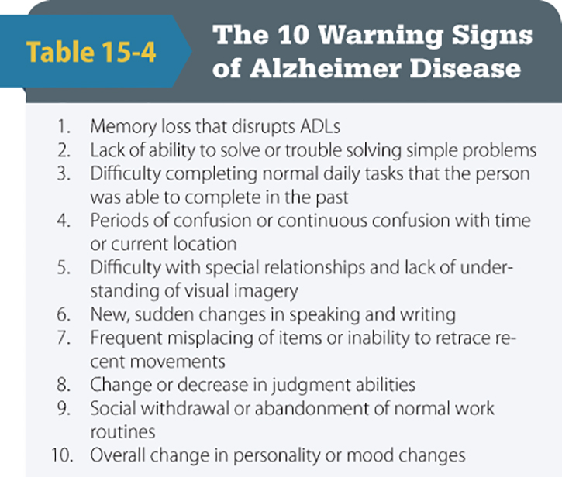
Common Neurologic Conditions (9 of 39)
Alzheimer disease (cont’d)
Monitoring
Look for warning signs
Document any changes that may be assessed
© 2009 Alzheimer’s Association®. All rights reserved.
Notes:
Lecture Outline
7. These patients are very vulnerable to infections, as their normal defense mechanisms, hygiene, and ability to walk or swallow may be impaired.
8. Monitoring
a. The community paramedic should:
i. Monitor older patients for warning signs of Alzheimer disease
ii. Document any changes that may be noticed/assessed
b. Patients with diagnosed disease should be closely watched, as people with cognitive decline:
i. May experience either slow or rapid progression of their dementia
ii. May have difficulties managing their other disease processes
c. One of the best ways the community paramedic can monitor patients with Alzheimer disease is based on the time and location of visits.
i. Watch patients in natural environment
Discuss the patient’s progression with family/significant others
9. Patients with Alzheimer disease may be challenging to manage
a. Upset about loss of abilities or memories
b. Refuse all services
10. These patients are at high risk for:
a. Self-neglect
b. Abuse
11. Refer such patients to the appropriate Adult Protective Services agency in the area. Follow local protocols.

Slide 95
Common Neurologic Conditions (10 of 39)
Alzheimer disease (cont’d)
Management primarily geared toward:
Recognition of symptoms
Recognition of changes in symptoms
Monitoring for progression of the disease
Medication, behavioral changes, treatments
Notes:
Lecture Outline
12. Management primarily geared toward:
a. Recognition of symptoms
b. Recognition of changes in symptoms
c. Monitoring for progression of the disease
13. Many behavioral and pharmacologic treatments are available for this disease, but there is no cure.
14. Medications prescribed for early stages of dementia may include cholinesterase inhibitors such as:
a. Aricept
b. Exelon
c. Razadyne
15. Moderate or severe Alzheimer disease may require a combination of:
a. Cholinesterase inhibitors
b. N-methyl-d-aspartate (NMDA)–receptor antagonist
16. Treatment for late stages of Alzheimer disease:
a. Memantine (Namenda)
17. Behavioral changes and treatments have also been established to control:
a. Triggering situations
b. Irritability
c. Anxiety
d. Depression
18. Sleep disruptions may be addressed by ensuring routines are followed, and through use of medications such as:
a. Tricyclic antidepressants
b. Benzodiazepines
c. Atypical antipsychotics
19. Notify the medical director if the patient uses alternative treatments, herbal remedies, and dietary supplements.
20. Navigate the patient and caregiver to local outreach services to provide additional support.

Slide 96
Common Neurologic Conditions (11 of 39)
Alzheimer disease (cont’d)
Education: many resources available
Alzheimer’s Association helpline, website, and local chapters
Only possibility is to educate patient in early stages of disease; in later stages refocus education to caregivers
Notes:
Lecture Outline
21. Education
a. Many resources are available.
i. Alzheimer’s Association helpline, website, local chapters
ii. Only possible to educate patients in the early stages of disease; in later stages refocus education to caregivers

Slide 97
Common Neurologic Conditions (12 of 39)
Parkinson disease
Chronic neurologic disease that affects motor neuron response
Four symptoms are used for diagnosis:
Tremor
Bradykinesia
Postural instability
Rigidity
Notes:
Lecture Outline
C. Parkinson disease
1. Parkinson disease is a chronic neurologic disease that affects motor neuron response.
a. Believed to arise secondary to the loss of production of dopamine or the inability to produce an appropriate amount of dopamine
2. Patients commonly experience symptoms such as:
a. Tremor
b. Trembling or stiffness in the extremities
c. Slow movement
d. Poor coordination and/or balance
3. Patients progress to severe symptoms such as trouble or inability to:
a. Chew
b. Swallow
c. Speak
4. Many genetic and environmental factors may also influence the development of Parkinson disease.
a. Disease affects approximately 500,000 people in the United States
b. Average onset of 60 years
c. Prevalence increased: greater awareness, better identification
5. The diagnosis is based on medical history, neurologic examination results, and symptoms.
6. Four symptoms are used as the basis for diagnosis:
a. Tremor
b. Bradykinesia
c. Postural instability
d. Rigidity

Slide 98
Common Neurologic Conditions (13 of 39)
Parkinson disease (cont’d)
General stages include:
Mild
Moderate
Advanced
Notes:
Lecture Outline
7. Disease stages
a. Each person progresses with Parkinson disease differently.
b. Different symptoms may accompany progression, such as:
i. Depression
ii. Emotional changes
iii. Difficulty swallowing
iv. Speech control
v. Dysuria
vi. Sleep disturbances
vii. Dementia
viii. Orthostatic hypotension
ix. Dystonia
x. Sexual dysfunction
xi. Overall fatigue.
c. General stages include mild, moderate, and advanced disease.
8. Mild Parkinson disease: beginning stage and generally associated with only minimal symptoms
a. Patients do not require significant changes in ADLs but do continue to experience the primary four symptoms, sometimes unilaterally.
b. Most of the time, symptoms resolve with medication and exercise.
9. Moderate Parkinson disease: generally affects the body bilaterally
a. Patients experience episodes such as:
i. Freezing (movement of the body drastically slows)
ii. Trouble balancing or incoordination
b. Medications may become ineffective when their therapeutic levels decline.
c. Some physical therapy or occupational therapy is required.
10. Advanced Parkinson disease:
a. Patients:
i. Require assistance almost around the clock
ii. Are unable to live by themselves
iii. Generally are unable to walk, and may require wheelchairs or hospital beds
iv. May not respond to medications or therapies
v. Progression of the disease may be slow

Slide 99
Common Neurologic Conditions (14 of 39)
Parkinson disease (cont’d)
Monitoring
Watch the progression of the disease to decrease issues surrounding comorbidities or conditions that could become severe
Patients should be assessed for genitourinary symptoms, fall risks, gastrointestinal issues
Notes:
Lecture Outline
11. Monitoring
a. Closely monitor patients to watch the progression of the disease and to decrease the issues surrounding comorbidities or conditions that can become severe if not managed effectively.
b. Because these issues cause further complications and can cause death, patients should be assessed for:
i. Genitourinary symptoms
ii. Fall risks
iii. Gastrointestinal issues
c. Follow the plan of care and local protocols.

Slide 100
Common Neurologic Conditions (15 of 39)
Parkinson disease (cont’d)
Management
Follow the plan of care
Management techniques based on:
Symptom recognition, early detection of progression, need for full assistance
Notes:
Lecture Outline
12. Management
a. Follow the plan of care.
b. Management techniques may be based on:
i. Symptom recognition
ii. Early detection of progression
iii. The need for full assistance (eg, skilled nursing facilities, full in-home care, palliative care, and hospice care)
c. Three classes of medications are commonly prescribed for Parkinson disease:
i. Dopamine agonists
ii. Catechol-O-methyl transferase (COMT) inhibitors
iii. Medications to control non-motor symptoms (eg, antidepressants)
d. During the initial visits of enrollment and intake, community paramedics should fully document:
i. All symptoms
ii. Limitations
iii. Assistance the patient requires
e. Consider each level of assistance needed and navigate the patient to the appropriate outreach services. Follow local protocols.

Slide 101
Common Neurologic Conditions (16 of 39)
Parkinson disease (cont’d)
Education
Many online resources such as:
The Parkinson’s Disease Foundation
Michael J. Fox Foundation for Parkinson’s Research
National Parkinson Foundation
Notes:
Lecture Outline
13. Education
a. Many online resources from organizations such as:
i. The Parkinson’s Disease Foundation
ii. Michael J. Fox Foundation for Parkinson’s Research
iii. National Parkinson Foundation
b. All education should be focused on:
i. Coping with the disease and prevention of complications
ii. Progression as much as possible
c. Ensure that educational materials are tailored to the patient’s health literacy level.
d. Address hygiene needs, fall risks, and other preventive measures as necessary.

Slide 102
Common Neurologic Conditions (17 of 39)
Amyotrophic lateral sclerosis (ALS)
Also known as Lou Gehrig disease
Rare progressive neurodegenerative disease that affects voluntary muscle movement
Etiology unclear, possibly genetic
Notes:
Lecture Outline
D. Amyotrophic lateral sclerosis
1. Amyotrophic lateral sclerosis (ALS), also known as Lou Gehrig disease, is a rare progressive neurodegenerative disease that affects voluntary muscle movement.
a. The neurons that control all voluntary muscles die.
b. Etiology unclear, but believed to be genetic
c. Prevalence of 3.9 cases per 100,000 population in the United States and is most prevalent among White males

Slide 103
Common Neurologic Conditions (18 of 39)
ALS (cont’d)
Symptoms include:
Fatigue
Muscle cramping
Muscle fasciculations
Pain
Depression
Sleep disturbances
Constipation
Notes:
Lecture Outline
2. Symptoms of ALS include:
a. Fatigue
b. Muscle cramping
c. Muscle fasciculations
d. Pain
e. Depression
f. Sleep disturbances
g. Constipation
3. The disease:
a. Progresses very rapidly, over 3 to 5 years
b. Affects the entire body
c. Causes patients to lose all control over all voluntary and involuntary muscles
4. Latter stages of the disease:
a. Full thoracic paralysis, with patients needing a ventilator for full respiratory support
b. 24/7 support required fairly rapidly after diagnosis
c. Aggressive, yet palliative treatment
5. There are no specific laboratory tests or methods that can be used to make a definitive diagnosis of ALS. Potential tests include:
a. Electromyography
b. Nerve conduction study

Slide 104
Common Neurologic Conditions (19 of 39)
ALS (cont’d)
Monitoring
Fully document every symptom and abnormality
Report any sudden-onset, sustained neurologic change or symptom to the medical director
Ensure that patients are receiving appropriate level of care from their social networks
Notes:
Lecture Outline
6. Monitoring
a. Patients with ALS will vary in terms of where their symptoms originate.
b. Community paramedics should fully document every symptom and any abnormalities in the physical examination.
c. Early symptom monitoring is essential for appropriate treatment of these patients.
d. Any sudden-onset, sustained neurologic change or symptom should be reported to the medical director.
e. Ensure that patients are receiving the appropriate level of care from their social networks.
f. Follow local protocols.

Slide 105
Common Neurologic Conditions (20 of 39)
ALS (cont’d)
Management
Treatment is primarily supportive
Medications alleviate symptoms
Plan of care
Full management and care (later stages)
Notes:
Lecture Outline
7. Management
a. Treatment is primarily supportive in nature.
b. There is no cure, although some medications have been found to alleviate some of the symptoms.
c. Follow the plan of care.
d. In the later stages of this disease, patients will require full management and care.

Slide 106
Common Neurologic Conditions (21 of 39)
ALS (cont’d)
Education
Provide patient with a clear explanation of the physiology involved in his or her symptoms
Educate patient on devices
Provide patients, families, and caregivers with supportive care; navigate them to outreach services
Notes:
Lecture Outline
8. Education
a. To help patients understand this disease, provide an explanation such as the following:
i. “The neurons or communicators from your brain to your muscles are destroyed, which is why you sometimes have weakness, atrophy, and involuntary twitches.”
b. Educate the patient on devices such as hospital beds and tracheostomies.
c. Provide patients, families, and caregivers with supportive care and navigate them to outreach services.

Slide 107
Common Neurologic Conditions (22 of 39)
Huntington disease
Inherited, progressive neurodegenerative disorder
Caused by a change in, or faulty gene on, chromosome 4
Hallmark of disease: Chorea
Notes:
Lecture Outline
E. Huntington disease
1. Huntington disease is an inherited, progressive neurodegenerative disorder.
a. It is caused by a change in, or faulty gene on, chromosome 4.
b. The hallmark of disease is the extreme involuntary movements called chorea.
i. Chorea can affect one extremity or an entire side of the body.

Slide 108
Common Neurologic Conditions (23 of 39)
Huntington disease (cont’d)
Other symptoms include:
Fatigue, sedation, restlessness, anxiety
Patients die within 15 to 20 years after diagnosis
No treatment that can slow, stop, or cure
Notes:
Lecture Outline
c. Other symptoms include:
i. Fatigue
ii. Sedation
iii. Restlessness
iv. Hyperexcitability
v. Anxiety
vi. Depression
vii. Unsteadiness
ix. Rigidity
x. Seizures
2. Patients die within 15 to 20 years after their diagnoses, and there is no definitive treatment that can slow, stop, or cure the disease.

Slide 109
Common Neurologic Conditions (24 of 39)
Huntington disease (cont’d)
Monitoring: Similar to Parkinson disease and any other neuromuscular disorders
Closely assess and monitor all symptoms
Report symptoms to provider
Report any sudden neurologic changes to medical director
Ensure appropriate outreach services provided
Notes:
Lecture Outline
3. Monitoring
a. Similar to monitoring of Parkinson disease and any neuromuscular disorder
b. Closely assess and monitor all symptoms.
c. Report symptoms to the provider.
d. Report any sudden neurologic changes to the medical director.
e. Ensure appropriate outreach services are provided for patients.
4. Patients with Huntington disease will ultimately require 24/7 care, just as patients with ALS do.

Slide 110
Common Neurologic Conditions (25 of 39)
Huntington disease (cont’d)
Management
Tetrabenazine: only medication approved in the United States
Focus is to control and manage symptoms of disease, not to cure
Manage secondary issues
Notes:
Lecture Outline
5. Management
a. Tetrabenazine: only medication approved in the United States for Huntington chorea
b. As with other neurodegenerative disorders, focus of management is to control and manage symptoms of the disease, not to cure.
6. To help manage patients with Huntington disease, community paramedics should follow the plan of care.
7. Patients with neuromuscular disorders such as Huntington disease are vulnerable to complications from secondary issues such as:
a. UTIs
b. Wounds (eg, pressure ulcerations)
c. Muscle atrophy
8. Work with patients’ caregivers to ensure that basic hygiene needs are met and overall symptom management is accomplished.

Slide 111
Common Neurologic Conditions (26 of 39)
Huntington disease (cont’d)
Education
Six steps of management:
See your physician
Take medications as prescribed
Monitor your symptoms daily
Maintain a balanced diet for your conditions
Stay active and exercise as directed
Limit or avoid use of drugs, nicotine, and caffeine
Notes:
Lecture Outline
9. Education
a. Education for the patient with Huntington disease focuses on the six steps of management:
i. See your physician.
ii. Take the medications prescribed, as prescribed.
iii. Monitor your symptoms daily.
iv. Maintain a balanced diet for your conditions.
v. Stay active and exercise as directed.
vi. Limit or avoid use of drugs, nicotine, and caffeine.
b. Discuss symptom recognition, and document the patient’s progression

Slide 112
Common Neurologic Conditions (27 of 39)
Multiple sclerosis (MS)
Immune-related, unpredictable, chronic neurologic condition
Symptoms appear in midlife
Variable course of disease
Some forms are described as relapsing-remitting
Notes:
Lecture Outline
F. Multiple sclerosis
1. Multiple sclerosis (MS) is an immune-mediated, unpredictable, and chronic neurologic condition.
a. Begins as an immune response to an unknown antigen, with the immunologic components attacking the myelin sheath of the nerves
b. This response causes a complete breakdown of the myelin, with eventually the nerves themselves becoming damaged or permanently disabled.
c. Patients begin to have symptoms in midlife (20 to 40 years of age), but follow a variable course of disease.
e. More than half of all people with MS experience some form of cognitive decline.
2. Some forms of MS are described as a relapsing–remitting disease, referring to the disease’s tendency to come and go with time.
a. Relapses: symptoms fully incapacitating; remission: patient may full regain function
b. Pattern varies; symptoms can persist and cause permanent damage
c. More than 60% of patients develop a steady progression of the disease without remission, a condition called secondary-progressive MS.

Slide 113
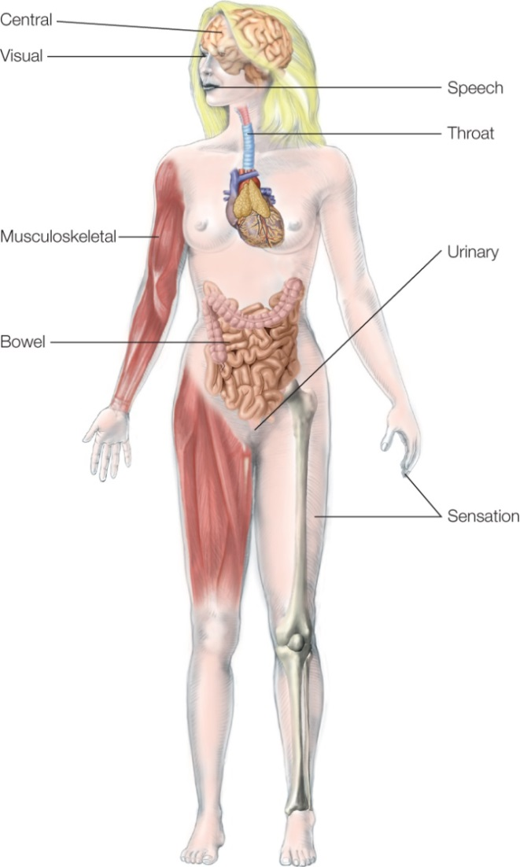
Common Neurologic Conditions (28 of 39)
MS (cont’d)
Symptoms range from blindness to paralysis
© Jones & Bartlett Learning
Notes:
Lecture Outline
Symptoms range from blindness to paralysis or inability to balance.

Slide 114
Common Neurologic Conditions (29 of 39)
MS (cont’d)
Currently, the diagnosis is made based on:
Physical assessment
Symptoms
Careful medical history
Neurologic examination
Magnetic resonance imaging
Spinal fluid analysis
Notes:
Lecture Outline
3. Approximately 2.3 million people worldwide are believed to have the disease, with as many as 400,000 people in the United States.
4. The exact cause of MS is unknown, although some sources suggest it may be linked to a virus.
5. There is no single test for the disease or identifiable cause of MS.
6. Currently, the diagnosis is made based on:
a. Physical assessment
b. Symptoms
c. Careful medical history
d. Neurologic examination,
e. Magnetic resonance imaging
f. Spinal fluid analysis
7. The criteria for diagnosis are:
a. Evidence of damage in two separate areas of the central nervous system
b. Evidence that the damage occurred within a 1-month time span

Slide 115
Common Neurologic Conditions (30 of 39)
MS (cont’d)
Monitoring
Evaluate for any possible acute abnormality of the central nervous system (CNS) or progression of the disease
Patients with advanced-stage disease may require around-the-clock care
Notes:
Lecture Outline
8. Monitoring
a. The community paramedic should note and evaluate for any possible acute abnormality of the central nervous system (CNS) or progression of the disease.
b. Document these findings and notify the medical director.
9. Patients with advanced-stage disease may have significant lifestyle challenges, so continuous therapy (up to around-the-clock care) may be required.

Slide 116
Common Neurologic Conditions (31 of 39)
MS (cont’d)
Monitoring
Maintain high suspicion for possible infections, wounds (eg, pressure ulcerations), and UTIs
Monitor any devices the patient requires
Perform in-depth skin evaluations
Notes:
Lecture Outline
a. Monitor any devices the patient may require.
b. Maintain a high suspicion for possible infections, wounds (eg, pressure ulcerations), and UTIs.
c. Perform in-depth skin evaluations to ensure that no pressure wounds are present.

Slide 117
Common Neurologic Conditions (32 of 39)
MS (cont’d)
Management primarily focuses on treating the symptoms as acutely as possible with:
Corticosteroids
Plasma exchange
Medications
Combination therapy
Notes:
Lecture Outline
10. Management
a. Primarily focuses on treating the symptoms as acutely as possible with:
i. Corticosteroids
ii. Plasma exchange
b. Patients may also be on medications intended to modify or slow progression of the disease, such as
i. β-interferons
ii. Glatiramer acetate
iii. Dimethyl fumarate
iv. Fingolimod
v. Mitoxantrone
c. To reduce fatigue, many patients may receive combination therapy consisting of:
i. Physical therapy
ii. Muscle relaxants
iii. Other medications
d. Follow the plan of care.
e. Learn to recognize subtle signs and symptoms so the primary care physician can treat them quickly.
f. Discuss and evaluate all aspects of the patient’s intake and output during the patient assessment, as changes in these parameters may be early signs of complications.
g. Do not disregard any subtleties.

Slide 118
Common Neurologic Conditions (33 of 39)
MS (cont’d)
Education
Varies with patient’s progression
Patient should understand disease and potential complications.
One consistent message from health team
Notes:
Lecture Outline
11. Education
a. Patient education varies with the patient’s progression.
b. It is important for patients to understand the disease and its potential complications.
c. The patient’s health care team should speak with one voice, and the patient should receive a consistent message.

Slide 119
Common Neurologic Conditions (34 of 39)
Seizures
Sudden involuntary movements, actions, thought disturbances, or any combination
Caused by involuntary electrical impulses in the brain
Notes:
Lecture Outline
G. Seizures
1. Seizures are sudden involuntary movements, actions, or thought disturbances, or any combination of these, caused by involuntary electrical impulses in the brain.
a. There are many types of seizures, but we will focus on epilepsy—prolonged or repeated seizures that occur over long periods.

Slide 120
Common Neurologic Conditions (35 of 39)
Seizures (cont’d)
Symptoms can be caused by:
Injury (ie, stroke or traumatic brain injury)
Alcoholism
Narcotic ingestion
Medication overdose
Brain tumors
Notes:
Lecture Outline
2. Seizures can be caused by:
a. Injury (ie, stroke or traumatic brain injury)
b. Alcoholism
c. Narcotic ingestion
d. Medication overdose
e. Brain tumors

Slide 121
Common Neurologic Conditions (36 of 39)
Seizures (cont’d)
Epilepsy diagnosed by:
Thorough physical examination
Lab tests
Imaging (electroencephalogram [EEG])
Notes:
Lecture Outline
3. Epilepsy is diagnosed by:
a. Thorough physical examination
b. Lab tests
c. Imaging
i. Electroencephalogram (EEG): most commonly and most accurate way to diagnose seizures
4. Blood testing tends to focus on electrolyte, infectious and genetic causes; tests may also be used to confirm that medications (eg, phenytoin, phenobarbital) are present at therapeutic levels.

Slide 122
Common Neurologic Conditions (37 of 39)
Seizures (cont’d)
Monitoring
Thorough neurologic examination:
Symptoms that occurred during the seizure
Provoking factors
Any predispositions that occur with seizures
Notes:
Lecture Outline
5. Monitoring
a. When patients have been diagnosed with epilepsy, perform a thorough neurologic examination. Evaluate:
i. The symptoms that occurred during the seizure
ii. Provoking factors
iii. Any predispositions that occur with the seizures
6. Notify the medical director if:
a. You encounter any new signs or changes in the seizures
b. If the patient experiences new tremors or muscle involvement

Slide 123
Common Neurologic Conditions (38 of 39)
Seizures (cont’d)
Self-management focuses on:
Taking medications
Keeping appointments
Recognizing provoking factors/keeping a log
Engaging in lifestyle management
Notes:
Lecture Outline
7. Self-management should focus on treatments such as:
a. Taking medications
b. Keeping appointments with the primary care physician and specialists
c. Recognizing provoking factors and keeping a log of seizures
d. Engaging in lifestyle management (eg, getting adequate sleep, avoiding stimulants, and maintaining social support)

Slide 124
Common Neurologic Conditions (39 of 39)
Seizures (cont’d)
Education should focus on self-management techniques
Seizure First Aid
Work with family and friends on management
Follow local protocols
Notes:
Lecture Outline
8. Education
a. Education should focus on patients’ self-management techniques and what to do when they have seizures.
b. Seizure First Aid: program includes training for laypeople in seizure management
c. Work with family and friends to discuss seizure management.
d. Follow local protocols.

Slide 125
Pain and Chronic Pain Management (1 of 7)
Pain
Uncomfortable subjective sensation that occurs with actual, potential, or perceived damage or inflammation of:
Tissue
Nerves
Bone structures
Notes:
Lecture Outline
XI. Pain and Chronic Pain Management
A. Pain
1. Pain is an uncomfortable subjective sensation that occurs with actual, potential, or perceived damage or inflammation of:
a. Tissue
Nerves
Bone structures
2. There have been many advances in the treatment of pain in the past few decades, with the CDC publishing its most recent guideline on pain management in 2016.
a. Guideline provides an overview of the differences in and preferences for non-opioid management versus opioid management of patients with chronic noncancerous pain.
b. Potential for abuse of opioids is clear: 52 people die every day from drug (opioid) overdoses in the United States.
c. There are no laboratory tests or imaging results to define pain—no objective data.
d. For a patient-centered outcome, it is essential that pain be managed with an interdisciplinary approach, by multiple health care providers and caregivers who use evidence-based medicine.

Slide 126
Pain and Chronic Pain Management (2 of 7)
Classification of pain
Based on duration
By the underlying pathology
By the type of syndrome
Duration can be acute or chronic
Notes:
Lecture Outline
B. Classification of pain
1. Pain can be classified in several different ways:
a. Based on its duration
b. By the underlying pathophysiology
c. By the type of syndrome
2. The duration can be:
a. Acute
i. Pain occurred rapidly
ii. Example: New fracture
b. Chronic
i. Pain lasting more than a few months
ii. Back injury that occurred years ago may cause the patient to feel an ongoing uncomfortable sensation of pain.

Slide 127
Pain and Chronic Pain Management (3 of 7)
Types of pain
Physiologic
Somatic
Visceral
Pathologic
Notes:
Lecture Outline
3. Physiologic (nociceptive) pain is the normal response to injury or acute inflammation of tissues or cells.
a. Pain is communicated to the cerebral cortex from the localized nerves that are affected via the:
i. Spinal column
ii. Brain stem
iii. Thalamus
4. Physiologic pain can be further subdivided into:
a. Somatic pain (affecting bone, skin, and soft tissue)
b. Visceral pain (affecting hollow structures such as the gastrointestinal tract)
5. Pathologic pain:
a. Has a neuropathic origin
b. Arises when a structural issue or other abnormality occurs within the nerves
c. Feelings associated with this sensation:
i. Burning
ii. Stabbing
iii. Numbness
iv. Tingling
v. Electrical current sensation
d. The patient may experience a lack of sensation for a period, which can lead to diminished reflexes or limited strength in the affected area.
e. This pain is very difficult to manage, and patients may not achieve satisfactory or complete relief from this type of pain.

Slide 128
Pain and Chronic Pain Management (4 of 7)
Assessment of pain
Evaluate for:
Location
Quality
Duration
Alleviating or exacerbating factors
Impact on ADLs
Quality of life
Associated medical conditions
Notes:
Lecture Outline
C. Assessment of pain
1. To effectively manage any condition, the primary care physician must perform a full and comprehensive assessment.
2. Pain, while a subjective phenomenon, must be fully evaluated for:
a. Location
b. Quality
c. Duration
d. Alleviating or exacerbating factors
e. Impact on ADLs
f. Quality of life changes
g. Past and current management techniques
h. Any other medical conditions that could be associated with the pain
3. It is important to review all of these aspects and ensure that each is documented.
4. Key to managing these patients effectively:
a. Effective communication
b. In-depth assessment
5. In traditional EMS, the mnemonic OPQRST is used to evaluate pain or injury.
a. In community paramedic’s setting, it is essential to evaluate other problems or perceived problems that can exist in patients with chronic pain.

Slide 129
Pain and Chronic Pain Management (5 of 7)
Pain (cont’d)
Monitoring
Fully evaluate the patient
Assess patient’s pain
Document findings
Review what other health care providers involved have found; note differences in your assessment
Notes:
Lecture Outline
6. Monitoring
a. At each visit in which you encounter the patient with chronic pain:
i. Assess the patient’s pain along with the assessment parameters mentioned earlier.
ii. Document these findings.
iii. If possible, review what other health care providers (eg, physicians, physician assistants, and nurse practitioners) involved in care for this patient have found and note any differences encountered during your patient assessment.
b. Take time to:
i. Fully evaluate the patient
ii. Assess the patient’s understanding of the pain
iii. Determine the pain’s effects on the patient
c. Reassure the patient that you will work with the health care team to define the best treatment approach in the plan of care.

Slide 130
Pain and Chronic Pain Management (6 of 7)
Pain (cont’d)
Management
Treatments depend on assessment and classification of patient’s pain
Alleviate pain by eliminating cause
Medications, supplements
Notes:
Lecture Outline
7. Management
a. Treatments depend on the assessment and classification of the patient’s pain.
b. The best treatment is to alleviate pain by eliminating or mitigating the cause.
c. Over time, the patient is prescribed or recommended:
i. Many medications (OTC and prescription)
ii. Supplements
d. Pain contracts are often used when patients are prescribed chronic opioids.
i. A pain contract is a written understanding and/or agreement between a patient and a provider.
ii. Highlight the appropriate use of medication, the patient’s expected behavior, and the communication to which the patient must commit.

Slide 131
Pain and Chronic Pain Management (7 of 7)
Pain (cont’d)
Education
Depends on the assessment and classification of patient’s pain
Full relief from pain may be unattainable
Plan of care/specific pain plan
Notes:
Lecture Outline
8. Education
a. Patient education about pain is:
i. Very complex
ii. Depends on the classification and assessment of the patient’s pain
b. All patients with pain must understand that they may never attain full relief from the pain.
c. The goals of the plan of care may include achieving control of the pain that permits functional improvement.
d. For the community paramedic, it is important to confirm with the plan of care regarding the essentials that the patient should know about his or her specific pain plan.

Slide 132
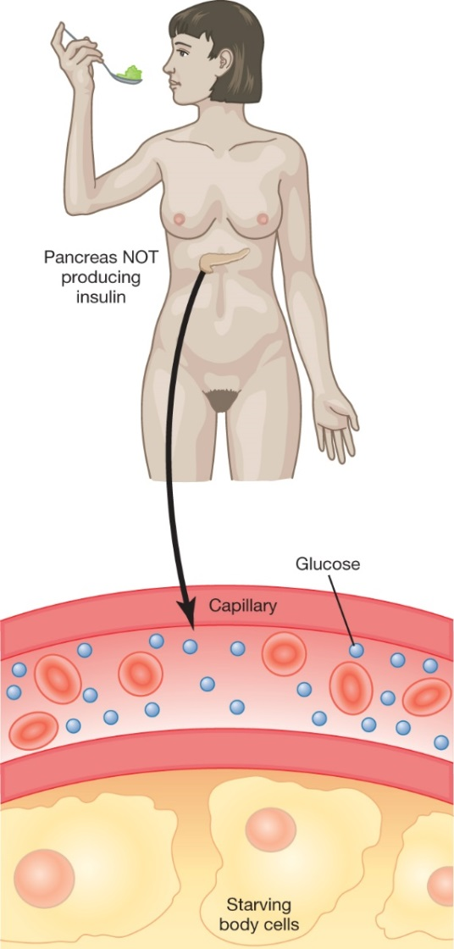
Common Endocrine Conditions (1 of 6)
Diabetes
Chronic condition
Body unable to:
Secrete appropriate amount of insulin
Metabolize glucose
© Jones & Bartlett Learning.
Notes:
Lecture Outline
XII. Common Endocrine Conditions
A. Diabetes
1. Diabetes is a chronic condition characterized by:
a. The body’s inability to secrete an appropriate amount of insulin OR
b. Production of insulin that the body is unable to use to metabolize glucose
2. Insulin is the primary hormone that allows glucose, amino acids, and other substances to cross the cell membrane, thereby facilitating metabolism and other functions.
3. Diabetes may cause a multitude of complications, such as:
a. Microvascular disease
b. Neuropathy
c. Peripheral vascular disease
d. Stroke
e. Heart disease
4. Diabetes may occur in conjunction with a variety of conditions, such as:
a. Obesity
b. Recurrent infection
c. Slow-healing wounds
d. Changes in vision
e. Abdominal pain
f. Heart disease
g. Stroke
5. In women, diabetes may occur in conjunction with:
a. Menstrual irregularities
b. Yeast vaginitis
c. Polycystic ovarian syndrome
6. Paramedics are taught to recognize the symptoms of hyperglycemic state, but these are the later signs of the disease.
7. For community paramedics, the goal should be to identify the earliest symptoms of acute and hyperglycemic states.
8. A definitive diagnosis of diabetes can be made by a series of tests including:
a. HgbA_{1c}
i. Measures the amount of glucose attached to the red blood cells
ii. Shows the average amount of glucose attached to the red blood cells over 2 to 3 months (more accurate descriptor of disease status)
b. Fasting plasma glucose test
c. Random plasma glucose test
9. When random testing is used, the presence of both of the following is considered diagnostic for diabetes:
a. Symptoms
b. A glucose level greater than 200 mg/dL
10. Diabetes is very common in the United States, with type 2 diabetes being the most prevalent form.
a. In 2014, the CDC reported that 9.3% of the US population—29.1 million people—have diagnosed diabetes; another 27.8 million people are thought to have undiagnosed diabetes.
b. Diabetes is the seventh leading cause of death in the United States and it causes $176 billion in direct medical costs each year.

Slide 133
Common Endocrine Conditions (2 of 6)
Diabetes (cont’d)
Type 1 diabetes
Complete destruction of beta cells in pancreas
Diagnosed early
Type 2 diabetes
Occurs later in life
Chronic hyperglycemic state
Prediabetes
Notes:
Lecture Outline
B. Types of diabetes
1. There are two primary types of diabetes mellitus:
a. Type 1 diabetes
b. Type 2 diabetes
2. A third condition known as prediabetes is also recognized.
3. Type 1 diabetes: a condition in which the body’s autoimmune response causes the complete destruction of beta cells in the pancreas
a. The beta cells in the pancreas produce, store and secrete insulin.
b. Diagnosed in the early years of life; rarely found in adults
c. Far less common than type 2 diabetes; accounts for only 5% of the total number of diabetes cases
d. Can cause deadly states such as diabetic ketoacidosis (DKA), a condition in which a persistently high blood sugar level triggers the body to metabolize fats for energy instead of glucose
i. DKA: a triad of events—hyperglycemia, then ketosis, and finally acidosis
ii. Type 2 diabetes can cause DKA, but much more rarely.
4. Type 2 diabetes generally occurs later in life (adult onset); characterized by a chronic hyperglycemic state secondary to a decrease in:
a. The quality of insulin produced
b. The sensitivity of the body’s cells to insulin
5. This condition evolves over a long period and generally is not found early.
a. Patients with type 2 diabetes may develop more complications and have irreversible issues.
6. Prediabetes is a chronic hyperglycemic state (fasting plasma glucose greater than 100 mg/dL or 2 hours postprandial plasma glucose of 140–199 mg/dL) combined with an HgbA_{1c} of 5.7% or greater.

Slide 134
Common Endocrine Conditions (3 of 6)
Diabetes (cont’d)
Monitoring: All patients should have
Close monitoring of their symptoms
Physical assessment for progression of disease and complications
Examine the skin for:
Infections
Poor circulation
Notes:
Lecture Outline
7. Monitoring:
a. All patients with diabetes should have:
i. Close monitoring of their symptoms
ii. Physical assessment for progression of disease and complications
b. The community paramedic should do a thorough examination of the skin to check for:
i. Infections
ii. Poor circulation
c. The primary care physician should conduct blood tests and urine tests.
e. Findings should be documented and assessed for trends.

Slide 135
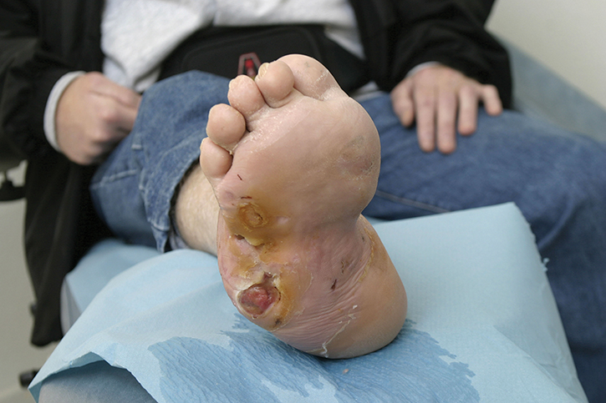
Common Endocrine Conditions (4 of 6)
Diabetes (cont’d)
Foot examinations are essential
50% of older patients with type 2 diabetes have risk factors for foot ulcerations
© BSIP SA/Alamy.
Notes:
Lecture Outline
d. Foot examinations are essential for all patients with diabetes.
i. Fifty percent of older adult patients with type 2 diabetes have one or two risk factors for foot ulcerations.
ii. The community paramedic evaluates all aspects of the skin on the foot and between the toes, as well as the nails.

Slide 136
Common Endocrine Conditions (5 of 6)
Diabetes (cont’d)
Management: Prevention of vascular disease to decrease risk of complications
Blood pressure control, tobacco cessation, glucose control, lowering lipid levels, aspirin prophylaxis
Lifestyle
Diet modification
Notes:
Lecture Outline
8. Management
a. Management includes prevention of vascular disease to decrease the risk of further complications.
b. Prevention is achieved through:
i. Blood pressure control
ii. Tobacco cessation
iii. Glucose control
iv. Lowering of lipid levels
v. Aspirin prophylaxis (sometimes)
c. These measures may also be combined with behavioral or pharmacologic management.
d. The least invasive form of management should be used first to treat the cause or exacerbating factors, such as:
i. Lifestyle
ii. Diet modification (lowering carbohydrate and sugar levels)
e. The community paramedic should emphasize the benefits of increasing:
i. Intake of fiber, whole grains, fruits, and vegetables
ii. Exercise
f. Pharmacologic therapy of chronic hyperglycemia includes medication classes such as:
i. Sulfonylureas
ii. Biguanides
iii. Meglitinides
iv. Thiazolidinediones
v. DPP-4 inhibitors
vi. SGLT2 inhibitors
vii. α-glucosidase inhibitors
viii. Bile acid sequestrants
g. The most commonly prescribed classes are sulfonylureas, biguanides, thiazolidinediones, and DPP-4 inhibitors.
h. In type 1 and late-stage type 2 diabetes, patients may require insulin therapy. Insulin comes in four specific types:
i. Rapid-acting insulin works within 15 minutes, peaks in 1 hour, and may work for up to 4 hours.
ii. Regular (short-acting) insulin begins to work within 30 minutes, peaks in 2 to 3 hours, and may last as long as 6 hours or as short as 3 hours.
iii. Intermediate-acting insulin begins to work within 4 to 6 hours after injection and may last up to 18 hours.
iv. Long-acting insulin maintains constant effects over a 24-hour period.
i. The specifics of each type of management/treatment for diabetes should be detailed in the patient’s plan of care.

Slide 137
Common Endocrine Conditions (6 of 6)
Diabetes (cont’d)
Education
Varies on the type and severity of patient’s comorbidities
Help patients understand diabetes is a chronic disease, not cured
Glycemic control
Notes:
Lecture Outline
9. Education
a. Very complex and sometimes overwhelming for many patients
b. Varies on the type and severity of the patient’s comorbidities
c. Help patients understand that diabetes is a chronic disease. Symptoms and complications of the disease are managed by the medications—not cured.
d. Patients should understand the correlation between estimated average glucose (eAG) and HgbA_{1c}, as this relationship helps patients understand their overall success in achieving glycemic control.

Slide 138
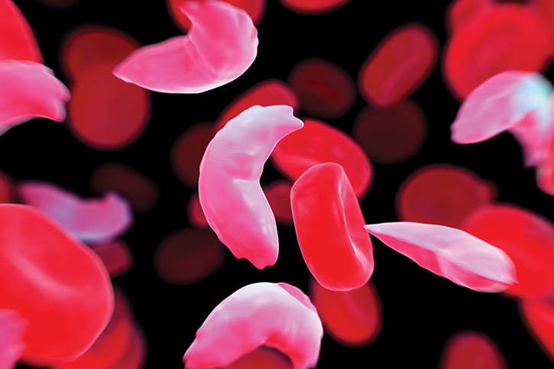
Common Hematologic/Lymphatic Conditions (1 of 4)
Sickle cell disease
Chronic condition
Production of abnormal form of hemoglobin
“S” or sickle shaped
© Science Picture Co/Science Source.
Notes:
Lecture Outline
XIII. Common Hematologic/Lymphatic Conditions
A. Sickle cell disease
Sickle cell disease is a chronic condition characterized by production of an abnormal form of hemoglobin, which is “S” or sickle shaped.
a. The deformation decreases:
i. Hemoglobin’s functionality
ii. Causes problems as it moves throughout the microvasculature
2. The most common form of sickle cell disease is the primary condition known as sickle cell anemia.
a. Body produces more “S” sickle hemoglobin than appropriate “A” hemoglobin cells.
b. Any disruption in the size, shape, and function of hemoglobin can cause multiple complications, pain, and even death.
c. Sickle cell anemia causes multiple complications and can be very complex to manage.
d. Some patients with this disease require complex treatments such as pain management, antibiotics, appropriate hydration, and blood transfusions.
e. Whenever a tissue or cell lacks oxygen or the ability to obtain oxygen, it may signal its hypoxic state through pain.
i. Sickle cell crisis is a vaso-occlusive crisis that is characterized by intense pain.

Slide 139
Common Hematologic/Lymphatic Conditions (2 of 4)
Sickle cell disease (cont’d)
Complications of disease include:
Recurrent bacterial infections
Stroke
Kidney failure
Chronic pain
Pulmonary hypertension
Notes:
Lecture Outline
f. Complications of sickle cell disease may include:
i. Recurrent bacterial infections
ii. Stroke
iii. Kidney failure
iv. Chronic pain
v. Pulmonary hypertension
g. Sickle cell disease is thought to affect approximately 100,000 people in the United States.
i. One out of every 365 African Americans has the disease, and 1 in every 13 African Americans has sickle cell trait.

Slide 140
Common Hematologic/Lymphatic Conditions (3 of 4)
Sickle cell disease (cont’d)
Management: techniques to prevent crisis
Hydration
Use of medication hydroxyurea
Blood transfusions
Bone marrow transplants
Notes:
Lecture Outline
3. Patients with sickle cell anemia should be closely monitored for appropriate hydration and diet compliance.
4. Management includes techniques to prevent sickle cell crisis, such as:
a. Hydration
b. Use of the medication hydroxyurea
c. Blood transfusions
d. Bone marrow transplants

Slide 141
Common Hematologic/Lymphatic Conditions (4 of 4)
Sickle cell disease (cont’d)
Education
Prepare patients for possibility of chronic pain
Assess patient’s understanding of the disease
Help patients to recognize:
What has caused exacerbations in the past
How and when to seek assistance for emergent situations
Notes:
Lecture Outline
5. Education
a. Some patients with sickle cell disease may have other issues, such as chronic pain. Prepare patients for the possibility of such conditions.
b. Community paramedics should take time to assess the patient’s level of understanding of the disease.
c. Patients with this disease should maintain good hygiene and learn to recognize what has caused exacerbations in the past.
d. This disease will progress, so the patient needs to understand how and when to seek assistance for emergent situations.

Slide 142
Common Immunologic Conditions (1 of 4)
Hepatitis
Inflammation of the liver; typically caused by a viral infection but may be traced to:
Use of alcohol
IV drug use
Medications
Autoimmune diseases
Types: A, B, C, D, E
Notes:
Lecture Outline
XIV. Common Immunologic Conditions
A. Hepatitis
1. Hepatitis—inflammation of the liver—is typically caused by a viral infection but may sometimes be traced to:
a. Use of alcohol
b. IV drug use
c. Medications
d. Autoimmune diseases
2. Abnormal inflammation of the liver tissue impairs the liver’s ability to function normally.
3. Hepatitis has many forms, but the most concerning are viral.
a. These types are designated as A, B, C, D, and E.
b. Community paramedics may work with hepatitis C patients depending on the scope of practice of the community paramedicine program.
i. Hepatitis C virus is transmitted by blood and other bodily fluids.
ii. Approximately 15% to 25% of patients who are exposed to this virus clear it without treatment; the remainder develop a chronic infection, and 5% to 20% of them develop liver cirrhosis over the next 20 to 30 years.
c. Liver cirrhosis:
i. A severe complication of hepatitis that occurs secondary to the significant scarring caused by hepatitis
ii. Patient’s condition has reached the advanced or terminal stage.
d. Another significant complication of hepatitis is hepatic encephalopathy.
i. The liver is simply unable to remove the toxins in the blood.
ii. While generally reversible, this condition can be a significant complication that may lead to death if untreated.

Slide 143
Common Immunologic Conditions (2 of 4)
Hepatitis (cont’d)
Monitoring: Physical signs indicate progression or stage of disease
Jaundice
Hepatomegaly
Notes:
Lecture Outline
4. Monitoring
a. Patients with hepatitis have many common physical signs that may indicate further progression or aid in staging their disease.
i. Jaundice: yellowing of the skin or sclera of the eyes
ii. Hepatomegaly: an enlarged liver
May be palpated during physical examination
b) Noted in a diagnostic test such as computed tomography or x-ray

Slide 144
Common Immunologic Conditions (3 of 4)
Hepatitis (cont’d)
Management
Supportive and seeks to prevent complications
Alert the medical director to red flags
Address chronic nausea and/or vomiting with hydration and correction of electrolyte abnormalities
Notes:
Lecture Outline
5. Management
a. Management is primarily supportive and seeks to prevent complications.
b. If patients demonstrate any red flags, such as altered mentation, alert the medical director.
c. Many patients will have chronic nausea and/or intractable vomiting, which need to be addressed with:
i. Appropriate hydration
ii. Correction of electrolyte abnormalities
d. Patients with hepatitis are immunocompromised. Do not place them in danger of infection more than necessary.
e. Follow the patient’s plan of care and local protocols.

Slide 145
Common Immunologic Conditions (4 of 4)
Hepatitis (cont’d)
Education focuses on:
Improving patient’s understanding of causes of exacerbations of their condition (eg, alcohol or sodium intake)
Informing patients on how the disease can be spread
Notes:
Lecture Outline
6. Education
a. Education should focus on improving their understanding of the causes of exacerbations of their conditions.
i. Especially important with patients whose exacerbations occur secondary to alcohol intake or sodium intake
ii. Limit daily sodium intake to 2 g
b. Patients also need education on how the disease can be spread.

Slide 146
Obesity (1 of 4)
Obesity
Characterized by the abundance and excess of fatty (adipose) tissue throughout the body
Caused by an energy imbalance between:
Caloric intake
Caloric expenditure
Body mass index (BMI)
Notes:
Lecture Outline
XV. Obesity
A. Overview
1. Obesity is characterized by the abundance and excess of fatty (adipose) tissue throughout the body.
a. Buildup of fatty tissue may eventually cause complications
b. Poses an overall risk to the patient’s safety and health
2. Obesity is generally considered to be caused by an energy imbalance between:
a. Caloric intake
b. Caloric expenditure
3. Diagnosis is based on the patient’s body mass index (BMI), which is calculated as follows:
BMI = [Weight (lb) ÷ height² (in.)] × 704.5
a. Obesity: a BMI greater than 30
Morbid obesity: a BMI greater than 40
4. Obesity is a leading cause of death throughout the world.
a. The obesity rate has doubled since 1980, such that this condition now affects 2.5 billion adults and children.
b. Obesity is believed to cause more deaths than underweight (ie, starvation).
c. In the United States, more than one-third of the population is considered obese.
5. Obesity is considered a preventable disease, although some medical conditions can cause significant issues in metabolizing foods, such as:
a. Certain endocrine disorders
b. Use of certain medications
c. Inability to sustain physical activity
6. Obesity is a very complex condition that may have genetic, biologic, metabolic, behavioral, social, economic, and cultural roots.
a. Many of these causes may be out of the person’s control; obesity is not a simple condition of overeating.
7. Obesity causes many complications and serious health issues, such as:
a. High cholesterol levels
b. Type 2 diabetes
c. Hypertension
d. Metabolic syndrome
e. Heart disease
f. Stroke
g. Cancer
h. Breathing disorders (eg, Pickwickian syndrome)
i. Gallbladder disease
j. Gynecologic and erectile dysfunction
k. Osteoarthritis
8. Because of the significant stigma associated with obesity, the community paramedic should be nonjudgmental and unbiased toward the patient.

Slide 147
Obesity (2 of 4)
Obesity (cont’d)
Monitoring
Many comorbid conditions such as hypertension, CHF, and diabetes
Evaluate BMI at initiation of enrollment
Investigate underlying conditions (eg, depression, CHF, COPD)
Notes:
Lecture Outline
9. Monitoring
a. Patients with obesity may have many comorbid medical conditions, such as hypertension, CHF, and diabetes.
b. Monitoring parameters generally not the community paramedic’s responsibility unless the community paramedicine program sees patients for more than 6 months.
c. Evaluate BMI at the initiation of enrollment
d. Investigate any underlying conditions or disorders that may contribute to worsening obesity.
i. Depression, CHF, COPD

Slide 148
Obesity (3 of 4)
Obesity (cont’d)
Management: The community paramedic should:
Evaluate the primary cause of the patient’s obesity
Discuss appropriate intake and nutrition
Help the patient understand condition
Notes:
Lecture Outline
10. Management
a. Management of obesity is very complex and may involve many other factors.
b. The community paramedic should:
i. Evaluate the primary cause of the patient’s obesity
ii. Discuss appropriate intake and nutrition
iii. Help the patient understand this condition, while remaining gentle and compassionate

Slide 149
Obesity (4 of 4)
Obesity (cont’d)
Education should start with:
Diet
Physical exercise
Understanding of intake versus burning of calories
Notes:
Lecture Outline
11. Education
a. Education should start with:
i. Diet
ii. Physical exercise
iii. Understanding of intake versus burning of calories
b. Patients should understand that each meal and all items that they consume will affect them in some way.

Slide 150
Medical Technology in the Home Setting (1 of 28)
Community paramedic’s role
Help troubleshoot various forms of technology/devices
Provide assistance if device fails
On each visit, evaluate all devices and equipment that assists the patient
Notes:
Lecture Outline
XVI. Medical Technology in the Home Setting
A. Community paramedic’s role
1. The community paramedic will encounter many various forms of technology in the field.
2. Patient may ask community paramedic to:
a. Help troubleshoot devices
b. Provide assistance if a device fails
3. On each visit, the community paramedic should fully evaluate all devices or equipment that assists the patient in any way.
a. Simple as a guardrail on the stairs or complex as ventricular assist device
4. The community paramedic should gather as much information about each device a patient uses as possible.
a. The user’s manual should be read by the patient and community paramedic.

Slide 151
Medical Technology in the Home Setting (2 of 28)
Pacemakers
Internal medical devices to regulate heart’s rhythm
12-lead electrocardiogram (ECG)
Community paramedic discusses abnormalities or lack of function with provider overseeing device
Notes:
Lecture Outline
B. Pacemakers
1. Pacemakers are internal medical devices that regulate the heart’s rhythm.
2. Role of community paramedic:
a. Minimal and supportive in nature
b. If device was placed recently, evaluate issues
c. Ensure no device wires or part of device protruding from chest wall
3. Monitoring
a. The community paramedic may perform a 12-lead ECG and transmit it to the medical director for evaluation. Follow local protocols.
4. Management
a. The community paramedic
i. Should not be managing the pacemaker
ii. Discusses any abnormalities or lack of function of the device with the electrophysiologist or provider overseeing device
b. Many new devices can be tested remotely by a technician.
5. Education
a. Education is generally provided to the patient in the hospital
i. Community paramedic should ask patients about what they understand about the device
ii. Ask them if it functions as a demand or fixed-rate pacemaker.
b. The newer pacemakers are not vulnerable to inference from microwave ovens, handheld remotes, or televisions.
i. Common misconception that these interfere with pacemakers
ii. Some cell phones could cause interference with pacemakers; keep them more than 6 inches (15 cm) away from device.

Slide 152
Medical Technology in the Home Setting (3 of 28)
Wearable cardioverter defibrillators (WCDs)
External defibrillator given to patients who are not candidates for pacemakers
© Lori Ann Cook-Neisler/The Pantagraph/AP Photo.
Notes:
Lecture Outline
C. Wearable cardioverter defibrillators
1. A wearable cardioverter defibrillator (WCD) (eg, the ZOLL LifeVest) is an external defibrillator that is given to patients who are not candidates for pacemaker placement.
a. This device allows the patient to:
i. Have the benefit of a defibrillator
ii. Be able to carry out ADLs
2. Patients are given the device:
a. While awaiting placement of a more long-term device
b. Because they may not survive internal pacemaker placement procedure

Slide 153
Medical Technology in the Home Setting (4 of 28)
WCDs (cont’d)
Monitoring and management
Ensure compliance with requirements
Discuss importance of device; assess what patient understands
Notes:
Lecture Outline
3. Community paramedics should:
a. Help patients understand the importance of the WCD
b. Ensure appropriate compliance with the requirements
Some of these devices can be taken off for hygienic purposes, although these occasions should be limited and removal done rarely.
5. Monitoring
a. The community paramedic who encounters a patient with a WCD may perform a 12-lead ECG and transmit it to the medical director for evaluation.
b. Follow local protocols.
6. Management
a. Management of a patient with a WCD includes ensuring compliance with wearing the device.
7. Education
a. Discuss the importance of the WCD with the patient.
b. Determine what the patient understands about the device with questions such as:
i. Why do you wear the device?
ii. Do you know what it can do to save your life?
iii. How does it affect your daily routines?

Slide 154
Medical Technology in the Home Setting (5 of 28)
Ventricular assist devices (VADs)
Either fully take over or assist the ventricles in pumping blood to rest of body
Commonly placed to assist the left ventricle
Next-to-last resource for patients with advanced ventricular failure
Notes:
Lecture Outline
D. Ventricular assist devices
1. Ventricular assist devices (VADs) either fully take over or assist the ventricles in pumping blood to the rest of the body.
a. Most commonly placed to assist the left ventricle
b. Right VADs may also be placed in the right ventricle for:
i. Severe diastolic heart failure
ii. Severe myocardial infarction
2. VADs are the next-to-last resource for patients with advanced ventricular failure (with a heart transplant being the last resource).
3. Patients eligible for these devices:
a. Those with advanced systolic heart failure who are in need of a heart transplant (most common)
b. Those who are ineligible for a heart transplant due to age or other medical complications

Slide 155
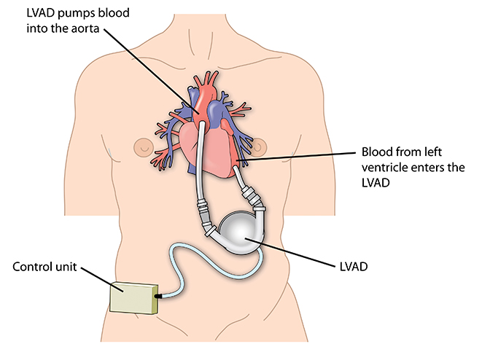
Medical Technology in the Home Setting (6 of 28)
VADs (cont’d)
All contain 3 parts:
Pump
Controller
Outside energy source
© Blamb/Shutterstock.
Notes:
Lecture Outline
4. Some devices are now fully implantable.
5. All VADs contain three parts:
a. The pump
b. The controller
c. An outside energy source (eg, a battery pack)
6. Current-generation (third-generation) pumps are implanted in the abdomen just below the diaphragm.
a. Controller attached to the belt of the patient
b. Bilateral suspenders hold the battery packs
7. Older versions had the ability to mechanically pump from outside the body, but the devices used now do not.
8. For patients using VADs, the device is essential for life.
9. Patients now are placed on this therapy for a longer time than in the past.
a. 80% to 90% of patients are alive 1 year after VAD placement
b. 60% to 70% are alive 2 years after VAD use begins
c. Newer studies even suggest that the heart may even be able to heal itself when a VAD is used.
10. The community paramedic should be familiar with VADs and how to troubleshoot problems with them, as these devices may occasionally fail.
11. It is important to fully assess, monitor, and document all findings related to the VAD. During assessment, note:
a. The device name
b. The placement of the exit site
c. Controller function
d. Battery packs
e. Overall patient compliance with the device
12. At each visit, ensure that there is no newfound abnormality with the device.
13. Management
a. The community paramedic may perform a 12-lead ECG and transmit it to the medical director for evaluation. Follow local protocols.
14. Education
a. When patients receive VADs, they undergo an extensive process of education prior to leaving the hospital.
b. An entire team of educators will review the device with them
i. Nurses, physicians, representatives from the device’s manufacturer
c. Community paramedic should:
i. Obtain a user’s manual for each device
ii. Fully discuss the VAD with your patient to ensure his or her complete understanding of the device
iii. Familiarize himself/herself with the device

Slide 156
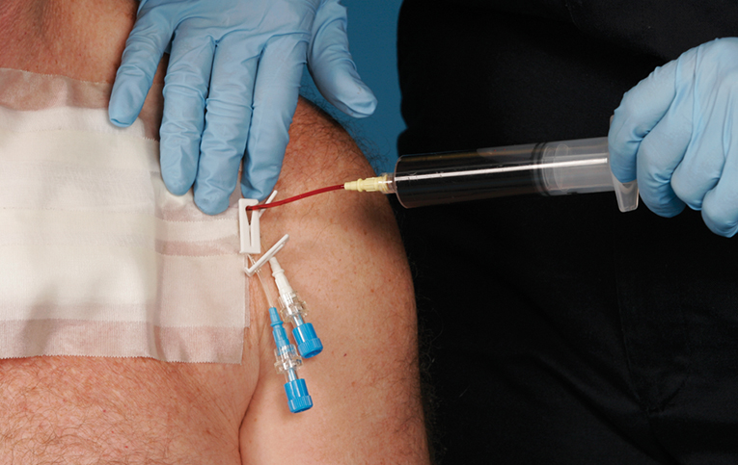
Medical Technology in the Home Setting (7 of 28)
Long-term vascular access devices
Variety of devices placed for a variety of reasons
© Jones & Bartlett Learning. Courtesy of MIEMSS.
Notes:
Lecture Outline
E. Long-term vascular access devices
1. Many patients use a variety of long-term vascular access devices.
2. Central and long-term VADs are placed for a variety of reasons, including:
a. Inadequate or impossible peripheral IV access
b. Administration of medications that are irritating to smaller blood vessels
c. Vasopressor medication infusion
d. Chemotherapy
e. Frequent blood draws
f. Long-term antibiotic therapy
g. Dialysis

Slide 157
Medical Technology in the Home Setting (8 of 28)
Long-term vascular devices
Peripherally inserted central catheter (PICC)
Midline catheter
Double- or triple-lumen central catheter
Hickman, Broviac, Ghoshong catheters
Implanted ports (eg, Port-a-Cath)
Dialysis catheters (Vas-Cath/Permcath)
Notes:
Lecture Outline
3. There are many different types of devices for vascular access, including:
a. Peripherally inserted central catheter (PICC): a long IV catheter that is usually placed in the arm and follows the peripheral veins into the superior vena cava
b. Midline catheter: placed into an upper extremity but not as long as the PICC and does not reach the central circulation
c. Double- or triple-lumen central catheter: a traditional central line that is placed through the skin in relatively close proximity to a large central vein
d. Hickman, Broviac, and Ghoshong catheters: three similar brands of catheters that are “tunneled” under the skin and placed into the superior vena cava
e. Implanted ports (Port-a-Cath or similar): placed completely under the patient’s skin and tunneled into a central vein, typically the superior vena cava
f. Dialysis catheters (Vas-Cath/Permcath): thick-walled, high-volume catheters that are usually placed into a patient’s neck, biceps, or groin to provide dialysis

Slide 158
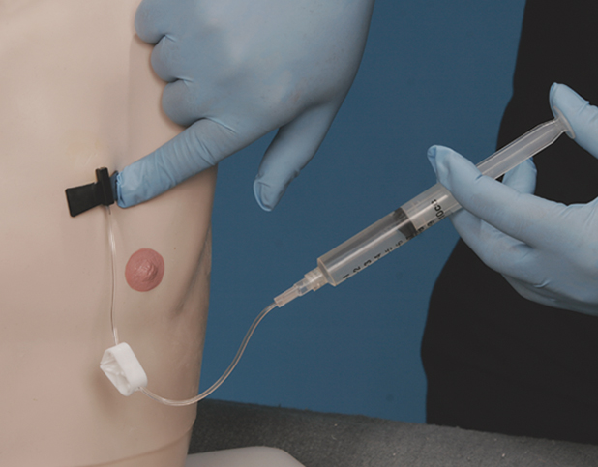
Medical Technology in the Home Setting (9 of 28)
Long-term vascular devices (cont’d)
Problems include:
Limited life span
Clog with blood
Infections
Mechanical failure
© Jones and Bartlett Learning. Courtesy of MIEMSS.
Notes:
Lecture Outline
4. Several problems may occur with a long-term vascular access device:
a. Limited life span
b. Clog with blood clots
c. Harbor infections
d. Present a risk of mechanical failure or accidental removal
5. The role of the community paramedic relative to these devices is to:
a. Monitor them
b. Ensure there are no abnormalities at the placement sites
c. Notify the medical director of any changes/abnormalities
6. Monitoring
a. The community paramedic who encounters a patient with a long-term VAD may perform a 12-lead ECG and transmit it to the medical director for evaluation.
b. Follow local protocols.
7. Management
a. The community paramedicine program determines whether the community paramedic needs to access any of the long-term VADs.
i. Extensive education by a vascular specialist or medical director is required in such a case.
b. Refer any questions about abnormalities in the device’s size or function and/or need for access to the medical director.
8. Education
a. Work with patients to ensure that they have received proper education on the devices prior to your involvement.
b. Have them teach back the information to you, and correcting any gaps in education you find.
c. Educate patients on appropriate bleeding control measures and ensure that patients are protecting the device as much as possible.
d. If patients are self-administering medications or otherwise accessing the device, they must understand:
i. Infectious disease prevention
ii. Management procedures

Slide 159
Medical Technology in the Home Setting (10 of 28)
Medication infusion pumps
IV medications delivered in the home setting:
Inotropic medications for CHF
IV nutrition
Chemotherapy
IV antibiotics
Notes:
Lecture Outline
F. Medication infusion pumps
1. Patients may receive a wide assortment of IV medications in their homes.
2. Categories of IV medications delivered in the home setting include:
a. Inotropic medications for CHF
b. IV nutrition
c. Chemotherapy
d. IV antibiotics

Slide 160
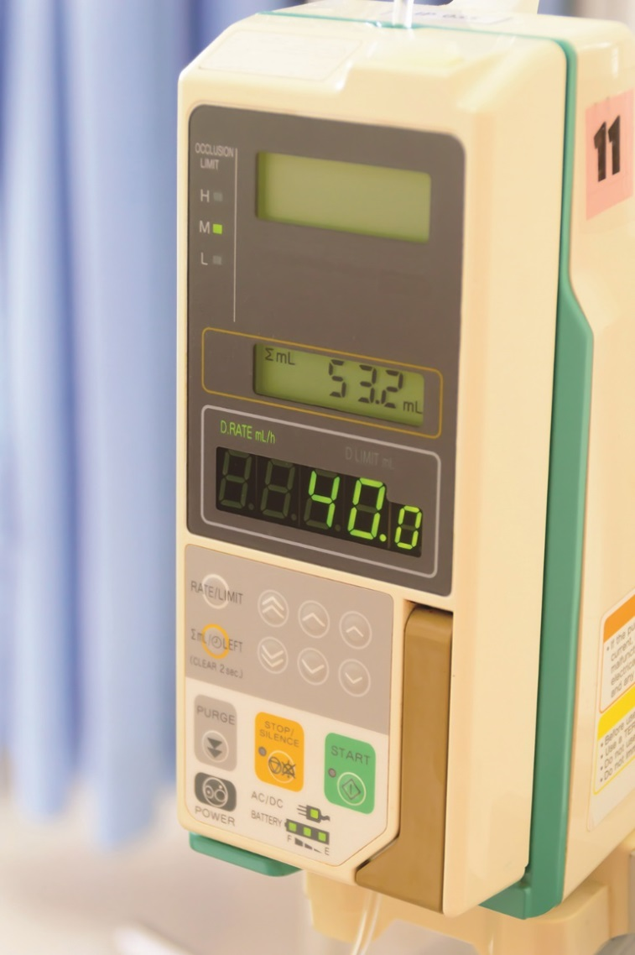
Medical Technology in the Home Setting (11 of 28)
Medication infusion pumps (cont’d)
Many IV medications administered with infusion pumps
5 rights of medication administration
© Lek Changply/Shutterstock.
Notes:
Lecture Outline
3. Many of these medications will be administered with infusion pumps.
4. The community paramedic may encounter devices that infuse medications and may be asked to respond or stand by when an agency is providing IV therapy at home.
a. Determine the type of infusion system.
b. Ensure compliance with the “five rights” of medication administration:
i. Right patient, right drug, right dose, right route, right time
c. Ensure that the appropriate protocols are observed and online or offline medical control is available.
d. Follow local protocols.
5. Monitoring and management
a. Monitor and document each aspect of the medication administration procedure.
b. If the patient presents with an adverse reaction or the efficacy of the medication does not seem to be appropriate, ensure that the five rights of medication administration have been observed and then contact the medical director.
6. Education
a. Most patients with medication infusion pumps will have received significant education from the:
i. Home health agency administering the medication
ii. Pharmacy providing the device
b. Discuss patients’ understanding of the device and have them teach back the information.
c. Provide information to fill in any gaps in understanding.
d. Follow local protocols.

Slide 161
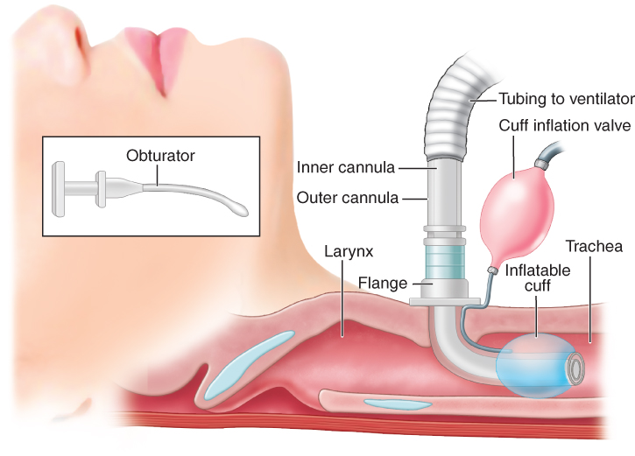
Medical Technology in the Home Setting (12 of 28)
Tracheostomy
Surgical opening created in the anterior aspect of the neck
Temporary or permanent
© Jones & Bartlett Learning
Notes:
Lecture Outline
G. Tracheostomy
1. A tracheostomy is a surgical opening created in the anterior aspect of the neck at the inferior border of the cricoid cartilage.
2. Paramedics are familiar with emergent cricothyroidotomy, but a tracheostomy procedure is generally performed in a stable environment after the emergency has been stabilized.
3. A tracheostomy can be either temporary or permanent.

Slide 162
Medical Technology in the Home Setting (13 of 28)
Tracheostomy (cont’d)
Indications include:
Severe trauma
Inhalation burns
Cancer
Reconstructive surgical procedures of the neck
Long-term need for intubation
Notes:
Lecture Outline
4. Indications for tracheostomies include:
a. Severe trauma
b. Inhalation burns
c. Cancer
Reconstructive surgical procedures of the neck
Long-term need for intubation such as with chest wall injuries or diaphragm dysfunction as occurs in patients with ALS

Slide 163
Medical Technology in the Home Setting (14 of 28)
Tracheostomy (cont’d)
Ventilator support
Long-term replacements for endotracheal tubes
Frequent suctioning required
Notes:
Lecture Outline
5. Most patients will require an initial period of ventilator support, although this therapy is rarely continued at home.
6. A tracheostomy affects the patient’s speech, as the site of the tracheostomy is below that of the vocal cords.
7. Note the normal anatomy and physiology of the airway when looking at a tracheostomy.
a. Tracheostomy tubes function as long-term replacements for endotracheal tubes.
b. These devices are used for patients who:
i. Require long-term ventilator support
ii. Frequent tracheal suctioning
iii. Airway protection owing to a medical condition such as traumatic brain injury, quadriplegia from any disease, or ALS.
c. Displacement of a tracheostomy tube may be an immediate threat to life.
d. Tracheostomy tubes may be placed:
i. Electively in patients already receiving mechanical ventilation via endotracheal tubes
ii. In patients with a slowly evolving upper airway obstruction or tumor
e. The tube passes directly from an opening in the anterior neck, below the thyroid cartilage, into the trachea.
f. Speech is not possible unless expired air is allowed to pass around the tracheostomy tube and through the larynx (vocal cords).
g. Patients with tracheostomy tubes need frequent deep suctioning with an appropriate size of suction catheter.
i. When possible, deep tracheal suctioning is performed.
ii. Oral suctioning may also be required
h. Community paramedics should brush up on the suctioning techniques learned in paramedic school.
i. Work with the patient on techniques such as measuring the suction cannula.
i. Follow local protocols.
j. Support the patient as needed per local protocols, and document normal and abnormal findings.
8. Monitoring and management
a. Monitoring of a tracheostomy is the same as monitoring of any other ostomy or surgical opening in the body.
b. Document all findings and note any changes.
c. If immediate changes or infectious changes are apparent, notify the medical director.
d. During each visit, the community paramedic should perform a patient assessment and document all findings.
e. Immediately address any potential life threats and alert the medical director.
f. Ensure that the patient has long-term respiratory therapy and an open line of communication to the agency that is providing this service, including access to a 24/7 on-call line.
9. Education
a. Education for tracheostomies is similar to that for all ostomies.
b. Take a step-by-step approach to all education and ensure that the patient fully understands all information provided.
c. Have the patient demonstrate:
i. The procedures for suctioning
ii. Cleaning and replacing the inner cannula
iii. Decompressing and inflating the cuff
iv. Using any alternative application devices they may have, such as a speech valve.

Slide 164
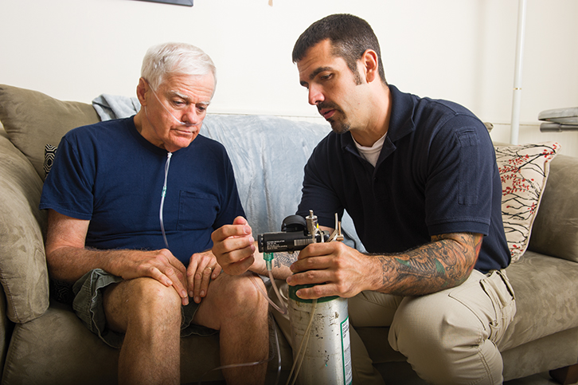
Medical Technology in the Home Setting (15 of 28)
Oxygen or supplemental oxygen delivery systems
For patients who do not achieve optimal oxygen delivery
© Jones & Bartlett Learning.
Notes:
Lecture Outline
H. Oxygen or supplemental oxygen delivery systems
1. Supplemental oxygen systems are provided for patients who do not achieve an optimal oxygen delivery to their system by normal ventilation.

Slide 165
Medical Technology in the Home Setting (16 of 28)
Oxygen or supplemental oxygen delivery systems (cont’d)
Patients with these devices have:
Chronic asthma
COPD
CHF
Morbid obesity
Notes:
Lecture Outline
2. Patients with these devices are those who have:
a. Chronic asthma
b. COPD
c. CHF
d. Morbid obesity
3. Community paramedics should monitor and report any patients who sustain along-term oxygen saturation (Spo₂) of less than 90% to the medical director.
a. This will help determine the patient’s eligibility for long-term oxygen therapy at home.
4. Monitoring
a. Monitor the type of device and efficacy of the therapy with:
i. The patient assessment
ii. Spo₂ readings
b. If possible and if local protocols allow:
i. Monitor end-tidal carbon dioxide (etco₂)
ii. Ensure that the patient is maintaining adequate levels (35 to 45 mm Hg) or parameters set by plan of care
c. Determine whether the patient is on supplemental oxygen through an oxygen cylinder or via a concentrator.
d. As a community paramedic, you should familiarize yourself with the type of device provided and evaluate every aspect of the device to ensure proper delivery of oxygen.
e. Check the power source, electrical cords, on and off buttons, and delivery tubing from the machine to the patient.
f. Ensure the patency of the tubing; it should not have holes or kinks.
g. Evaluate the patient end of the oxygen system.
i. Assess the patient’s work of breathing, lung sounds, airway patency, and the delivery device itself.
ii. Confirm that the patient has not tampered with the cannula and confirm there is a proper seal with the mask.
iii. If the patient has a tracheostomy placement, ensure its patency.
iv. Help patients understand how to self-monitor their symptoms and evaluate their devices.
v. If a device failure has occurred, document it, provide supplemental oxygen if required, and contact the medical director for further direction.
5. Management
a. To help manage patients, follow the patient’s plan of care.
b. Ask patients questions such as:
i. How do you feel with the device?
ii. Do you feel like it is helping you?
iii. Do you feel like you are not having to work as much to breathe when you are wearing this device?
iv. Have you discussed with your primary care physician why you are on oxygen?
v. Do you have any questions about this device that we can discuss?
c. If the device is providing the ordered therapy per the plan of care (eg, 2 L/min flow) and there is no issue with the device itself, follow the appropriate protocols.
6. Education
a. Ensure that the patient fully understands the oxygen delivery device, including how the device works.
b. Have the patient teach back the information provided, and ask if the patient has any further questions.
c. Review some of the troubleshooting guidelines and assess the patient’s understanding of what to do when there is a problem with the device.
d. If the patient continues to have difficulties with the oxygen delivery device, contact the medical director.

Slide 166
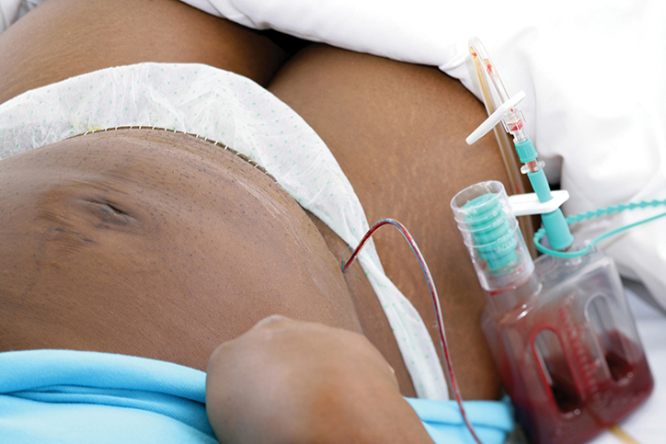
Medical Technology in the Home Setting (17 of 28)
Postsurgical devices
Variety of drains and devices used following surgery
Surgical drain
© CHASSENET/age fotostock.
Notes:
Lecture Outline
I. Surgical drains, NPWT devices, and other postsurgical devices
1. There is a variety of drains and devices that are used following surgery to monitor and assist wound healing and closure.
2. The community paramedic may have to care for patients with many different types of surgical drains and devices.

Slide 167
Medical Technology in the Home Setting (18 of 28)
Postsurgical devices (cont’d)
Wound drains
Prevent pockets of fluid from collecting
Allow health care providers to monitor characteristics of the fluid being drained
Notes:
Lecture Outline
a. Wound drains prevent pockets of fluid from collecting at the surgical site, while allowing health care providers to monitor characteristics of the fluid being drained, such as:
i. Volume
ii. Appearance
iii. Composition
b. Other devices rely on mechanical forces to stabilize a surgical site and promote healing.
3. Monitoring
a. During the full physical assessment:
i. Note all aspects of the device, from where it connects to the patient to the device itself.
ii. Monitor and document the type, amount, and color of the discharge it is suctioning.
iii. Obtain the user’s manual for this device if possible.
iv. Follow local protocols.
4. Management
a. Contact the medical director if:
i. The device fails to work or to hold suction
ii. There is evidence that the patient is being harmed by the device
b. Each community paramedicine program will have protocols for such devices.
5. Education
a. Ensure that the patient fully understands the surgical drain, negative pressure wound therapy (NPWT) device, or other device, including how the device works.
b. Have the patient teach back the information provided, and ask if the patient has any further questions.
c. Review some of the troubleshooting guidelines and assess the patient’s understanding of what to do when there is a problem with the device.
d. Contact the medical director if the patient continues to have difficulties with the device.

Slide 168
Medical Technology in the Home Setting (19 of 28)
Feeding tubes
Allow nourishment and water to enter digestive system directly, without need for chewing or swallowing
Decrease the risk of aspiration in patients who cannot swallow effectively or protect the airway
Notes:
Lecture Outline
J. Feeding tubes
1. Patients who are unable to take nutrition orally may receive some or all nourishment from tube feeding.
2. Flexible catheters can be placed through:
a. The mouth
b. The nose
c. The skin
3. These tubes:
a. Allow nourishment and water to enter the digestive system directly, without the need for chewing or swallowing.
b. Decrease the risk of aspiration in patients who cannot swallow effectively or protect the airway.

Slide 169
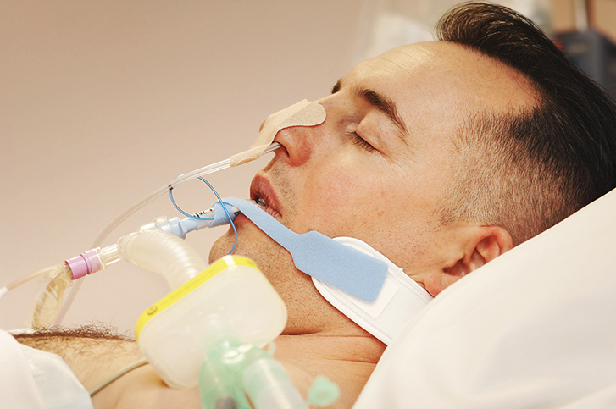
Medical Technology in the Home Setting (20 of 28)
Feeding tubes (cont’d)
Nasogastric and orogastric feeding tubes
Placed from the nose and mouth into patient’s stomach
© Bodenham, LTH NHS Trust/Science Source.
Notes:
Lecture Outline
4. Nasogastric feeding tubes and orogastric feeding tubes are placed from the nose and the mouth, respectively, into the patient’s stomach.
5. Other types of feeding tubes include:
a. Nasoduodenal and nasojejunal tubes
b. Gastronomy tubes
c. Jejunostomy tubes
d. Percutaneous endoscopic gastronomy (PEG) tubes
e. Percutaneous endoscopic jejunostomy (PEJ) tubes
6. PEG tube allows nutrition, fluids, and medications to be administered directly into the stomach, bypassing the mouth and esophagus.
7. Monitoring and management
a. Per protocols, at each visit, the community paramedic may:
i. Monitor and assess the site at which the feeding occurs
ii. Look for signs of infection and overinflation of the organs
iii. Confirm the absence of seeping from around the tubing or necrotic tissue surrounding the site
iv. Monitor for malfunction of the infusion pump and any signs of the patient vomiting or aspirating the tube feeding
v. Document and assess this information at every patient assessment
vi. Contact the medical director if there is any obvious abnormality
8. Education
a. Key to success when patients require tube feeding is patient and caregiver education.
b. Patient should be able to fully demonstrate the entire feeding process, including aspirating the tube and clearing occlusions.
c. Patients should be aware of:
i. How to prepare and place appropriate dressings around the site
ii. How to recognize the signs of infection and necrosis

Slide 170
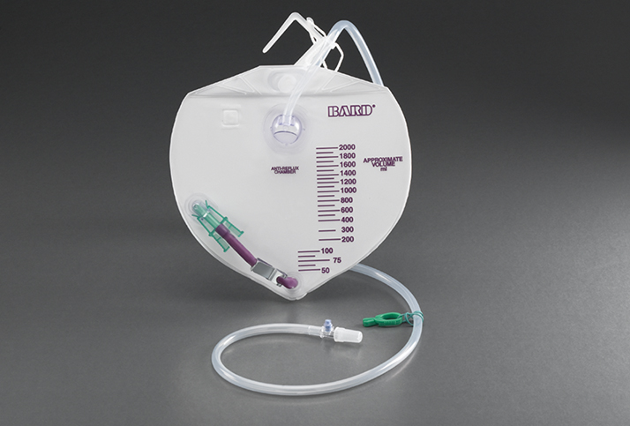
Medical Technology in the Home Setting (21 of 28)
Ostomies
Temporary or permanent surgical placement of device or opening
Urinary drainage bag
© 2012 C. R. Bard, Inc. Used with permission.
Notes:
Lecture Outline
K. Ostomies
1. An ostomy is a temporary or permanent surgical placement of a device or opening to rid the body of waste.
2. Most patients are able to function and have no limitations in their normal ADLs when they have ostomies.
3. While the ostomy devices and their locations may differ, their similarities include:
a. The overall management
b. Role of the community paramedic
c. Patient education
4. The role of a community paramedic is supportive and educational in nature.
5. The community paramedic should evaluate the patient’s overall understanding of the ostomy and determine how the patient is managing it.

Slide 171
Medical Technology in the Home Setting (22 of 28)
Ostomies (cont’d)
Types of ostomies
Colostomy
Ileostomy
Urostomy
Common complications:
Infection
Reduction of size
Blockage of stoma
Mild irritation
Notes:
Lecture Outline
6. Types of ostomies
a. Colostomy: ostomy performed through the anterior abdominal cavity to connect the large intestine to the outside via a stoma
i. The site of the stoma depends on the origination or cause of the diversion.
ii. There is no change in the way in which the intestines work with a colostomy, although some mucus may still be discharged from the anus.
iii. A colostomy is often performed because of infection, injury, blockage, cancer, and wounds and fistulas in the perineum.
b. Ileostomy: opening created in the abdominal wall to the small intestine
i. Common indications for an ileostomy are similar to those for colostomy.
ii. Some patients with Crohn disease and ulcerative colitis will require an ileostomy after bowel resection.
c. Urostomy: surgical opening directly to the bladder through the anterior abdominal wall
i. A urostomy is required secondary to complete blockage and inability to remove the blockage from below the bladder, following postsurgical resection, or following irreversible damage to the urinary tract.
ii. On occasion, an Indiana pouch is placed to replace the bladder completely; this device is fully drained by the urostomy.
iii. Unlike a colostomy or ileostomy, a urostomy must be secured with a temporary stent that will keep the location open for continued use.
7. Monitoring
a. Evaluate and document the site, size, type or name of the device, and any barriers that might prevent the device from completely expelling waste.
b. Common complications with all ostomies are:
i. Infection
ii. Reduction of size
iii. Blockage of the stoma.
iv. Mild irritation during the initial placement of the ostomy or device.
c. Evaluate the ostomy—or at least the site—to ensure there are no complications, injury, or infection.
d. Identify and document the properties of the stool or urine.
e. If there are any changes or significant signs of infection, notify the medical director.
8. Management
a. Management focuses on ensuring there are no changes in the location of the ostomy, problems such as infection, or change in size.
b. Ensure proper discharge is obtained and adequate waste discharge is maintained.
c. Discuss with the patient how changes in diet and activity will affect the ostomy.
d. Help the patient understand “normal” versus “abnormal” in regard to waste discharge.
e. Follow local protocols.
9. Education
a. Education should focus on ensuring patients are able to “cope” with their ADLs while having the ostomy in place.
b. Patients should make a checklist containing all additional items they may need while away from their stock of supplies at home.
c. Provide education on:
i. Proper care of the ostomy
ii. Maintenance of the ostomy
iii. Replacement of bags
iv. Cleaning at home
d. Patients should understand the food items that may change their stool or cause gas.
e. Discuss common complications of ostomies, such as narrowing of the stoma and blockage of the ostomy tubes or stoma.
f. Help the patient understand the overall hygiene related to the ostomy and common infectious disease management.
g. Follow local protocols.

Slide 172
Medical Technology in the Home Setting (23 of 28)
Ambulatory assist devices
Items that help the patient maintain balance during normal ambulation (ie, walking)
Devices vary in size, shape, and function
Cane
Walker
Notes:
Lecture Outline
L. Ambulatory assist devices
1. Overview
a. Ambulatory assist devices are items that help the patient maintain balance during normal ambulation (ie, walking).
b. Devices vary in size, shape, and function.
c. This discussion focuses on two standard types:
i. Canes
ii. Walkers
d. A cane is a small, one-legged device that allows the user to maintain balance or assists with standing and ambulating.
i. Some more modern canes have four legs at the bottom.
e. Use of a cane should require only one upper extremity, whether it be with a hand–wrist device or a full-arm device that connects at the elbow.

Slide 173
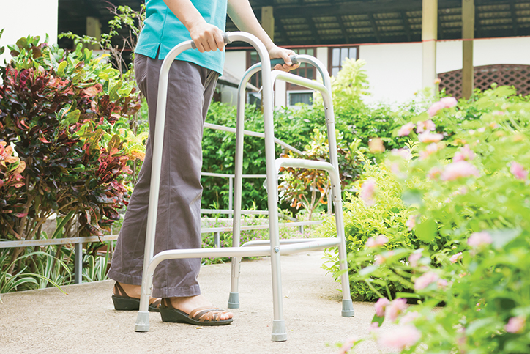
Medical Technology in the Home Setting (24 of 28)
Ambulatory assist devices (cont’d)
Walkers
Four legs
Require use of both upper extremities
© nongningstudio/Shutterstock
Notes:
Lecture Outline
f. Walkers are generally devices that have four legs and require the use of both upper extremities for balance and stability.
g. These devices come in many different designs, such as:
i. Four straight legs
ii. Two legs and two wheels
iii. All wheels
h. Some walkers can also serve a chair, and some have brakes.
i. These devices may be covered in part by the patient’s insurance.
2. Role of the community paramedic
a. One benefit of community paramedicine is the ability to see patients in their home environments and determine if they need assistance with their ADLs inside their homes.
b. The community paramedic should:
i. Document how the patient ambulates
ii. How well he or she is able to perform ADLs
c. Document the efficacy of the device the patient uses; evaluate from top to bottom, especially at the joints.
d. If questions arise about the specific device, obtain the user’s manual, look online for information, or discuss the problem with the medical director.

Slide 174
Medical Technology in the Home Setting (25 of 28)
Commode chairs
Portable toilet generally not attached to a running water supply
For patients who are either:
Confined to their bedroom
Have extreme difficulty ambulating from the bed to the bathroom
Notes:
Lecture Outline
M. Commode chairs
1. Overview
a. A commode chair is a portable toilet that generally is not attached to a running water supply.
b. These devices are intended for patients who are either confined to their bedrooms or have extreme difficulty ambulating from the bed to the bathroom.
c. Commonly found in hospital rooms with patients who have a fall risk, but they may also be found in the home
2. Role of the community paramedic
a. The community paramedic should evaluate:
i. The need for a commode chair
ii. The efficacy of an existing one
b. Evaluate whether someone is available to assist the patient with appropriate cleaning and maintenance of the device.
c. Check the device from top to bottom and at joints to confirm its stability
d. Make sure that all contents are disposed of properly in a toilet or appropriate septic system.
e. Follow local protocols.

Slide 175
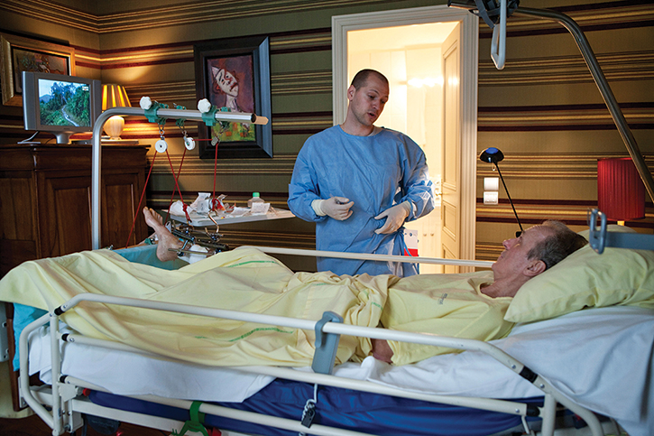
Medical Technology in the Home Setting (26 of 28)
In-home hospital beds
For patients who require specific positioning during sleep or chronically
© BSIP SA/Alamy.
Notes:
Lecture Outline
N. In-home hospital beds
1. Overview
a. An in-home hospital bed is prescribed to a patient who requires specific positioning during sleep or chronically.

Slide 176
Medical Technology in the Home Setting (27 of 28)
In-home hospital beds (cont’d)
Position requirement may be associated with a medical diseases such as:
COPD
CHF
Cardiac disease
Notes:
Lecture Outline
b. This position requirement, which must be documented, may be associated with a medical disease such as:
i. COPD
ii. CHF
iii. Cardiac disease
c. Document the severity or frequency of the symptoms.
d. If specific additions to the device are needed, such as rails, this issue must be documented by the physician as proof of need.
2. Role of the community paramedic
a. There are many types of in-home hospital beds available, but most follow the same general principles in terms of height, head/leg lift capabilities, and side rails.
b. Contact the medical director if a patient may benefit from one of these beds but does not currently have one.
c. If the patient already has an in-home hospital bed, discuss the requirements for the bed and the patient’s medical conditions during the enrollment visit.
d. Evaluate and document the type of device, and become familiar with its functionality.
e. Evaluate the patient’s understanding of how to use the bed.

Slide 177
Medical Technology in the Home Setting (28 of 28)
Patient transfer devices
Allow a health care provider to assist or fully support transfer of the patient from one location to another
Devices include:
Belts for lifting, slide boards, Hoyer lifts, draw sheets, air-assisted transfer mats
Notes:
Lecture Outline
O. Patient transfer devices
1. Overview
a. Patient transfer devices allow a health care provider to assist or fully support transfer of the patient from one location to another.
b. Devices in this category include:
i. Belts for lifting
ii. Slide boards for bed-to-bed transfers
iii. Hoyer lifts
iv. Draw sheets
v. Air-assisted transfer mats
c. All of these devices have very different techniques of operation and require education on the specific device.
d. During the patient needs assessment, the community paramedic should:
i. Locate such equipment
ii. Become familiar with the mechanics of the specific device
iii. Work with the provider to develop an educational piece for the patient
2. Role of the community paramedic
a. Each community paramedicine program will have different requirements for the community paramedic to follow when moving, lifting, or transferring patients.
b. Discuss these guidelines with the medical director.
c. As with all devices, ensure that they are clean, free of debris, and structurally sound.
d. When using a patient transfer device, maintain the appropriate posture during the actual transfer.
e. When working with the family, ensure that the transfer device is appropriate for the patient.
i. If the patient needs full assistance, make sure he or she does not only have a transfer belt.

