Slide 1
Chapter 21: Professionalism
Notes:
Identify the elements of professional deportment in lifeguarding.
Describe characteristics of a professional lifeguard uniform.
Explain the importance of understanding different cultures.
Discuss considerations a lifeguard should know prior to contact with the media.

Slide 2
Lifeguard Deportment
Deportment is another word for behavior or manners
Keep and even, calm temperament in dealing with others
Use courtesy and respect with all beach users
Positive public perception is critical to maintaining respect for lifeguards

Slide 3
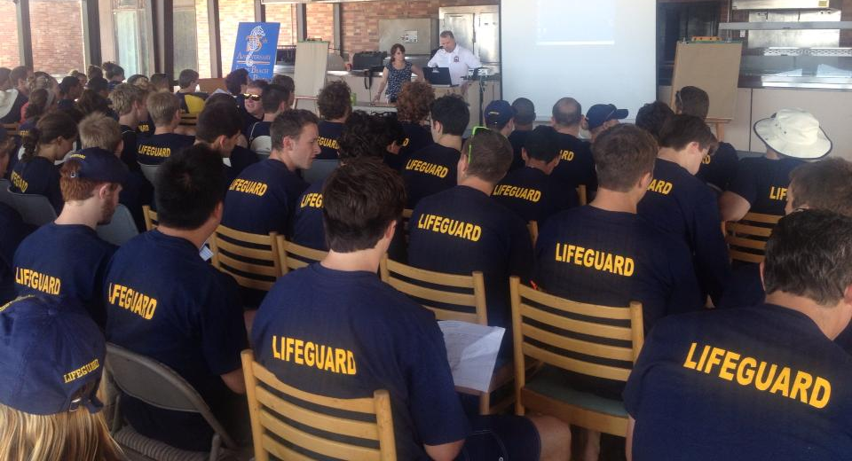
Professional Conduct

Slide 4
Maintain a professional appearance
Keep equipment clean and maintained
Face the water
Avoid grouping up
Use equipment for duties only
Address supervisors by title
Keep the personal out of the work place
Enforce rules consistently
Keep it “G” rated
Be respectful
Notes:
Maintain a professional appearance – alert and well-groomed
Avoid distractive items (personal items, pictures, etc.)
No games while on duty
Keep station and equipment neat and clean
Face the water to keep beach and water in full view
Avoid congregating
Don’t appear to leer
Use binoculars for lifesaving duties
Address supervisors by title
Keep disagreements private - don’t argue with other lifeguards
Don’t pose for unprofessional photographs
Enforce rules consistently
Keep language clean
Don’t disrespect other lifeguards
No hazing – hazing is unprofessional and unacceptable

Slide 5
Public Contact
Be courteous and polite
Keep electronic communications professional
Answer questions courteously
Be prepared with answers
Don’t flirt
Identify yourself

Slide 6
Uniforms
Typical uniforms
Effective uniforms
Wearing of uniforms off duty
Notes:
Uniforms
Establish a professional image
Establish authority - people react to individuals in uniforms during emergencies.
Typical Uniforms
Trunks for men
Tank suits for women
Consistent color
Allows the public and other responders to recognize the lifeguard immediately.
Effective Uniforms
Always must be neat and clean
Never faded
Wearing of Uniforms While Off Duty
Wearing of the uniform items off duty is unprofessional
Policies restricting the wearing of the uniform off duty exist because the image of the agency can be compromised.

Slide 7
Cultural Diversity
Tourism draws people of all ethnicities, cultures, and socioeconomic backgrounds
Display respect and evenhandedness
Treat all people with fairness and equality

Slide 8
Media Contacts
Usually handled by supervisors
Follow your agency’s media policy
If interviewed, remember you may be quoted verbatim; be clear and professional
State only the facts
Keep confidential information confidential

Slide 9
Notes:
Using the “Discussion Points” following the chapter summary, develop a 5 minute presentation for the media on professional lifeguarding, with an emphasis on professionalism

