Slide 1
Chapter 1: Lifesaving History
Notes:
After completing this lesson, the student will be able to:
1. Identify responsibilities of the first American lifesavers.
2. Explain how the United States Life-Saving Service was created.
3. List early examples of rescue apparatus.
4. Identify the United States Life-Saving Service procedures.
5. Identify the roots of modern lifeguarding.
6. Describe the development of lifesaving devices.
7. Describe the development of open water lifeguard standards.
8. Identify the emergence of modern lifeguarding.
9. Identify historical perspectives of the progression of modern lifeguarding.

Slide 2
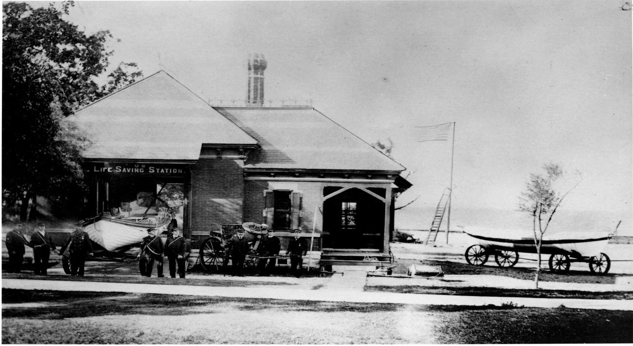
The First American Lifesavers

Slide 3
The first lifesavers
The hot season wasn’t so hot
Notes:
The first lifesavers rarely worked during the summer months.
Most of their work came during fall, winter and spring and using foot patrols mostly at night.

Slide 4
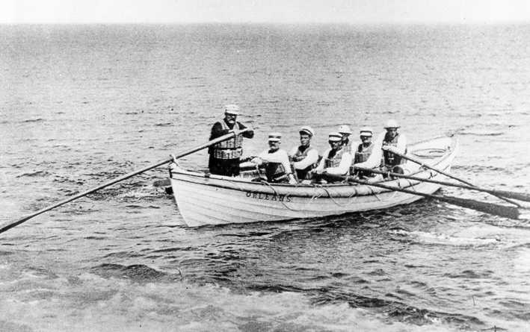
The Early Days

Slide 5
The 1700’s
Not many swimmers
Storms
Shipwrecks
Notes:
During the 1700’s much of the American coastline was totally uninhabited.
Recreational swimming was of little interest.
Yet loss of life due to drowning was a serious problem due to shipwrecks
Much of this was due to storms and lack of navigational aids common today
By mid-1800’s Cape Cod alone was having a shipwreck once every two to three weeks

Slide 6
The Massachusetts Humane Society
The Eastern Seaboard states
Notes:
The first United States organized (but volunteer) lifesaving efforts began with the founding of the Massachusetts Humane Society in 1786.
Additional volunteer efforts spread to other Eastern seaboard states, including the placement of lifesaving stations and equipment for local volunteers to use in rescue attempts.

Slide 7
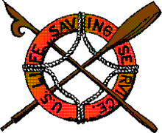
Creation of the US Life-Saving Service

Slide 8
The 1878 Congress
The Lifesaving Stations
The surfmen and the station keeper
The US Life Saving Service expands
Notes:
Started in 1878 with funding from Congress.
Crews were employed to staff each station.
The rescuers who worked these stations were known as surfmen.
The officer in charge was called a Station Keeper.
This system eventually grew to 189 lifesaving stations on the Atlantic, Pacific, and Great Lakes coasts.

Slide 9
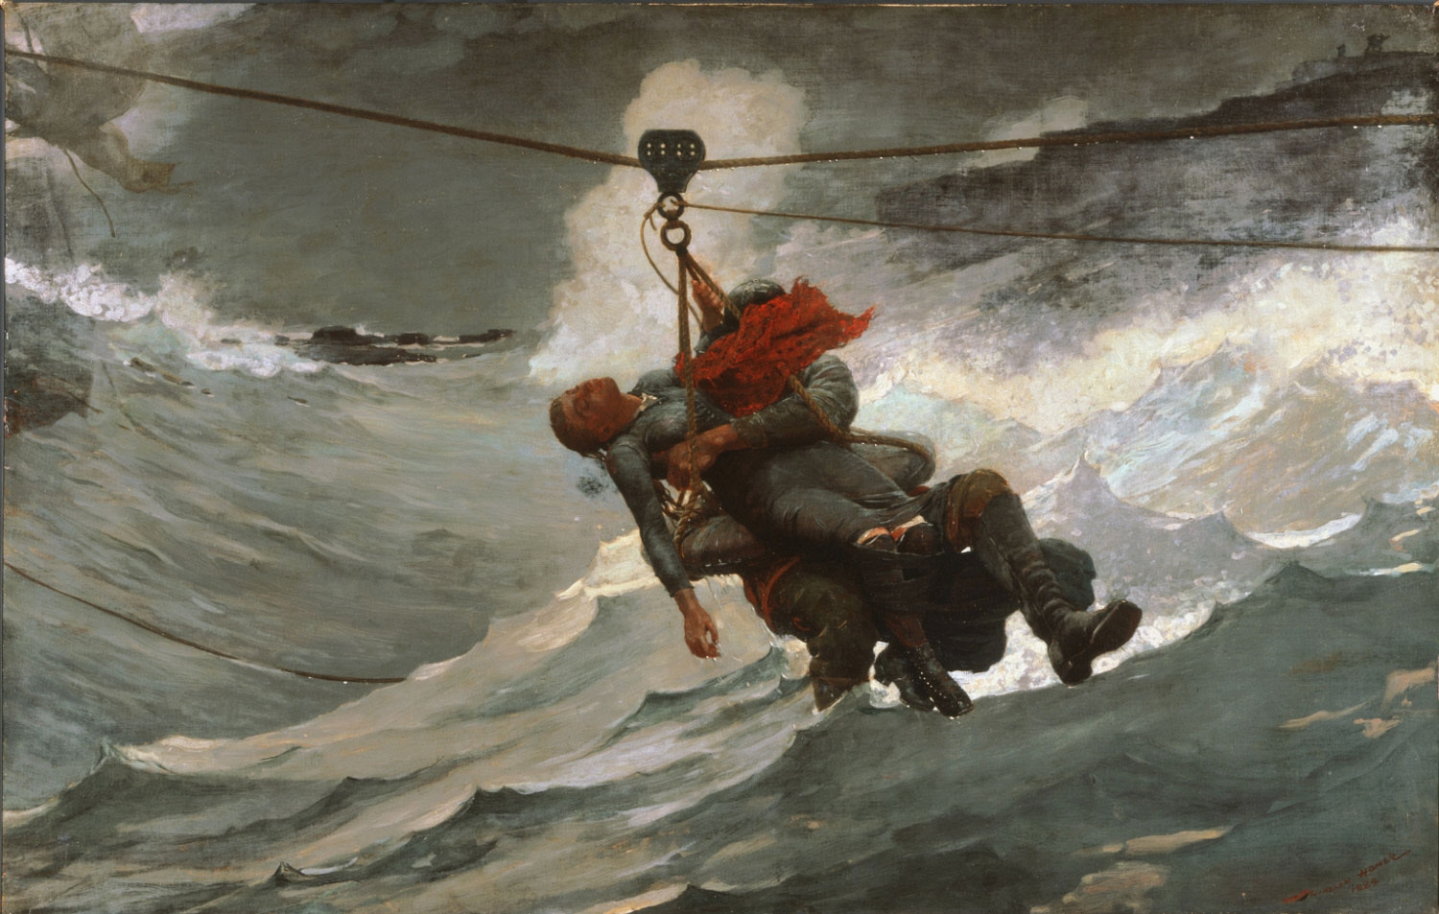
Early Lifesaving Apparatus

Slide 10
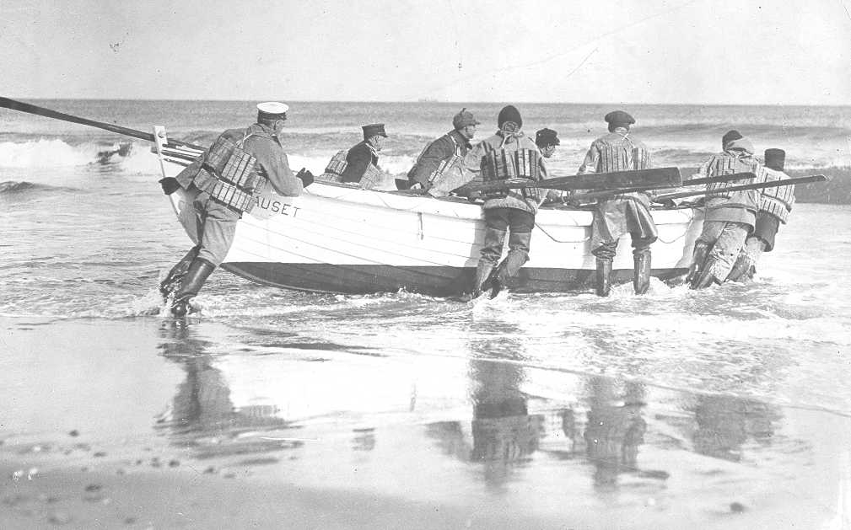
Lifeboats
Notes:
Lifeboats most commonly associated with early lifesavers were made of wood, weighed 700 to 1,000 pounds and were 25 to 30 feet long.
A crew of six surfmen generally rowed them, with the Station Keeper at the sweep oar

Slide 11
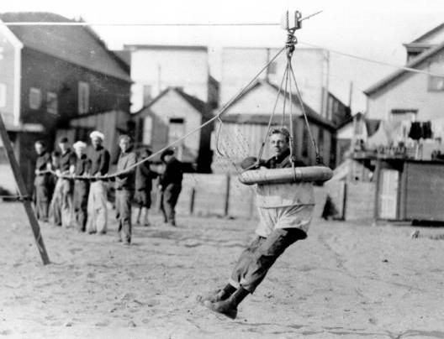
The Breeches Buoy
Notes:
When a surfboat was unavailable or could not be used due to ocean conditions, the Breeches Buoy was used. It was actually a large life ring, with canvas slung across the center and two holes for the legs of the victim. It was hung from a clothesline-like rigging strung between the distressed ship and the shore, with victims pulled ashore hanging in the breeches buoy.
A Lyle gun was used to shoot a metal projectile and a light line to the distressed vessel. That line was used by those aboard the ship to pull one end of the Breeches Buoy device to the ship. This gun was actually a small, 163-pound cannon.
These devices were transported down the beach via a cart.

Slide 12
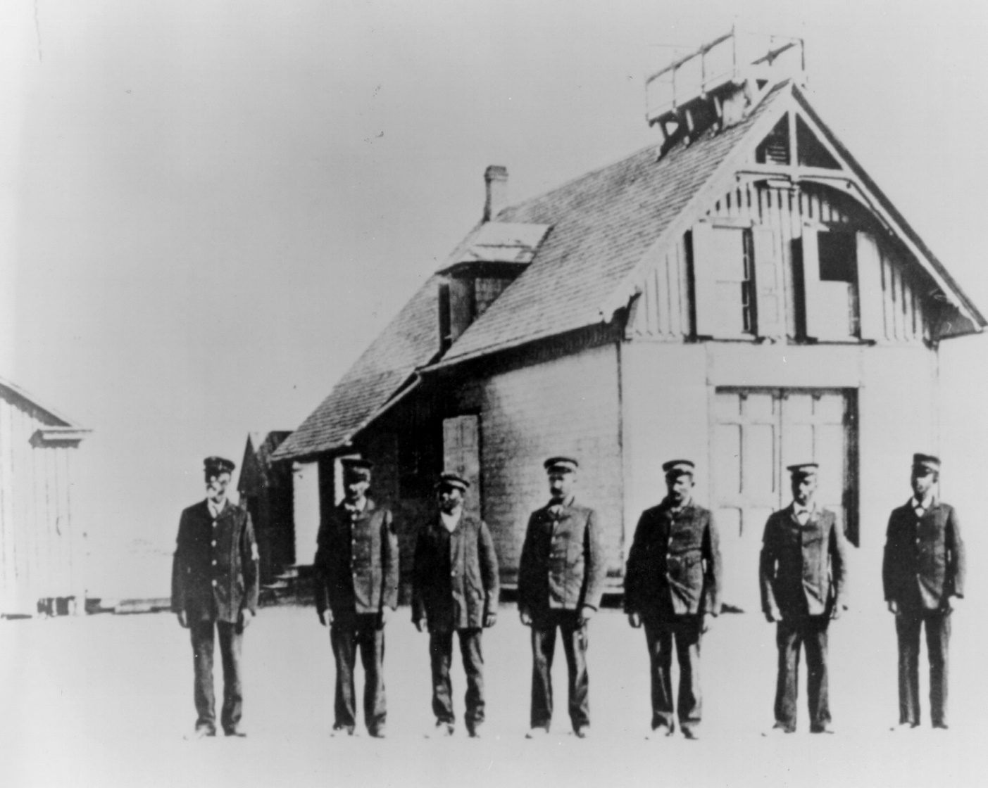
U.S. Lifesaving Service Procedures

Slide 13
Vigilance through
  Procedure
  Observation
  Protocol
Early preventative measures
Heroism
USLS Statistics
  28,121 vessels aided
  178,741 Saved
The birth of the USCG
Notes:
Lifesavers patrolled beaches on foot throughout the night.
They would walk to a halfway point to the next station, exchange a brass “check” with a lifesaver from the neighboring station, and return to wake up the next lifesaver whose turn it was to patrol.
For a ship sighted near shore, the lifesavers would burn a red coston signal as a warning to turn away.
Heroism of lifesavers became legendary.
The U.S. Lifesaving Service amassed an extraordinary record of 28,121 vessels aided and 178,741 people saved. In 1915, the Life-Saving Service merged with Revenue Cutter Service to form the United States Coast Guard.

Slide 14
The Roots of Modern Lifeguarding

Slide 15
Prosperity Leads to recreation
Resorts flourish
Drownings become part of the conversation
Notes:
During the 1880’s American prosperity resulted in increased leisure time. One result was increased interest in recreational swimming.
Entrepreneurs built seaside resorts, in part to capitalize on this interest.
News reports buzzed with reports of drownings, such as an 1865 incident in Atlantic City, in which 13 lives were lost.

Slide 16
The First
Lifeguards

Slide 17
Atlantic City
The YMCA and swimming
Commodore Longfellow and the ARC
Volunteer vs. pro
Notes:
Atlantic City was the first municipality to employ paid personnel called lifeguards to patrol beaches.
One approach to drowning prevention was to teach swimming. The YMCA of the USA provided pools and taught mass swimming lessons.
In 1914, Commodore Wilbert Longfellow formed the Life-Saving Service of the American Red Cross. This service consisted of a corps of volunteers recruited and trained to provide rescues at beaches not regularly patrolled by paid lifeguards.
Longfellow also began a program to “Waterproof America”.
Longfellow’s slogan was, “Everyone a swimmer, every swimmer a lifesaver”.
The YMCA and ARC were reluctant to become involved with professional lifeguarding. Instead, paid lifeguards were typically provided by resort owners and municipal governments.

Slide 18
The coasts lead the charge
Some guards seen as public safety personnel, some as recreation staff
Accident prevention and emergency medical care
National lifeguard association created
Notes:
Other efforts followed on the East Coast and the West Coast, often as a result of the needs created by beach resorts.
Some lifeguard services were governed by public safety organizations, such as police and fire departments. This provided lifeguards stature equivalent to that of other public safety providers.
In other cases lifeguard services found themselves governed under park and recreation organizations. This recreation perception persisted through the 1960’s until two events changed the course of professional lifeguarding.
These events included the creation of a national association of open water lifeguards, and the increased attention of Americans to accident prevention and treatment.
The profession of lifeguarding is relatively new to public safety when compared to police and fire professions.

Slide 19
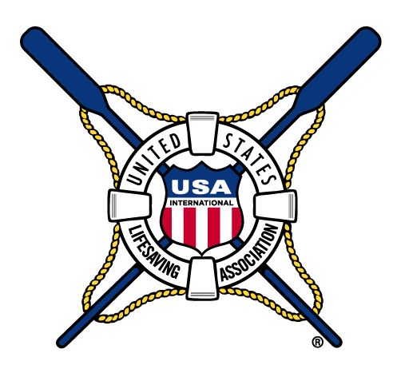
The Birth of the USLA

Slide 20
The History of the USLA
1956 - The Surf Life Saving Association of America
1964 - The National Surf Lifesaving Association
1979 – The United States Lifesaving Association
2016 The USLA Helps Establish Water Safety USA
Notes:
California lifeguards first organized the Surf Life Saving Association of America so that they could participate in an invitational lifesaving competition in Australia held in the same year of the 1956 Olympic Games there.
After this event, the organization grew to include lifeguards from multiple agencies in California and in 1965 the organization changed its name to the National Surf Lifesaving Association.
In 1979 the organization officially broadened its mandate to include lifeguards from both surf and Stillwater bodies of water. The name was changed to its current name of the United States Lifesaving Association (USLA).
The USLA goal has been to establish and maintain high standards of professional open water lifesaving and to educate the public in water safety and the role of lifeguards.
The USLA was one of the founding members of World Life Saving, which is now the International Life Saving Federation, in which USLA is the United States’ Full Member. The USLA was also a founding member, in 2016, of Water Safety USA.

Slide 21
Emergency Medical Aid Advances
The Highway Safety Act of 1966
Evaluation of emergency services training
USLA to set beach lifeguard standards
911
Lack of formal training
Notes:
The Highway Safety Act of 1966 helped establish and develop an Emergency Medical Service standard.
The nationwide 911 emergency call system is one of the outcomes of the Act.
This helped many communities evaluate training and service standards for emergency services including fire, police, and lifeguard services.
It became evident that some agencies worked with little or no formal training.
National standards for open water lifeguarding needed to be provided, and the USLA played a major role in developing them.

Slide 22
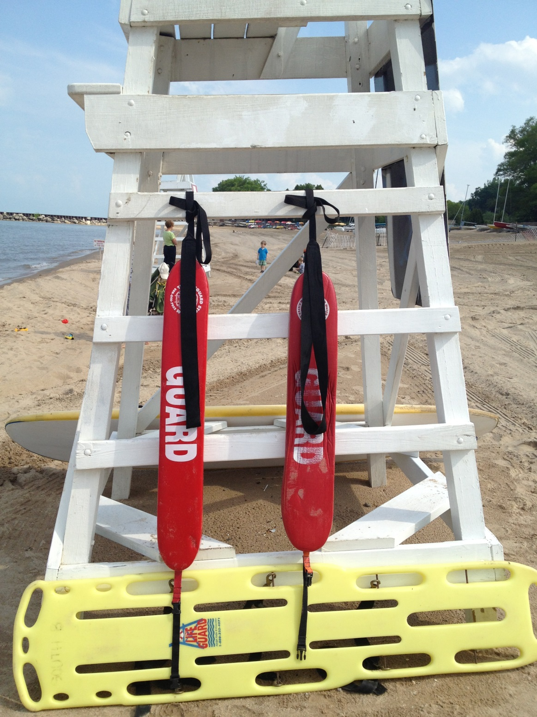
Lifesaving Devices

Slide 23
The Landline
Notes:
Line and reel (landline) allowed the rescuer to be attached by a line so that they could swim out, clutch the victim, and then be pulled back to shore.

Slide 24
Ring Buoy
Ring buoy with harness
Innovations were made after costly mistakes
Notes:
Atlantic City, NJ rescuers initially used a device that had a ring buoy attached by a line to a shoulder harness.
Some injuries and deaths to rescuers occurred in the US and in Australia. Eventually the device was mostly replaced by other methods.

Slide 25
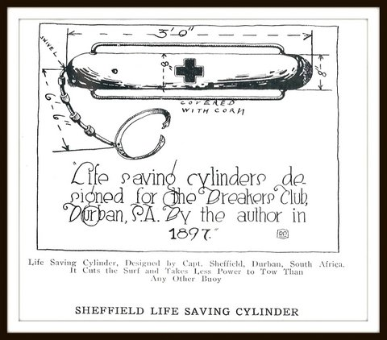
Rescue Buoy
The Sheffield Lifesaving Cylinder
Metal construction
The Burnside Buoy
Notes:
Captain Henry Sheffield developed the first rescue can made of sheet metal in 1897. It was pointed at both ends, with line supported by small cork floats and a belt to be attached to the lifesaver.
Rounding the ends and using copper, then aluminum, later modified this design.
It wasn’t until the mid-1960’s that Los Angeles County Lifeguard Lt. Bob Burnside developed the plastic rescue buoy widely used today. It became known as the Burnside buoy, but is now commonly known as the rescue buoy.

Slide 26
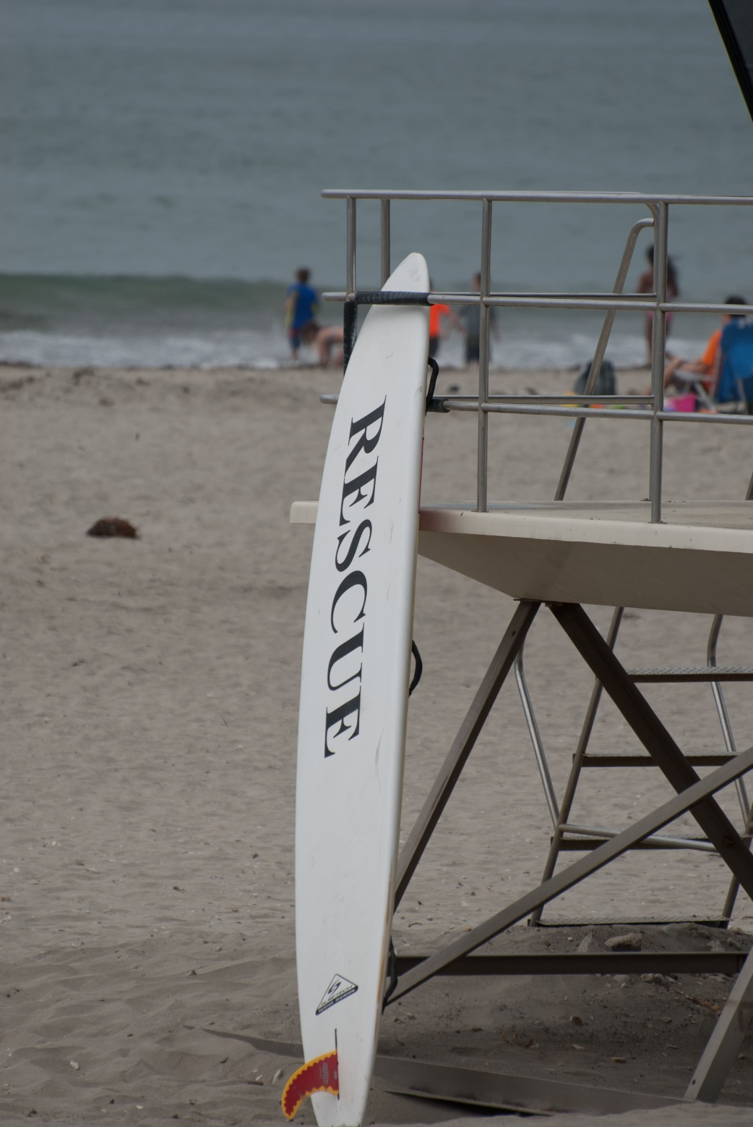
The Rescue Board
Notes:
The legendary Duke Kahanamoku introduced a redwood surfboard to Long Beach, California lifeguards, and they began using a modified (shorter) version as a rescue device.

Slide 27
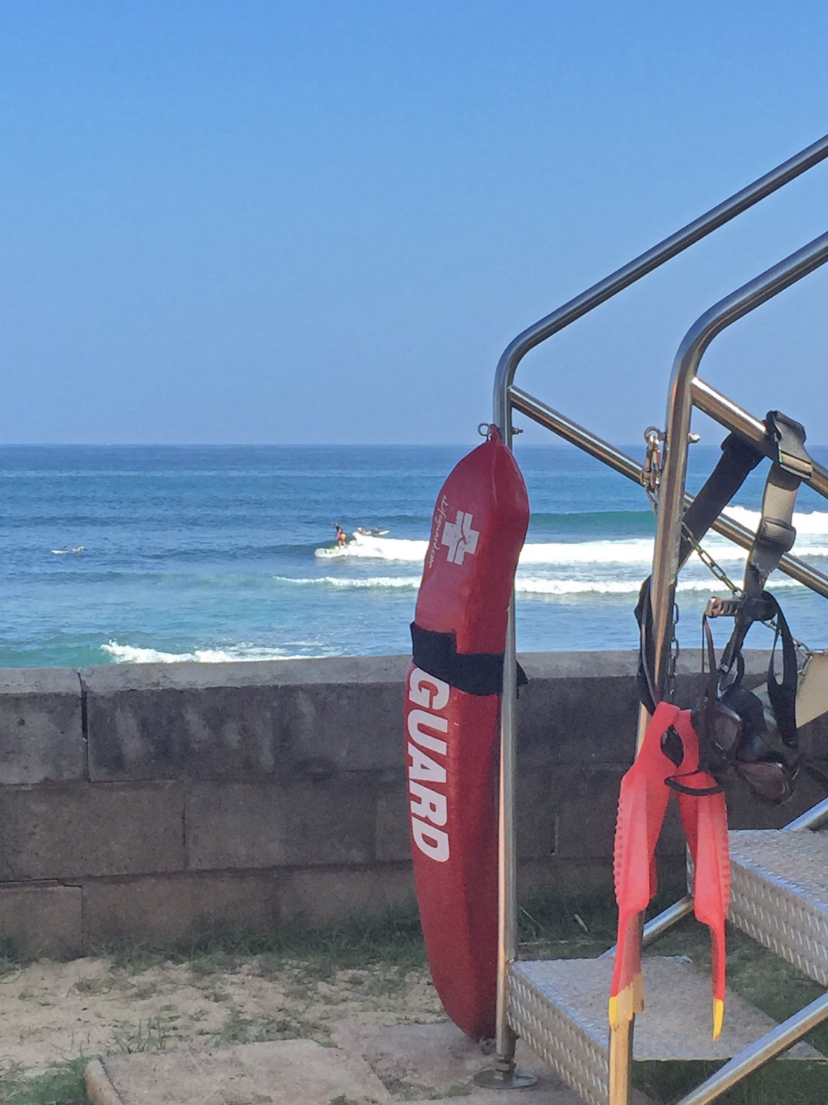
The Peterson Rescue Tube
  Inflatable
  Foam
Notes:
Santa Monica lifeguard Pete Peterson produced an inflatable rescue tube with a snap hook on one end, connected to a shoulder harness that could be wrapped around a victim for security in surf rescue.
It was later constructed of a flexible foam rubber.
It became known as the Peterson tube, but is now commonly known as the rescue tube.

Slide 28
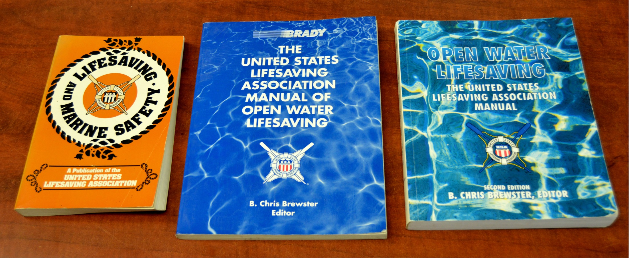
Developing National Open Water
Lifeguard Standards

Slide 29
The History of Lifeguarding Standards
1980 - Guidelines for Establishing Open-Water Recreational Beach Standards.
1981 - Lifesaving and Marine Safety
1993 - USLA created the Lifeguard Agency Certification Program
2016 – More Than 140 USLA Certified Lifeguard Agencies
Notes:
It became clear that the pool and open water environments are incomparable for the purpose of training or standards, but most national lifeguard standards primarily addressed pools.
As a result, open water lifeguards began to seek specialized standards for their unique environment.
In 1980, a conference held at University of Texas A & M brought together all of the major American organizations concerned with promoting public safety in and around the aquatic environment.
The result was a Sea Grant funded publication entitled, Guidelines for Establishing Open-Water Recreational Beach Standards.
The first USLA lifesaving text, “Lifesaving and Marine Safety”, was published in 1981.
Ten years later, the USLA formed the first national certification program for inland and surf lifeguard training programs.
Rather than certifying lifeguards and aquatic rescue response teams themselves, the USLA created the Lifeguard Agency Certification Program in 1993 to certify the training programs of agencies that meet USLA standards.
There are now over 140 USLA certified lifeguard agencies.

Slide 30
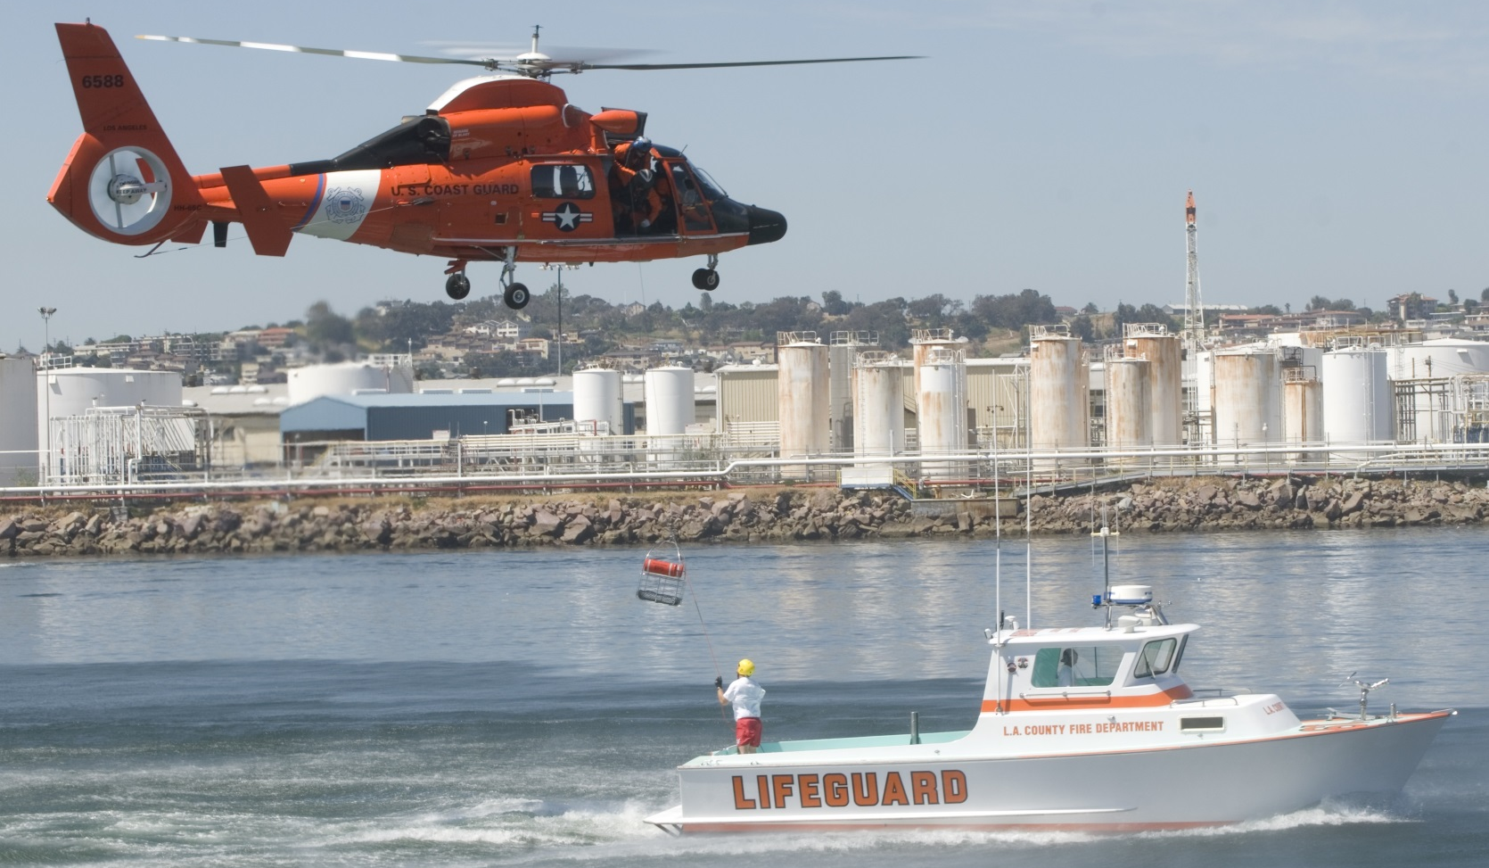
Modern Lifeguarding

Slide 31
Lifeguarding is unique
Year-round vs. seasonal
Differing responsibilities
Advancements in equipment
Advancements in medical training
Notes:
The profession of lifeguarding will always be unique among emergency services due to its highly seasonal nature.
While California, Florida, and Hawaii operate year-round on with many of their lifeguards employed career basis, lifeguards in most other states work seasonally.
Some lifeguard agencies are armed police officers, while others perform marine firefighting, cliff rescues, medical services, and scuba search and recovery.
Two lifeguard agencies (Los Angeles and San Diego) work 24-hour shifts.
Equipment continues to evolve with the use of inshore rescue boats (IRB), personal watercraft (PWC), and the larger hard-hull rescue boats.
There is also an increase in more advanced medical training, such as Emergency Medical Responder and EMT.

Slide 32
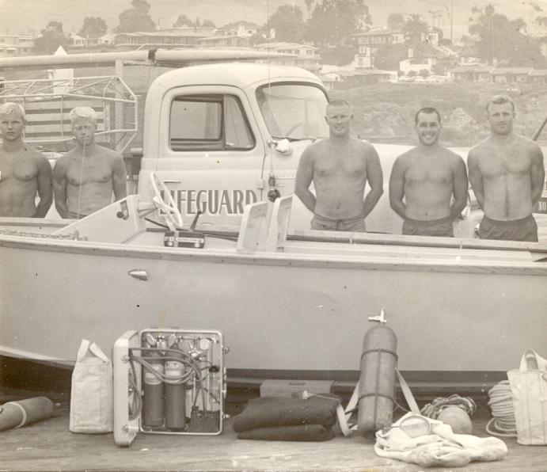
Historical Lessons

Slide 33
Not all agencies are the same
Traditions vs. standards
The public awareness of drowning and prevention differs
Notes:
Despite many advances, not all open water lifeguard agencies can boast of modern equipment and facilities.
Traditions were once the basis of local lifeguard standards, but have mostly been replaced with national standards that reflect “best practice.”
The importance of lifeguards in drowning prevention is sometimes recognized only after drowning deaths in the absence of lifeguards, though some communities still decline to provide lifeguard services.

Slide 34
Notes:
Using the “Discussion Points” at the end of Chapter One, divide the class into groups of three. Assign 3 or 4 questions to each group. Ask each group to answer their questions, then share their work with the rest of the group. Finally, link the discussion questions to the lesson objectives as a final check of participant understanding of the chapter.

